Slide 1
Provider Cerner Education Session #7
Eastern Maine Medical Center
Dr. Michael Ross

Slide 2
Overview:
Our final class!
Review areas where Survey reveals ongoing challenge and open session for questions
Results from Cerner Analytics
Sneak Peak of what is to come from Cerner in the future!

Slide 3
Survey results: Pre-Education, Dec 20, 2018 (Baseline)
 | Comfortable | Moderately Comfortable | Not Comfortable
PowerChart Structure:
I have organized my MPages and their components , and removed components I don’t use | 2 | 8 | 5
I know how to set up the contextual view (documentation on the right) | 5 | 6 | 4
I know how to change filters on the various M-page components | 2 | 3 | 11
I can accurately identify the banner bar, tool bars, table of contents (dark side), and MPage menu. | 7 | 7 | 1
I know the benefits of using the Workflow M-Page instead of going back/forth to the “Dark Side” | 2 | 9 | 4
I have configured my toolbars to meet my needs | 2 | 8 | 5
Note Creation:
I know the difference between the workflow M-page and a Note | 7 | 3 | 5
I am comfortable moving back and forth between the workflow M-page and the note without fear of losing work. | 2 | 4 | 9
I know how to use system auto-text for documenting (/) | 7 | 5 | 3
I have created personal auto-text (.) | 8 | 4 | 3
I have made a shortcut to pull nursing documentation into my note | 3 |  | 12
I have created auto-text that includes Smart Templates | 3 | 4 | 7
I know how to alter the title of a note | 5 | 3 | 6
 | Comfortable | Moderately Comfortable | Not Comfortable
Documentation Tools:
I know the difference between a diagnosis and a problem | 3 | 4 | 8
I know how to maintain a current problems list | 3 | 5 | 7
I know how to mark in error a problem on the patient’s problem list so it will no longer be part of their chart. |  | 4 | 11
I know how to free-text (Centricity-like) comments to the Family History, Social History, and Problems |  | 2 | 13
I have added items to the Family History Quick Selection section | 1 | 5 | 9
I know how to update the Social History through modify and add | 2 | 4 | 9
Message Center:
I have assigned proxies in my message center to my partners | 8 | 6 | 1
I have set up messaging favorites for pools and colleagues | 5 | 6 | 4
I know when and how to use between the visit encounters | 2 | 5 | 8
I have set up my between-the-visit encounter locations | 2 | 1 | 12
Ordering:
I have created favorites on my quick orders pages | 2 | 3 | 10
I know how to “borrow” someone else’s quick orders folder favorites so I can use them. |  |  | 15
I routinely use Quick Orders and make use of Order Sentences | 1 | 1 | 13
MModal:
I routine use MModal | 5 | 3 | 5
I have created commands to insert text | 1 | 3 | 8
I know how to use the next field button and command | 1 | 2 | 9
I know how to create auto-text that are MModal optimized | 1 | 1 | 10

Slide 4
Survey results: 6 Educational Sessions, March 27, 2019
 | Comfortable | Moderately Comfortable | Not Comfortable
PowerChart Structure:
I have organized my MPages and their components , and removed components I don’t use | 4 | 3
I know how to set up the contextual view (documentation on the right) | 7
I know how to change filters on the various M-page components | 4 | 1 | 2
I can accurately identify the banner bar, tool bars, table of contents (dark side), and MPage menu. | 5 | 2
I know the benefits of using the Workflow M-Page instead of going back/forth to the “Dark Side” | 4 | 3
I have configured my toolbars to meet my needs | 5 | 2
I know how to access the CCD | 4 | 2 | 1
Note Creation:
I know the difference between the workflow M-page and a Note | 6 | 1
I am comfortable moving back and forth between the workflow M-page and the note without fear of losing work. | 5 | 1 | 1
I know how to use system auto-text for documenting (/) | 6 | 1
I have created personal auto-text (.) | 5 | 1 | 1
I have made a shortcut to pull nursing documentation into my note | 2 |  | 5
I have created auto-text that includes Smart Templates | 3 | 2 | 2
I know how to alter the title of a note | 6 |  | 1
 | Comfortable | Moderately Comfortable | Not Comfortable
Documentation Tools:
I know the difference between a diagnosis and a problem | 5 | 1 | 1
I know how to maintain a current problems list | 4 | 3
I know how to mark in error a problem on the patient’s problem list so it will no longer be part of their chart. | 5 | 2
I know how to free-text (Centricity-like) comments to the Family History, Social History, and Problems | 3 | 1 | 3
I have added items to the Family History Quick Selection section | 3 |  | 4
I know how to update the Social History through modify and add | 3 | 1 | 3
Message Center:
I have assigned proxies in my message center to my partners | 6 | 1
I have set up messaging favorites for pools and colleagues | 4 | 2 | 1
I know when and how to use between the visit encounters | 3 | 2 | 1
I have set up my between-the-visit encounter locations | 3 | 2 | 2
I feel comfortable using the reply and delete buttons without fear of losing documentation | 6 |  | 1
I know the difference between co-signature and proposed orders | 4 | 2 | 1
I know how to use the trash and sent items to review old messages | 5 |  | 2
I know when to use the in-between encounter workflow | 4 | 2 | 2
I know how to use the message journal to track down a message | 1 | 3 | 3
I know how to send a reminder to my message center | 5 | 1 | 1
I know how to send a reminder to the patient’s chart (pop-up) | 4 | 2 | 1
I know the difference between messages and documents, and understand the lifespan of a message | 5 |  | 2
MModal:
I have created commands to insert text | 3 | 1 | 3
I know how to use the next field button and command | 3 | 1 | 3
I know how to create auto-text that are MModal optimized | 3 | 1 | 3
Ordering:
I have created favorites on my quick orders pages | 4 | 3
I know how to “borrow” someone else’s quick orders folder favorites so I can use them. | 4 | 1 | 2
I routinely use Quick Orders and make use of Order Sentences | 3 | 1 | 3
Rounding by Mmodal

Slide 5
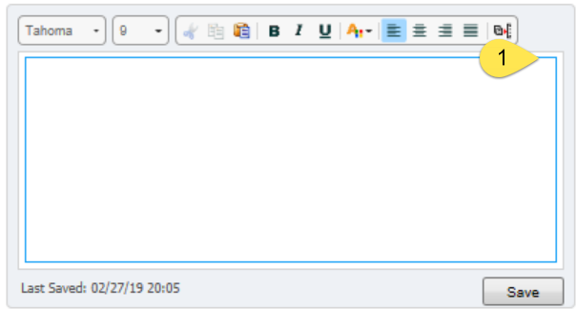
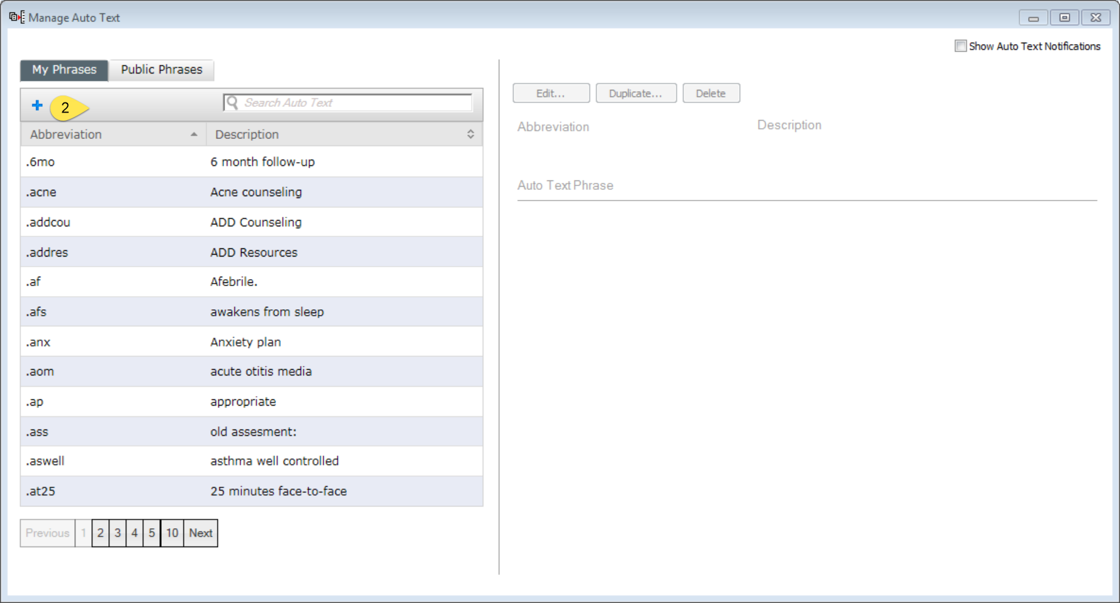
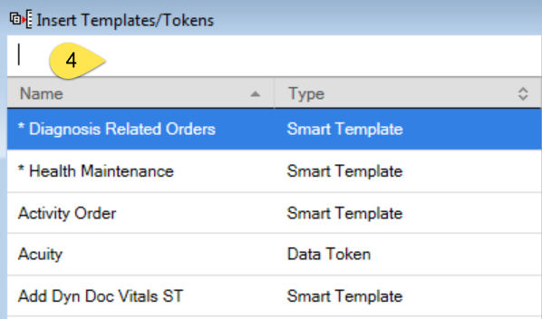
How to build smart-template-embedded Autotext:
hpi_intake

Slide 6
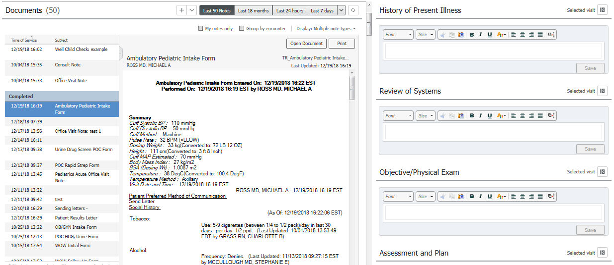
Connecting MA and Provider Documentation:
Pull the Nursing HPI into your note via the /hpi_intake autotext
Pull in the Nursing ROS into your note via the /ros_intake
Drag and Drop from the MA note in the chart into your note.
Let’s make this easier and build a shortcut, to streamline pulling in MA notes!

Slide 7
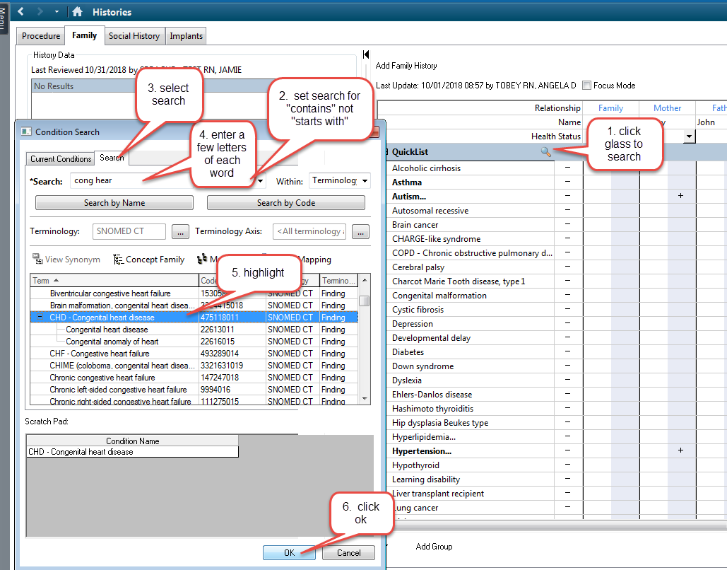
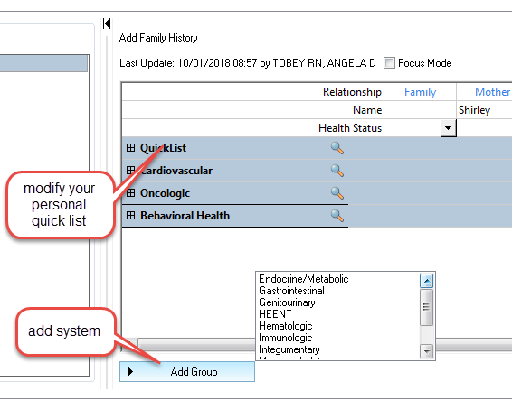
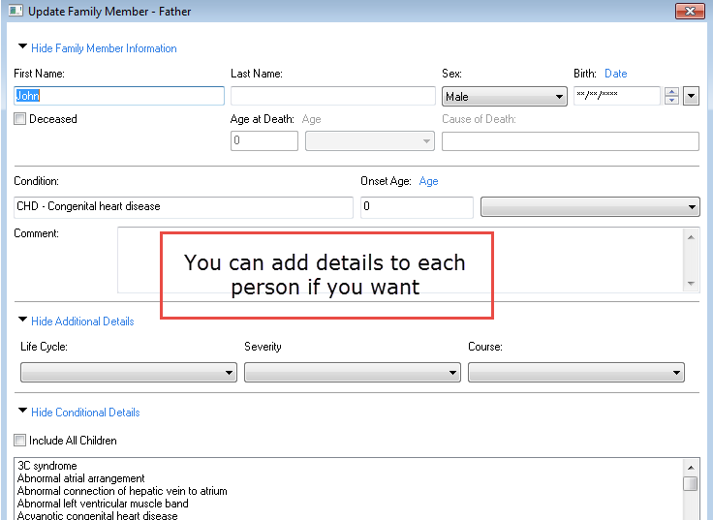
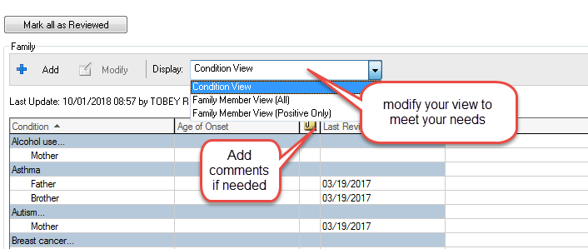
Family History
Select the system lists that make sense for you
Add to your quick list: Unique to you
Never select all negative, populates every field
Select system lists

Slide 8
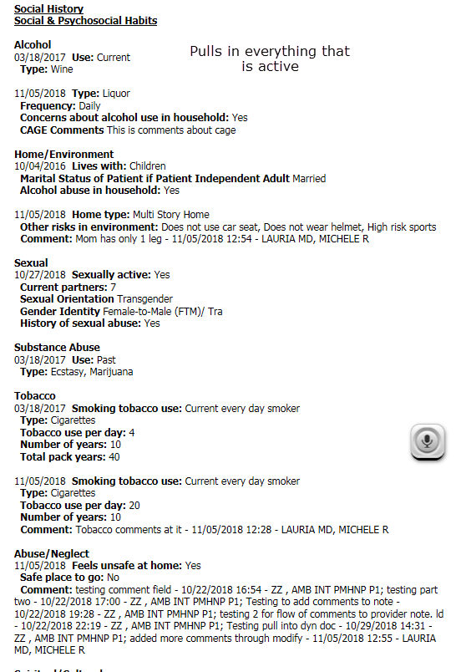
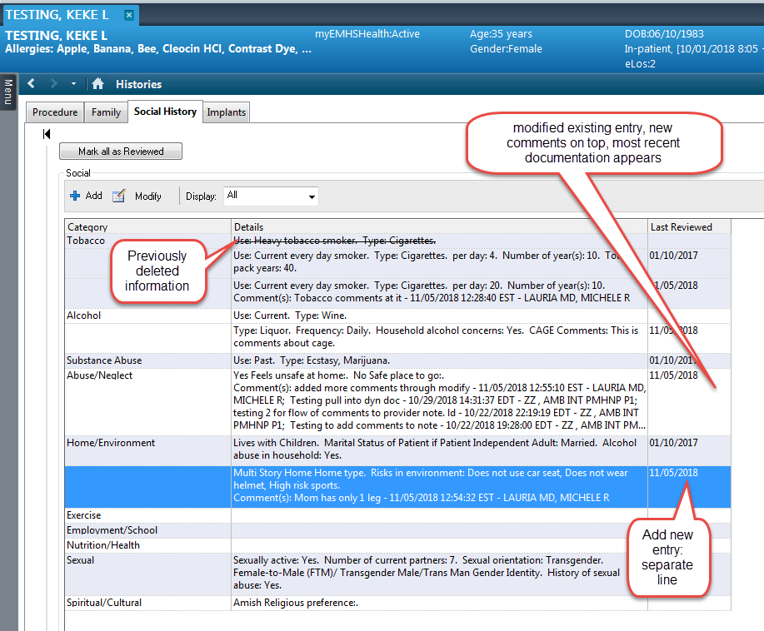
Social History
You can view current social history in the WF MPage: click a row to expand
To document click “Histories”
If social is open in the MPage, you land in social in the tool
Modify updates an existing entry
Add creates a new entry
You can choose to view “all” or “active” entries
Recommend:
“Mark as Reviewed“ if nothing is changed. Date on line updates
“Modify” to update small items
“Add” if major changes, legacy tool retired.

Slide 9
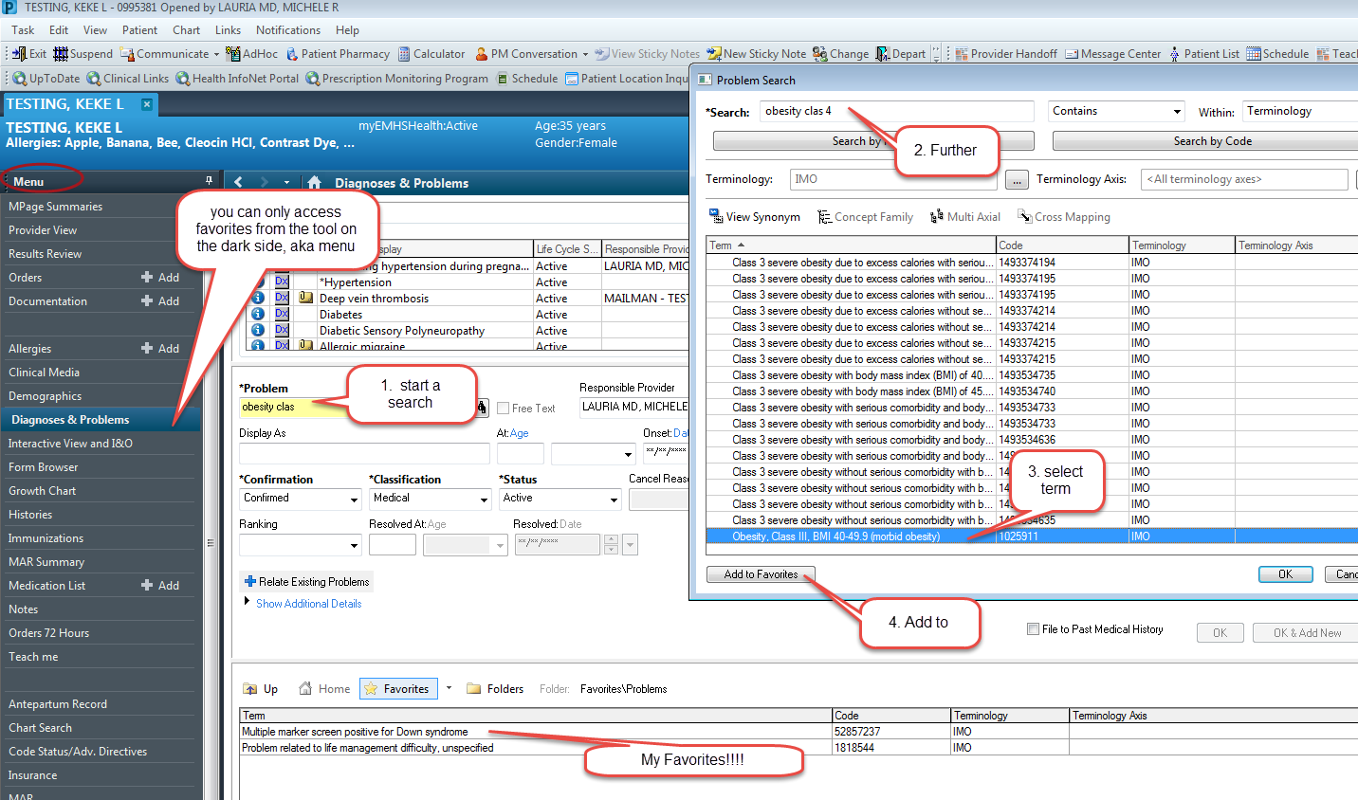
Problem List Favorites
Can’t be done in MPages
Useful for common items
Difficult to find items
Can add comments
Can change display names
My Favorites!!!!

Slide 10
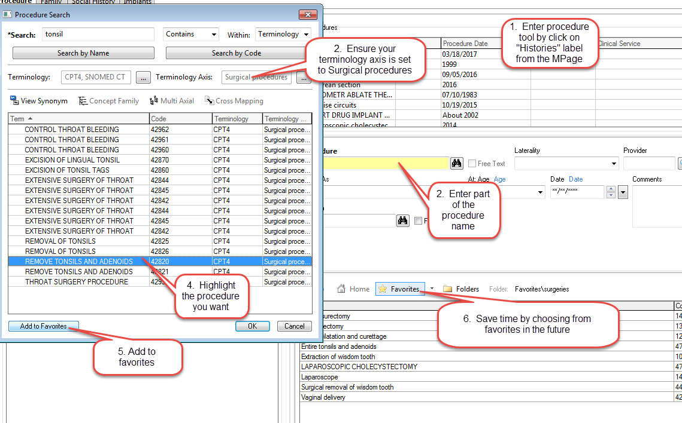
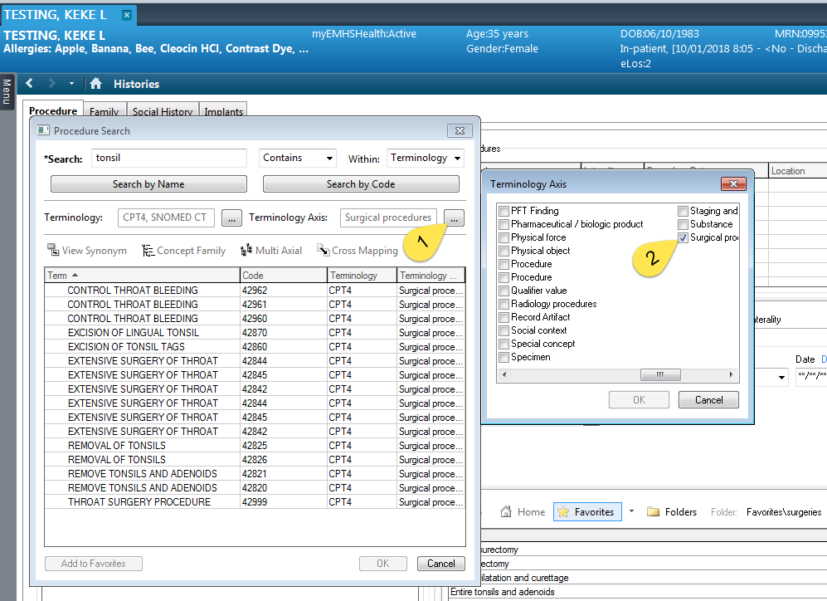
Procedure History
Set your terminology axis to Surgical Procedures
Save common procedures as a favorite
Default your display to show favorites by clicking the star then exit

Slide 11
Problem List
“This visit”: specific to an encounter, can be associated with orders
Displays in order selected
Can reorder with drop downs
“Chronic”: Diagnoses which cross encounters
Problems display alphabetically
Comments: if entered with “chronic “selected will cross encounters and displays in notes
Unchecking “this visit” and “chronic” removes items from the list
To restore, click historic at the bottom of the pane
You will see every problem & diagnosis with comments preserved

Slide 12
Messages: More complex than anticipated
Lifecycle of a Message
Created > Replied/Forwarded > Replied ( n times) > DELETED > turns into a Chart Document
All messages connected to a patient name are always saved to the chart as a chart document. Major difference between flags and messages.
Delete: Removes the message from your desktop. Mentally rename this button “remove” because that is more accurate about what it does. If you’re done with the message and don’t wish to add any more content to the message, you remove it by Deleting it.
Append: Anything you type into a message before hitting reply will be added to the message, and turn on the append button. Think of append as “sending to the chart”. Use Append if you want to time/date stamp when you reviewed an action, kind of how you would use .sign and send in Centricity.

Slide 13
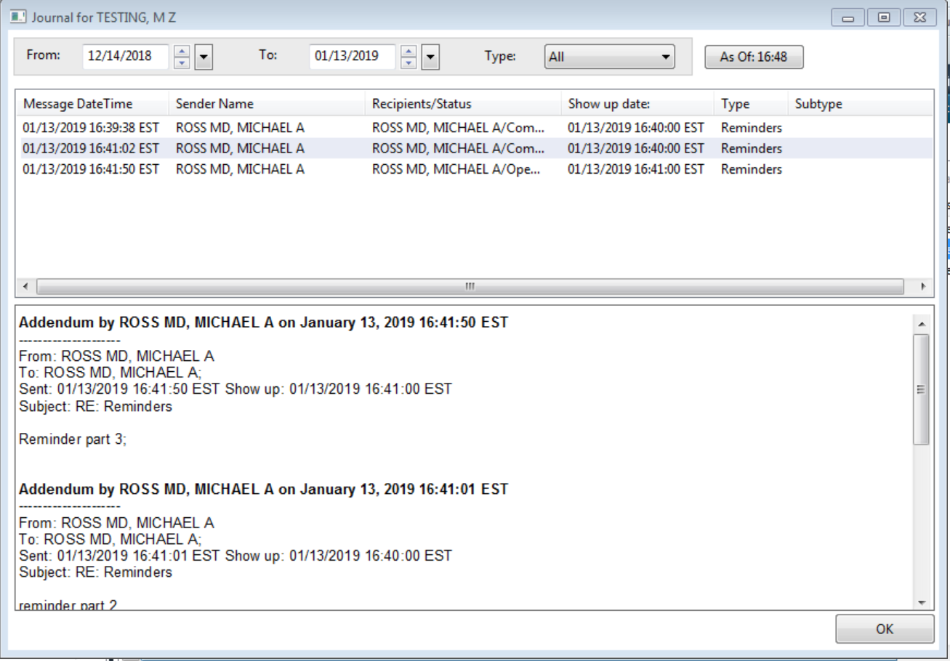
Message Journal
The message Journal can be used to determine if a message already exists in a patient’s chart, or can track responses on a message stream.

Slide 14
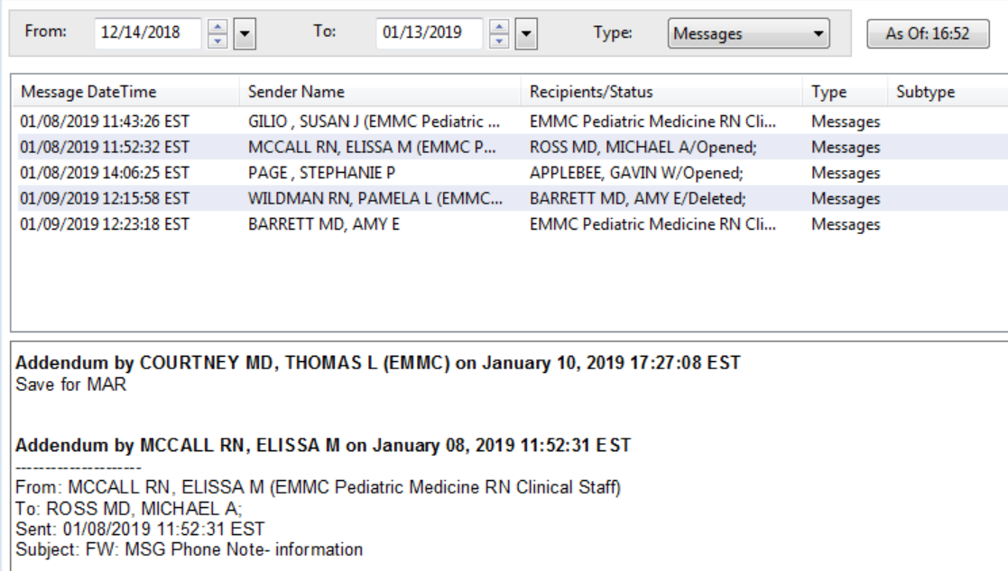
Message Journal
When in a message, the message journal shows existing message streams within the patient’s chart available for review:

Slide 15
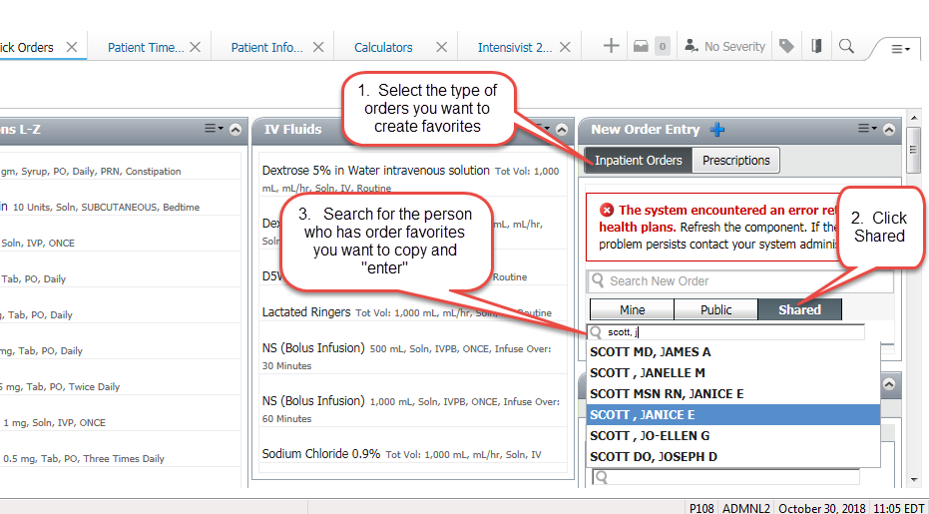
Sharing Quick Orders Favorites with Peers:
Go to Quick Orders Mpage
Under New Order Entry, click “Shared”
Search for the person’s name you want to borrow from
Select the folder you want to copy from
Place desired orders
Go into your cart and select /modify/add to favorites

Slide 16
Results of Adoption Education: Cerner Advance
03.28.2019

Slide 17
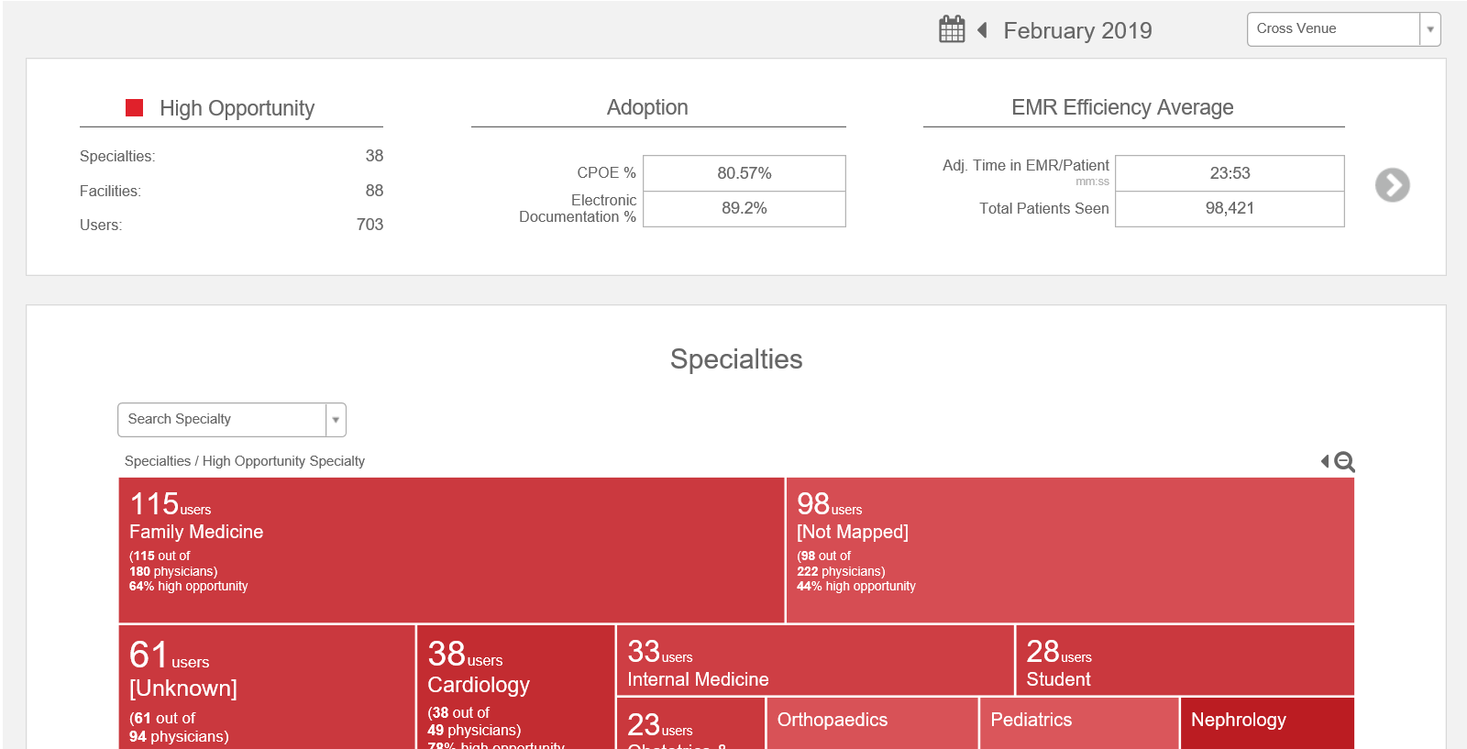

Slide 18
Control (No Training) N=18
Training cohort (N=18)

Slide 19
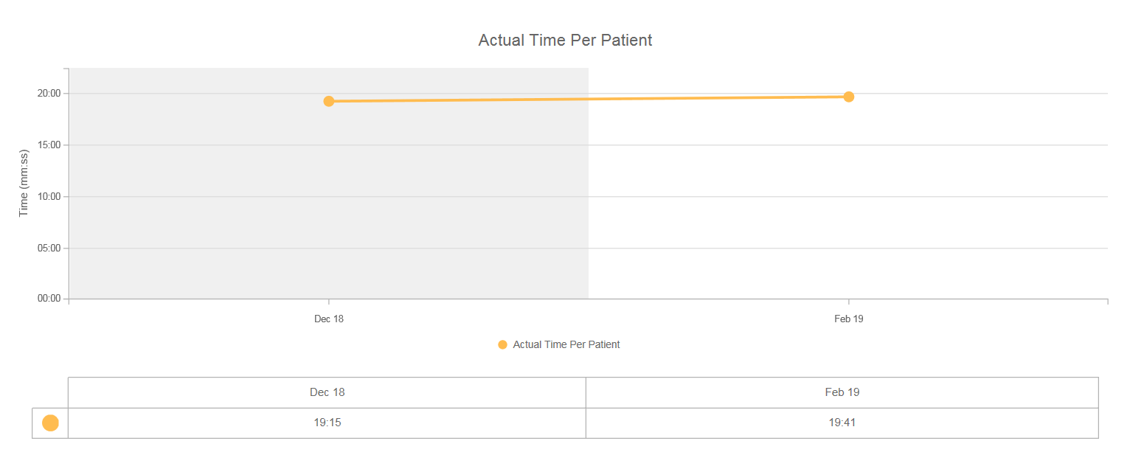
EMMC Control (No Adoption training) Group
Increase by 26 seconds/per patient

Slide 20
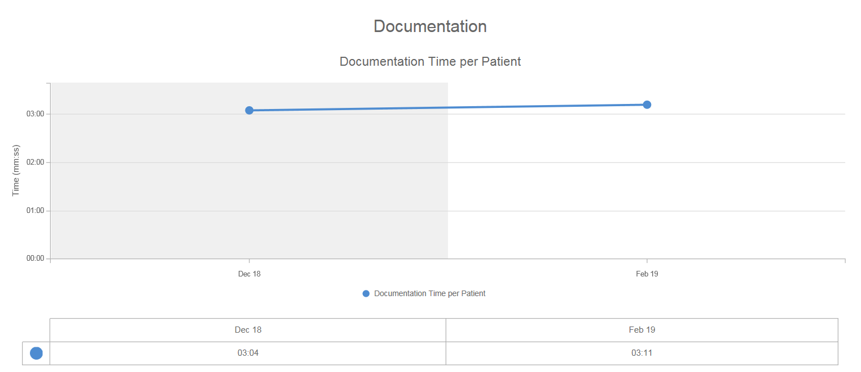
EMMC Control (No Adoption training) Group
Increase in documentation by 7 seconds/patient

Slide 21
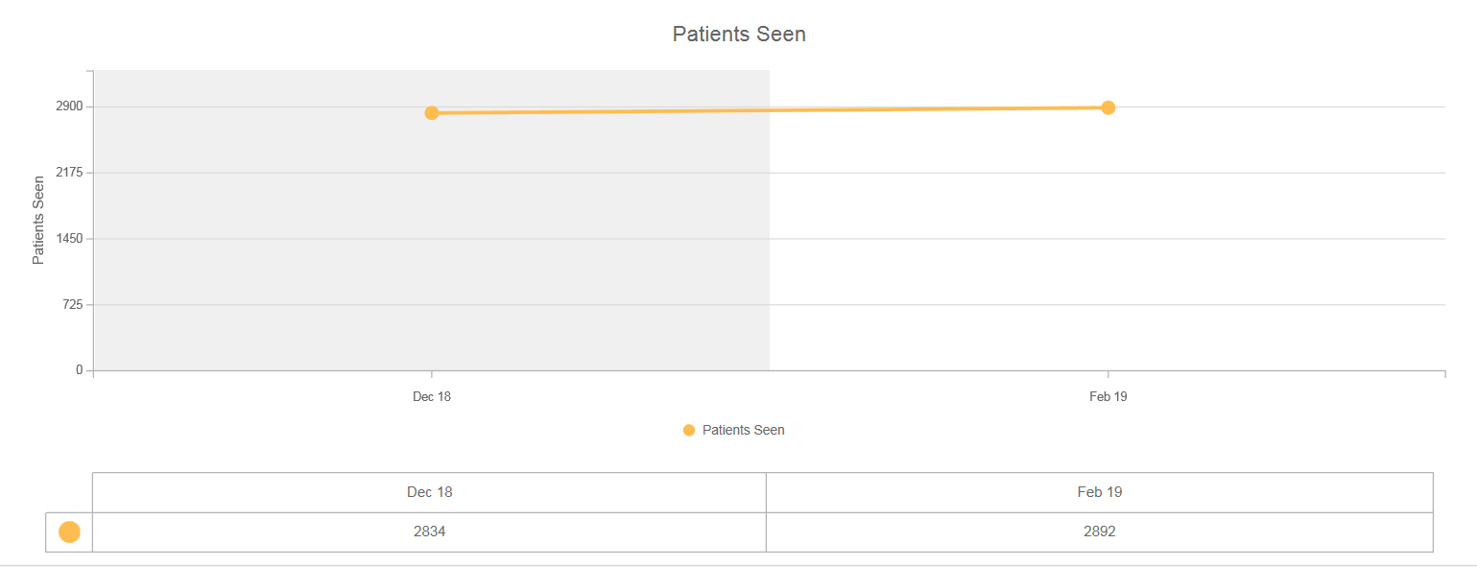
EMMC Control (No Adoption training) Group
Increase in 58 patients seen/month

Slide 22
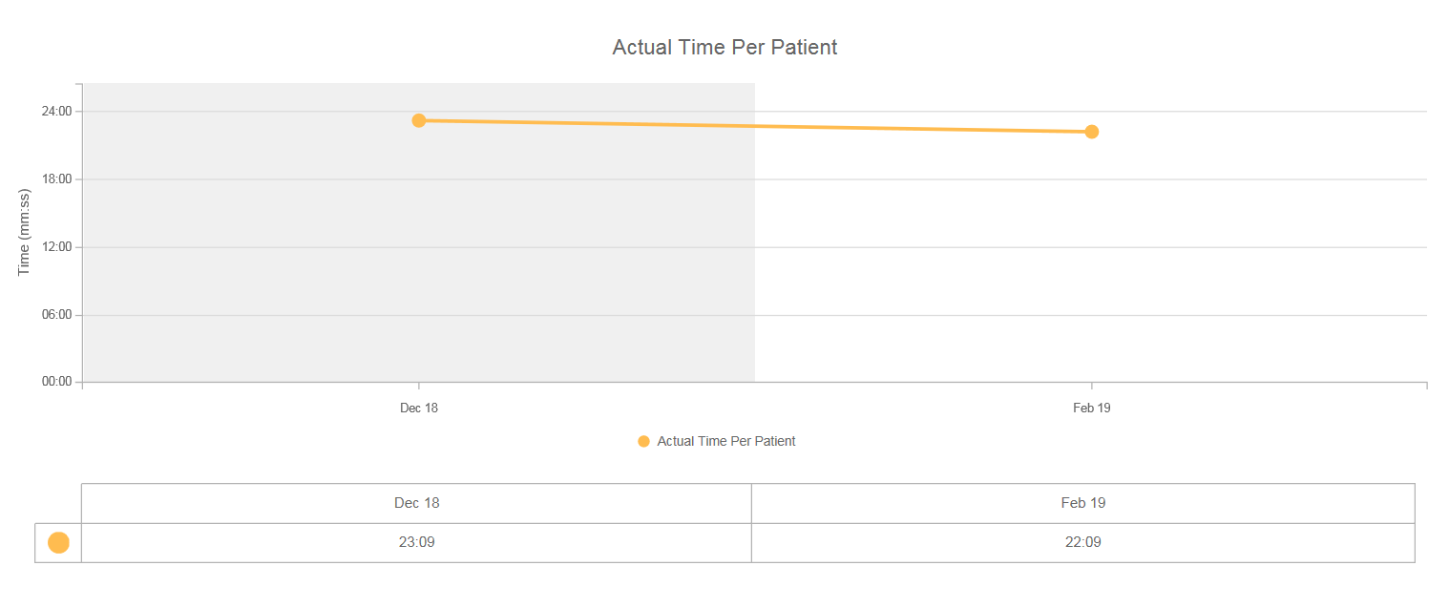
EMMC Adoption Training group
Time per patient Dropped by 1:00 Minute

Slide 23
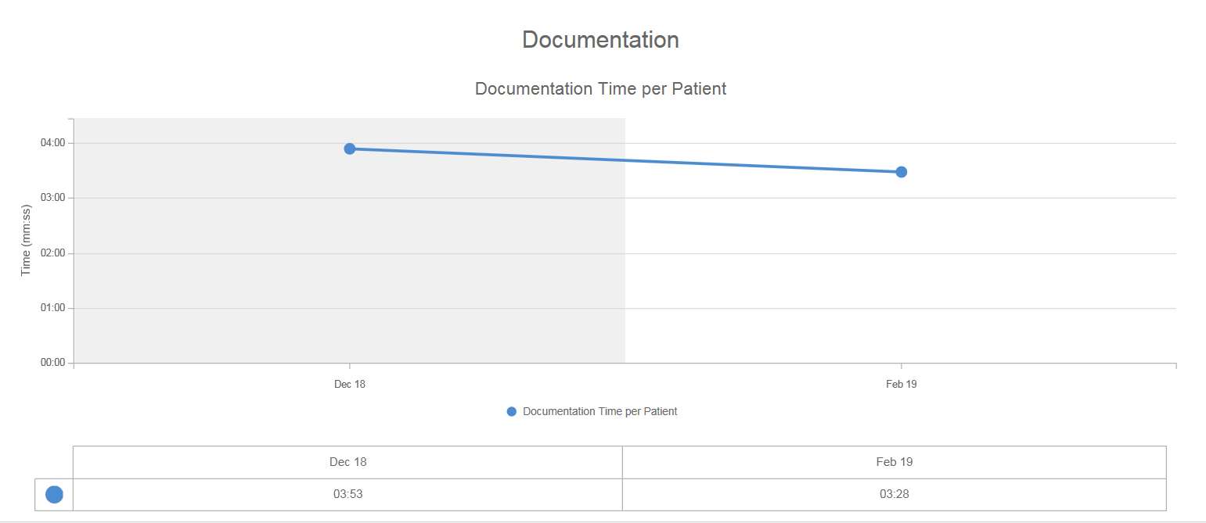
EMMC Adoption Training group
Documentation dropped by 30 seconds/patient

Slide 24
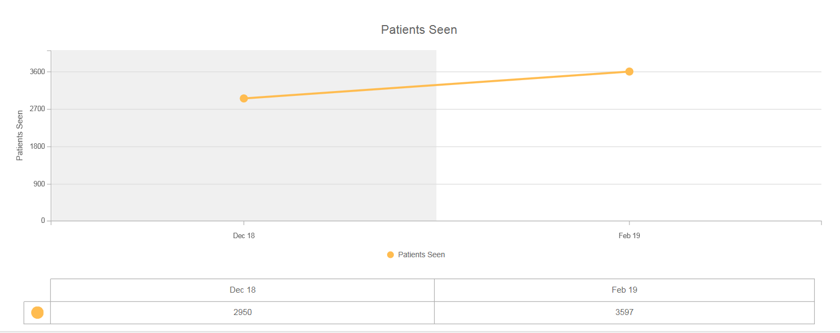
EMMC Adoption Training
Volume Increase of approximately 650 patients/month

Slide 25
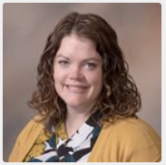
Provider Feedback
“As a physician in the Hampden practice, we had several years of experience with Cerner and I had become quite comfortable with it. I knew, however, that many of the things I did in my day to day work flow were clunky, likely as a result of work-arounds I had incorporated over the years. I was very interested to see what features Cerner had to make the work more efficient and I was pleased to find those solutions in the Cerner Education Sessions with Dr. Ross. I also felt that the time we
had allotted to us in October was not sufficient to learn the upgraded features in Cerner (which was, in many ways, quite a bit different from the version we were previously using). While at the time I felt this set us up for failure, I now feel that taking a few months to get familiar with the system followed by a “master class” actually was probably more effective to learn these efficiency tricks as learning all of this at the beginning would have likely been fairly overwhelming and difficult to retain. The sessions are not complete yet but I would say that my only real criticism is that the institution didn’t take advantage of the time we were out of the office to conduct similar training for our MAs who do a lot of our documentation and could really benefit from learning some of these short cuts. I’m very glad I went to these sessions and I think similar training with future EMR changes would be beneficial.” – Sarah Crane, DO

Slide 26
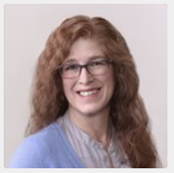
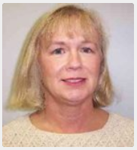
Provider Feedback
“I have had the great fortune to attend all of the additional provider specific CERNER training sessions offered by Dr. Ross and his team. These sessions have been invaluable and have served to increase my efficiency in documenting. While I still have a great deal to learn, the sessions have definitely helped. The added support is greatly appreciated.” – Dina Cole, FNP-BC
“I was struggling with Cerner, my skills limited to notes and orders. Through these classes, I am much better prepared to face the day ahead. Dr. Ross expertly guides the class through the work flow. And having Jenn and Dani on site for immediate assistance is extremely valuable. Thanks to all who made the classes be possible.” – Elizabeth Frederick, ANP

Slide 27
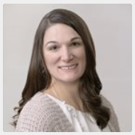
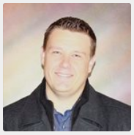
Provider Feedback
“I feel that I have gained a great amount of knowledge from each Cerner Training class. I am less overwhelmed with the documentation portion of my job, as I am able to move around Cerner with more ease. Thank you Dr Ross and team, for the great informational sessions!” – Stephanie Bosse, FNP
“I came, I saw, I conquered ‘Oh wait, how do I do that again’” – Marcus Christiansen, DO

Slide 28
A Taste of what is to come…..

Slide 29
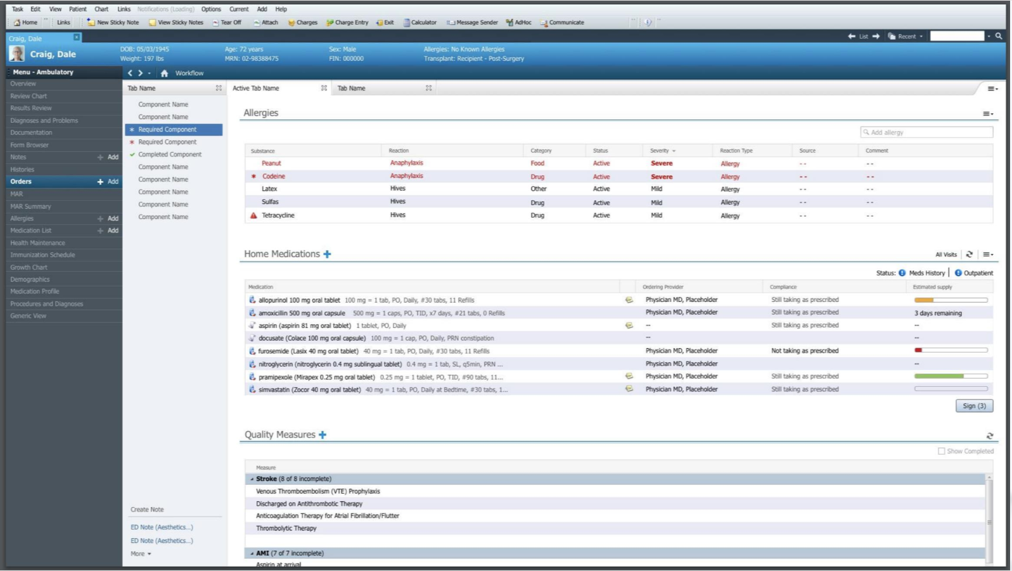
Current Day

Slide 30
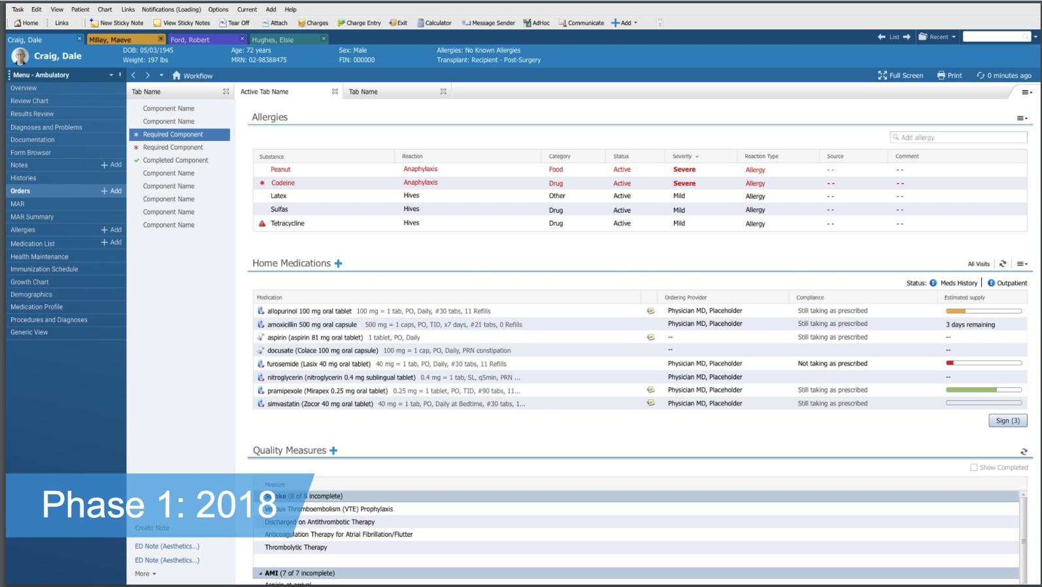

Slide 31
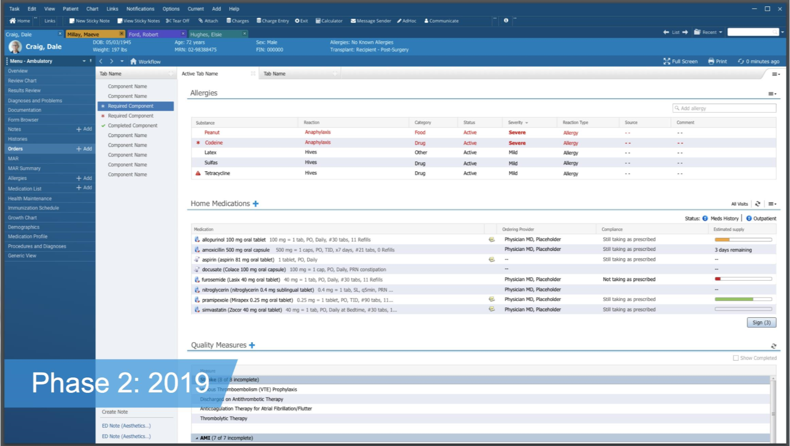

Slide 32
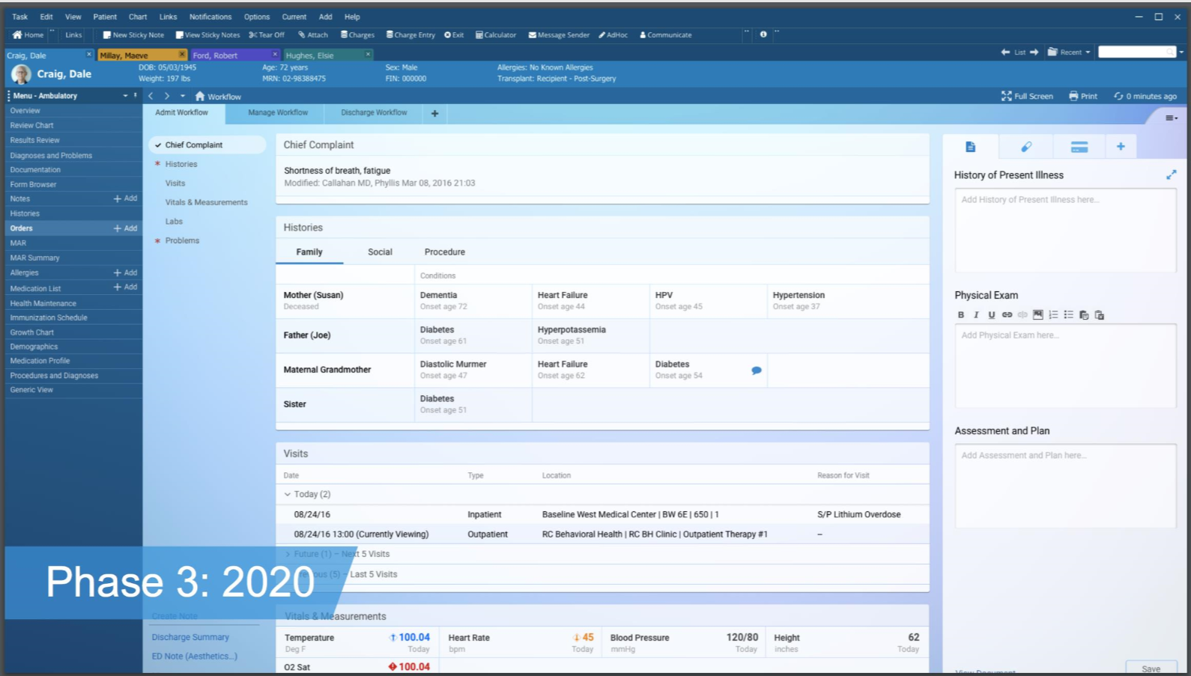

Slide 34
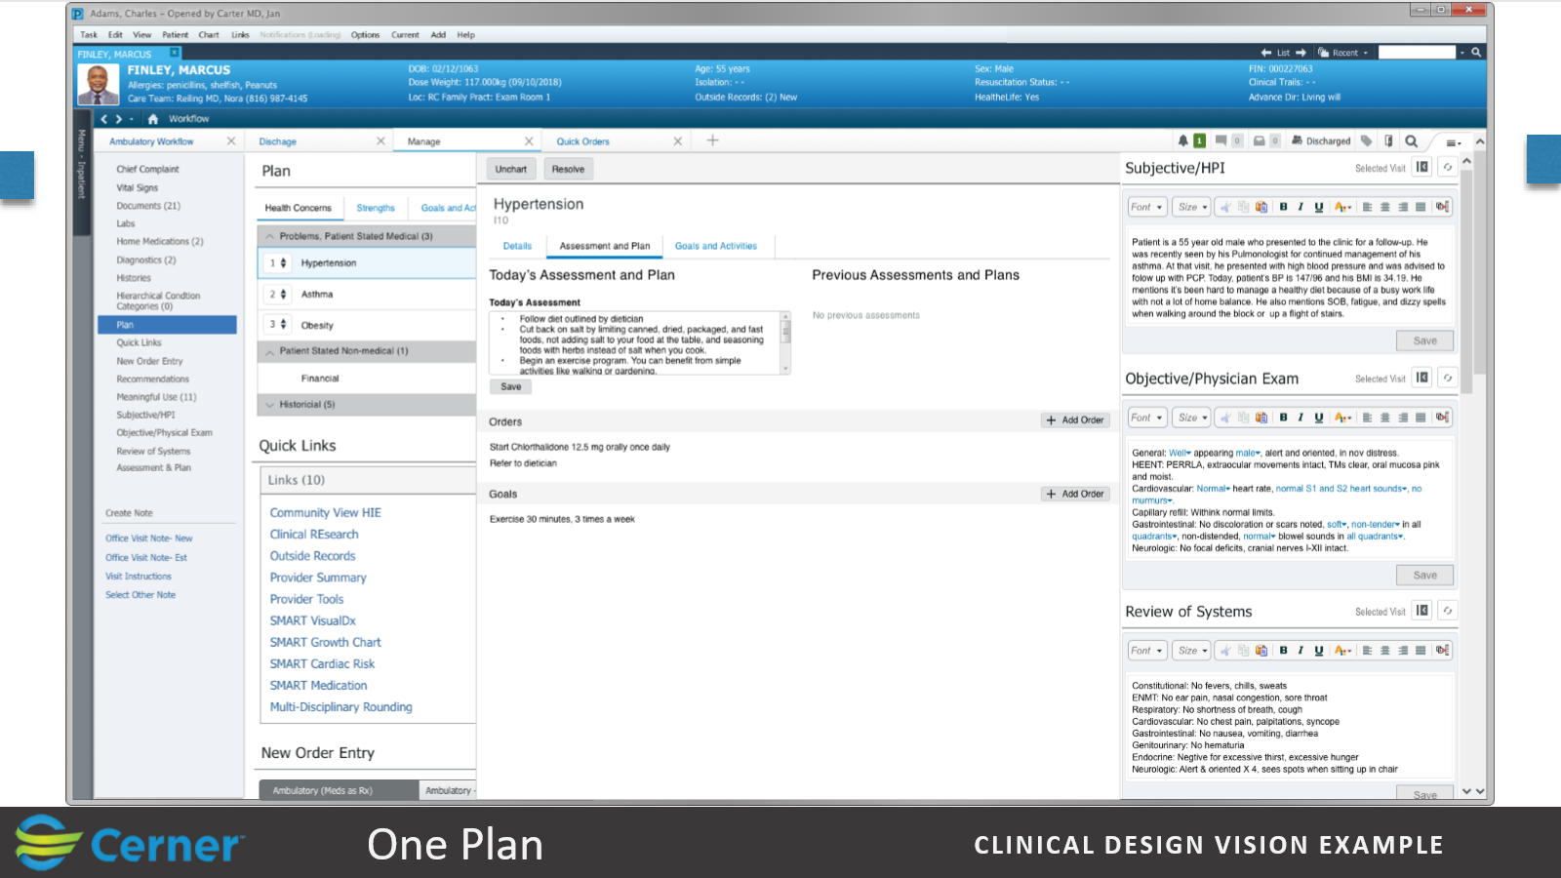
Prior assessments and plans reviewable:

Slide 36
PowerChart Touch

Slide 37
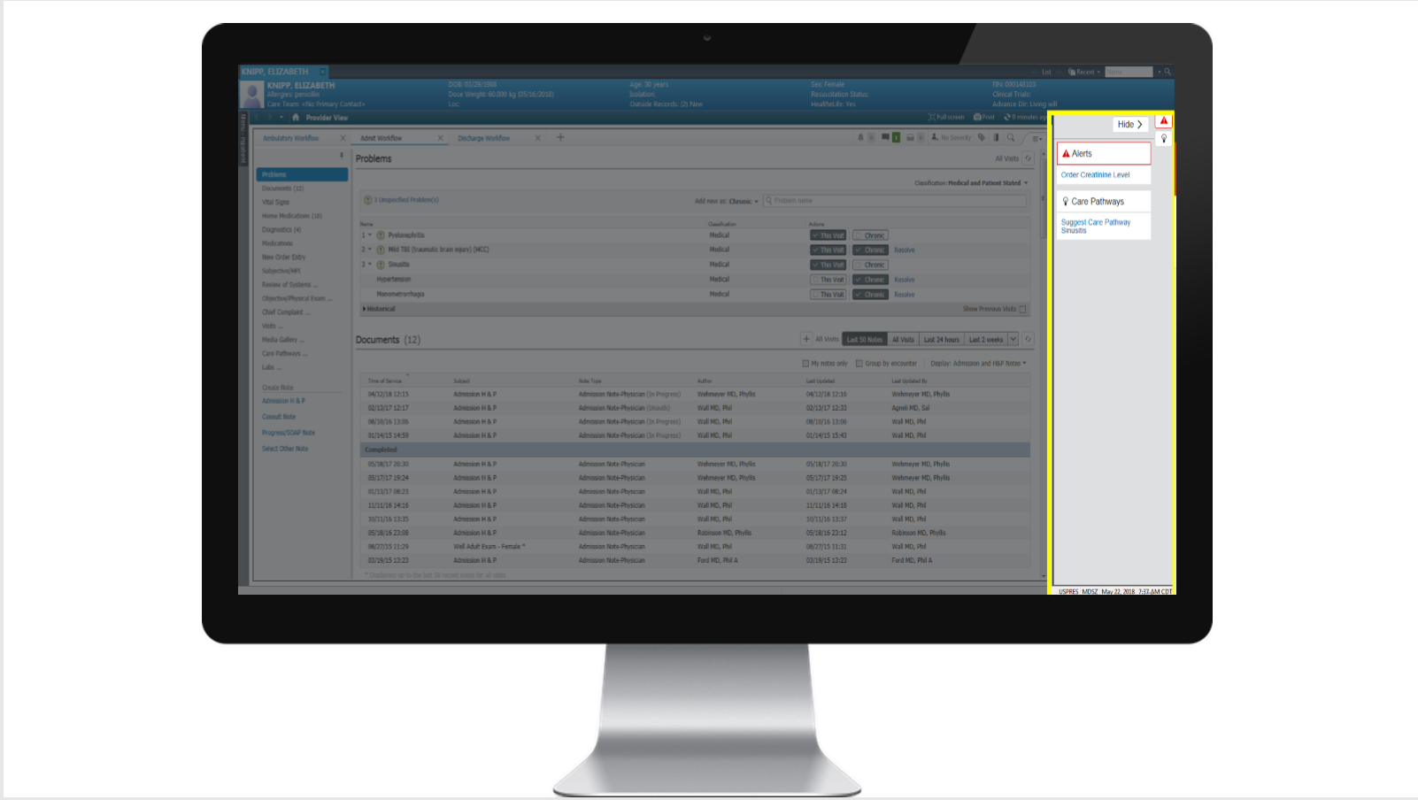

Slide 38
