Slide 1
Provider Cerner Education Session #6
Eastern Maine Medical Center
Dr. Michael Ross

Slide 2
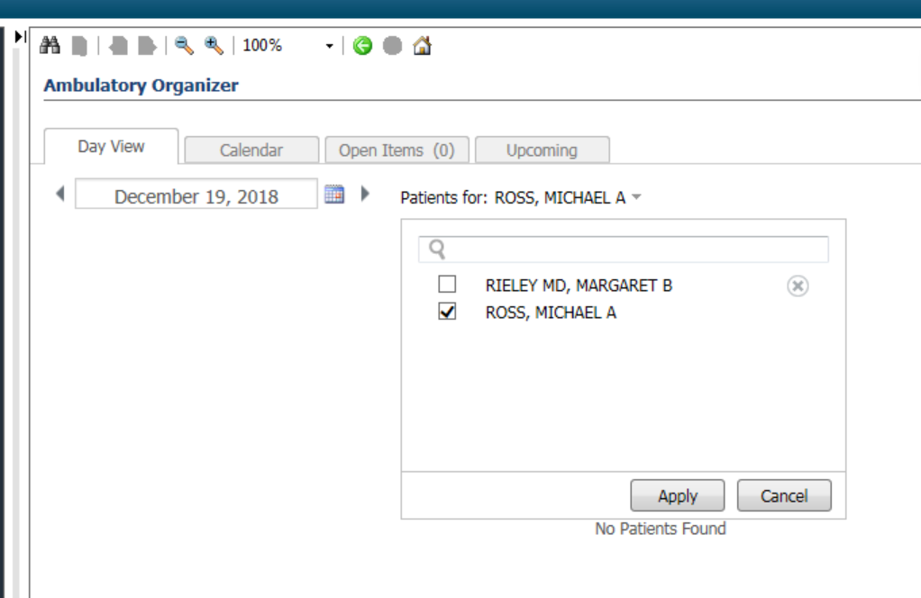
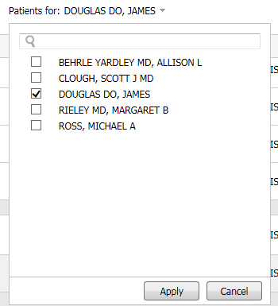
Test Patients for Use
Go to Ambulatory organizer/Home
Search for Douglas, James in the calendar; you will see his calendar filled with test patients.
Pick a test patient from the schedule for use today.
We will use this as a source of Test patient’s with Ambulatory encounters for future sessions as well.

Slide 3
Overview:
Todays class:
Recommendations M-page component
Patient Care Advisor
Dynamic Worklist
Next class (our final class!)
Review areas where Survey reveals ongoing challenge
Open session for questions
Sneak Peak of what is to come from Cerner in the future!

Slide 4
Recommendations and PCA:
Recommendations helps manage patient preventive and condition care. It allows for real-time notification of health screening, prevention, and management of diseases for patients based on various elements such as age, risk factors, gender, documented conditions, and documented procedures.
Preventive Care Advisor allows clinicians to see a Medicare patient's eligible Preventive Services according to CMS records. The view displays both eligible and future eligible Preventive Services. All services are checked again within Millennium to ensure no current orders or charges could affect eligibility.
Both of these Items work together within the Recommendations component to provide guidance on preventative care.
The Vision:

Slide 5
About Recommendations:
Preferred workflow for addressing patient care recommendations
Fully loaded visits
preventative services
Supporting highest level of quality care delivery
Localized and Owned by us (Northern Light Build)
Have specific actions that can/cannot be taken (and associated limitations)
Current build is an amalgamation of metrics from Centricity, Allscripts, Old Cerner newer Cerner build.
Continued cleanup by System recommendations workgroup; new metrics from the System Primary Care Improvement Group.

Slide 6
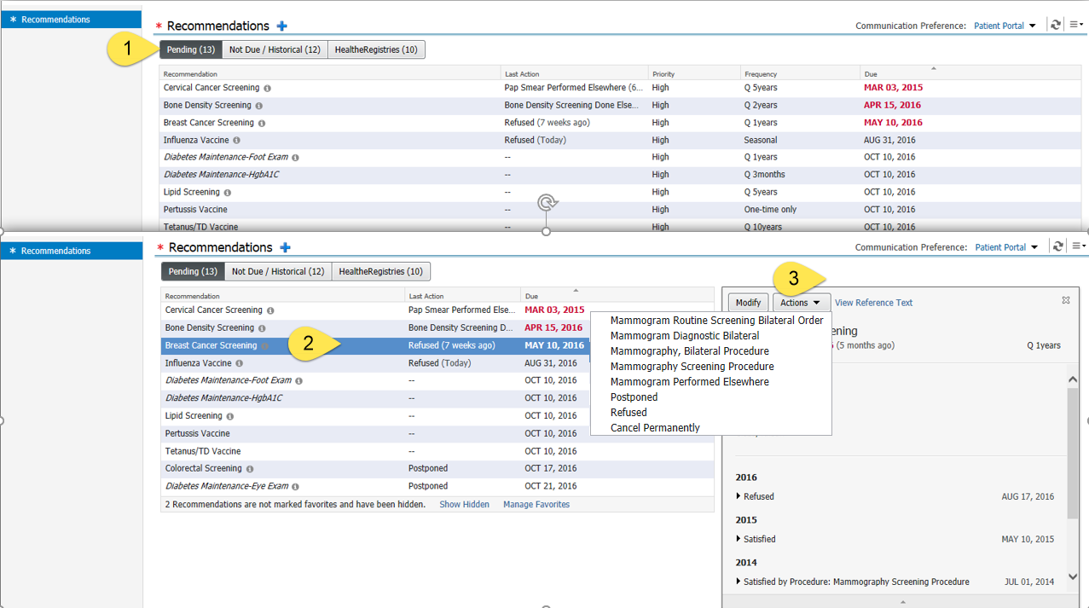
Workflow: Active Recommendations

Slide 7
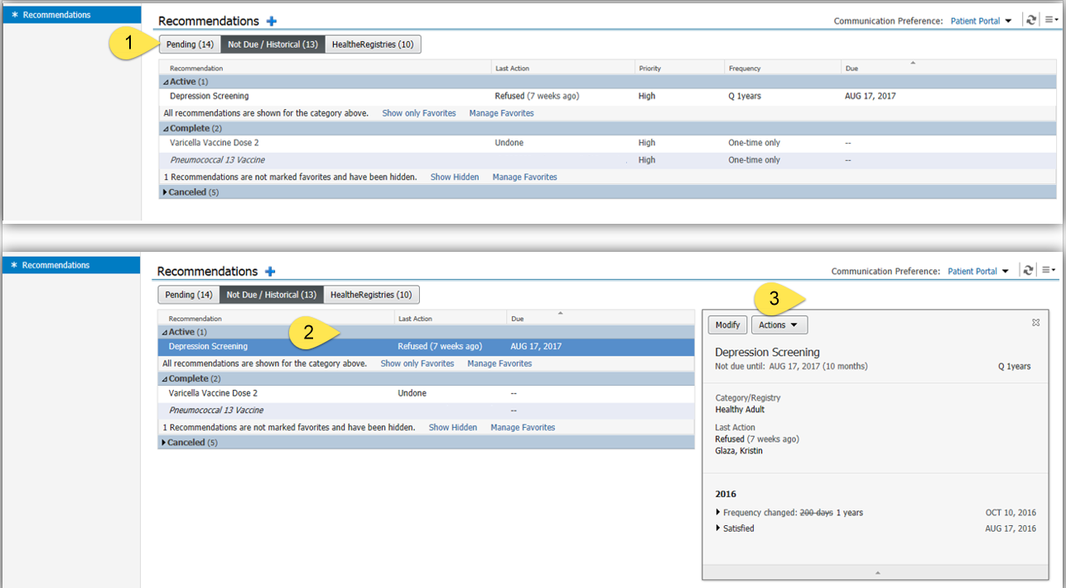
Workflow: Recommendations Review:

Slide 8
Wellness visit Recommendations:
Provides both follow-up and this visit options:
Full satisfier for visit billing; partial satisfier for next scheduled appointment.

Slide 9
Colon Cancer Screening…
Yes.
We Know.
Right now, our incoming colonoscopies do not satisfy the screening automatically.
Right now, you cannot order a colonoscopy from the recommendation.

Slide 10
Everyone is working on it. We promise.
Provider Cerner Education Session 6

Slide 11
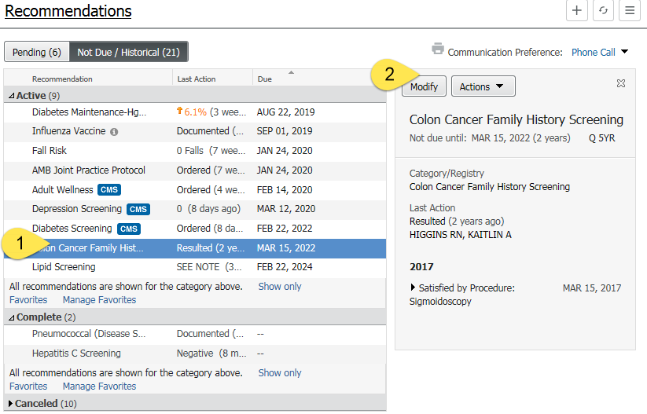
Modifying a time interval between recommendations:
Can be done at anytime (not just during a visit)
Best to do during results review
Indicate within the recommendation:
Next screening due
Reason
Comment (finding)

Slide 12
Recommendations: Adult
Reminder | Population Included | Frequency
AAA (Abdominal Aortic Aneurysm) Screening | Male tobacco users between 65 and 75 years of age | ONCE
Adult Wellness | Individuals at least 18 years of age | Annually
AMB Joint Practice Protocol | All patients | Annually
Blood Pressure Management | Individuals at least 18 years of age with condition of high BP (last result for SBP 140 or greater) | ONCE
BMI Management | Individuals at least 18 years of age with last BMI result greater than/equal to 25 OR less than 18.5 | Annually*
Healthy Adult - Bone Density Screening | Females at least 65 years of age | Every 2 years*
Breast Cancer Family Hx Screening | Females age 40-74 with family hx of breast cancer | Annually
Healthy Adult - Breast Cancer Screening | Females age 50-74 without family hx of breast cancer | Every 2 years
CAD Maintenance - Lipid Lowering Therapy Evaluation | Individuals with a condition of CAD | Annually
CAD Maintenance - ACE Inhibitor Prescribed |  | n/a
CAD Maintenance - Antiplatelet Agent Prescribed |  | n/a

Slide 13
Recommendations: Adult
Reminder | Population Included | Frequency
Healthy Adult - Cervical Cancer Screening Age 21-29 | Females age 21-29 | Every 3 Years
Healthy Adult - Cervical Cancer Screening Age 30-65 | Females age 30-65 | PAP Every 3 Years HPV +/- PAP Every 5 Years
Colon Cancer Family Hx Screening | Individuals age 40-75 with family hx of colon cancer | Fecal Occult Blood Every Year Flexible Sigmoidoscopy Every 5 Years Colonoscopy Every 5 Years
Healthy Adult - Colorectal Screening | Individuals age 50-75 without family hx of colon cancer | Fecal Occult Blood Every Year Flexible Sigmoidoscopy Every 5 Years Colonoscopy Every 10 Years
Condition Specific Immunizations - Meningococcal | Individuals at least 18 years of age with hx of splenectomy or cochlear implant | ONCE
Condition Specific Immunizations - Pneumococcal | Individuals at least 18 years of age with hx of any of the following: asthma DM splenectomy chronic lung disease chronic liver disease chronic kidney disease HF cochlear implant | ONCE

Slide 14
Recommendations: Adult
Reminder | Population Included | Frequency
Condition Specific Immunizations - Hepatitis B | Individuals at least 18 years of age with hx of any of the following: DM chronic liver disease chronic kidney disease substance use/opioid dependence | ONCE
Depression Management | Individuals with a condition of depression | Annually
Depression Screening | Individuals at least 18 years of age | Annually
Diabetes Maintenance - HgbA1c | Individuals with condition of diabetes | Every 6 Months
Diabetes Maintenance - Eye Exam | Individuals with condition of diabetes | Annually
Diabetes Maintenance - Foot Exam | Individuals with condition of diabetes | Annually
Diabetes Maintenance - Microalbumin | Individuals with condition of diabetes | Annually
Diabetes Maintenance - Statin Medication Prescribed | Individuals with condition of diabetes without statin medication on chart | Annually
Diabetes Screening | Individuals at least 45 years of age | Every 3 Years

Slide 15
Recommendations: Adult
Reminder | Population Included | Frequency
Fall Risk Screening | Individuals at least 65 years of age | Annually
Fluoride Screening | Individuals age 6-60 months | Annually
Hepatitis C Screening | Individuals born 1945 through 1965 | ONCE
Hypothyroidism Management | Individuals with a condition of hypothyroidism | Annually
Healthy Adult - Lipid Screening | Males at least 35 years of age Females at least 45 years of age | Every 5 Years
Lung Cancer Screening | Individuals age 55-77 years who are tobacco users or have a hx of tobacco use | Annually
PPD Skin Test | Individuals who were Acadia inpatients within the past 6 months, without PPD skin test ordered or completed in the past 6 months and without a positive result on the PPD Reading Form | Every 6 Months
Smoking Cessation Education | Individuals with condition of tobacco user | Annually
Spirometry | Individuals with condition of asthma | Annually

Slide 16
Recommendations: Pediatrics
Reminder | Population Included | Frequency
Autism Screening 18+ months | Individuals age 17-22 months | ONCE
Autism Screening 24+ months | Individuals age 23-26 months | ONCE
Chlamydia Screening | Females age 15-24 | Annually
Depression Management (ACO) | Individuals at least 12 years of age with initial depression screen score or detailed depression screen score greater than 9 | Annually
Depression Screening Adolescent | Individuals age 12-17 | Annually
Developmental Screening 9+ months | Individuals age 9-14 months | ONCE
Developmental Screening 15+ months | Individuals age 15-29 months | ONCE
Developmental Screening 30+ months | Individuals age 30-74 months | ONCE
Fluoride Screening | Individuals age 6-60 months | Annually
Influenza Vaccine | Individuals at least 6 months of age | Annually
Lead Screening | Individuals age 8-72 months | Annually

Slide 17
Recommendations: Pediatrics
Reminder | Population Included | Frequency
Well Child Visit | Individuals age 2-17 months of age | Between 2 and 11 months of age - every 2 months Between 12 and 17 months of age - every 3 months
Well Child Visit. | Individuals age 18 months-18 years of age | Between 18 and 35 months of age - every 6 months Between 3 and 18 years of age - annually

Slide 18
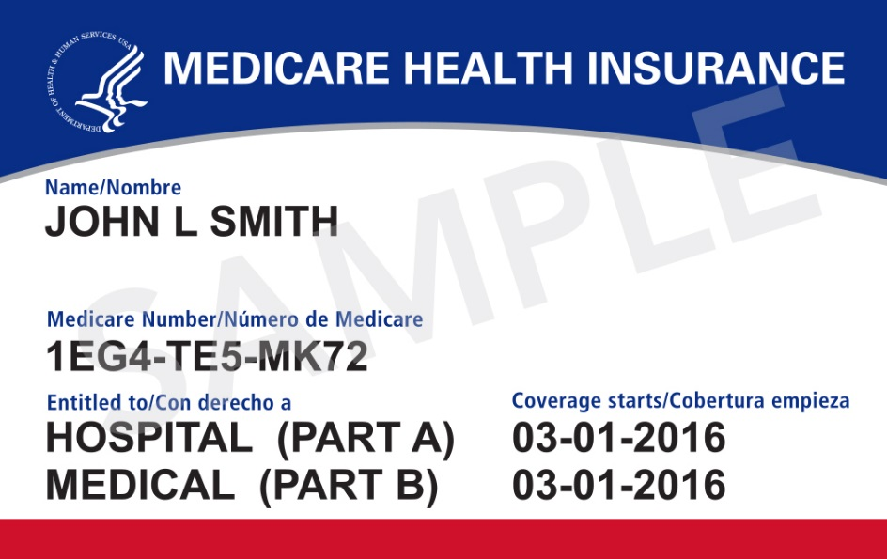
About the Preventative Care Advisor:
Real-time query to CMS database validates Medicare eligibility for preventive services; displays eligible and future services for a charge within the last 6 months.
Services are checked again within Millennium to ensure no current orders or charges could affect eligibility. Typical lag time: 5 days
Clinician can order directly from workflow view
Summary of screenings due are included on all patient visit Summary.
Consistent workflow with Recommendations allow other recommendations to be incorporated into the same workflow.
BUG: refresh issue
Provider Cerner Education Session 6

Slide 20
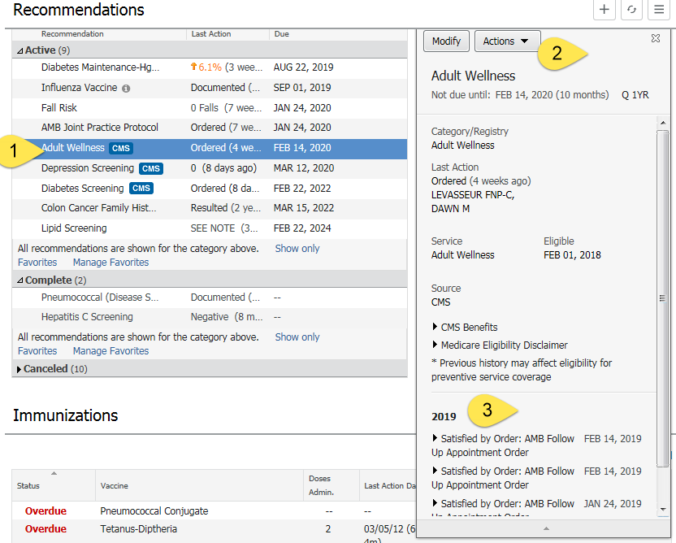
PCA-Specific Recommendations:
Always indicated by
Same actions as standard recommendations
Expandable to yield prior history of screenings

Slide 21
Preventative-Care-Advisor Specific Recommendations
Preventive Care Service
Annual Wellness Visit (AWV)
Bone Mass Measurements
Colorectal Cancer Screening
Depression Screening
Diabetes Screening
Glaucoma Screening
Pneumococcal Vaccine and Administration
Screening Mammography
Screening Pap Test
AAA screening
Provider Cerner Education Session 6

Slide 22
Dynamic Worklist:
Dynamic Worklist is a user-level query tool designed to query patients with multiple different criteria:
Conditions
Results
Orders
Appointment types
Age
Sex
Clinicians use the Dynamic Worklist to identify subsets of patients in PowerChart, gather relevant information about them, and act upon those findings.
Think of Dynamic worklists like a “Mini-Registry”

Slide 23
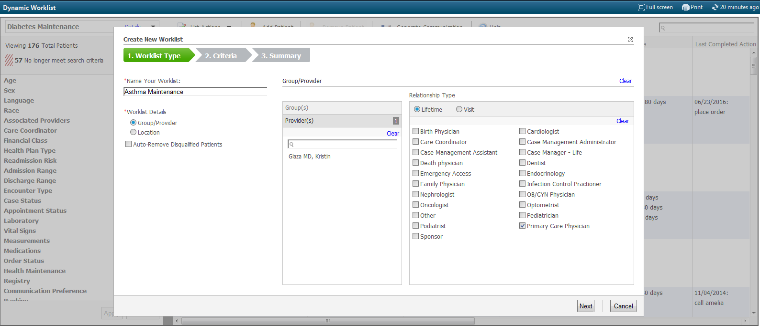

Slide 24
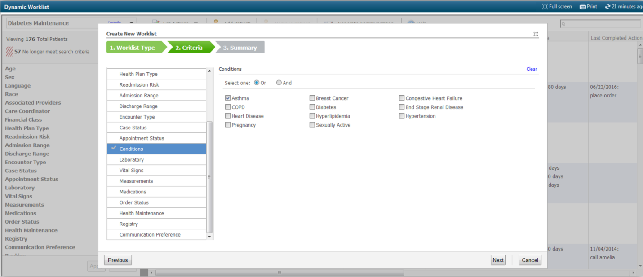
Limited, specific problems/conditions:

Slide 25
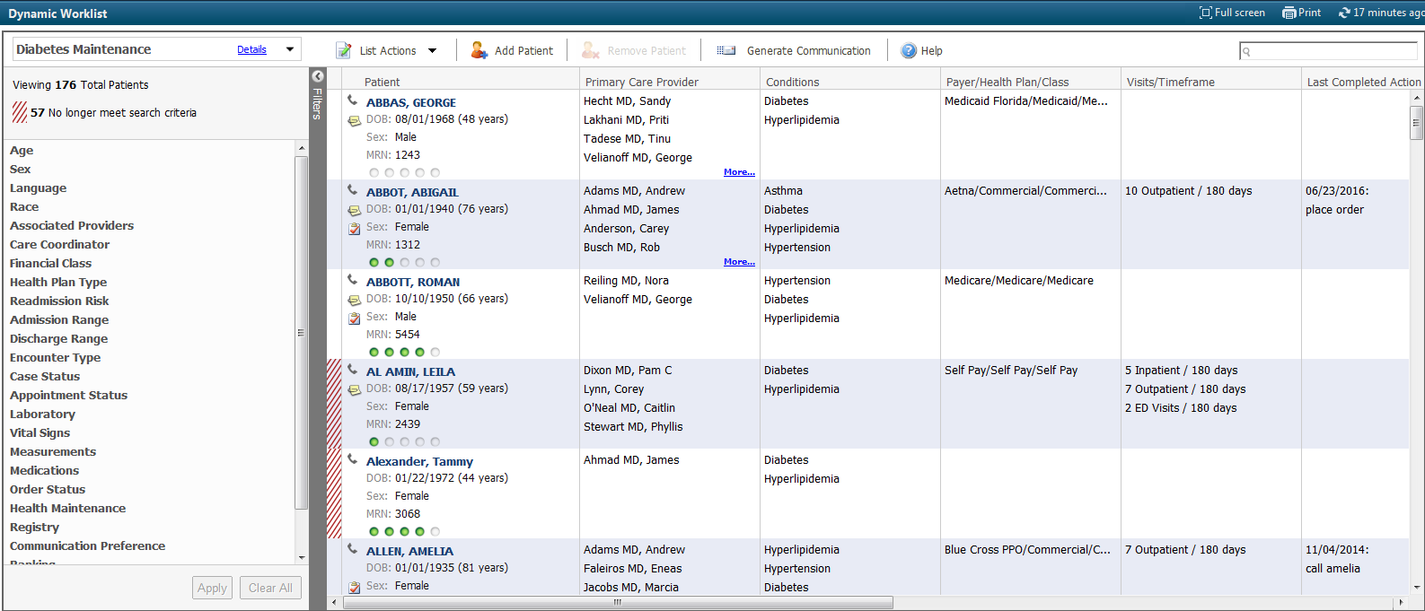
Queries return:

Slide 26
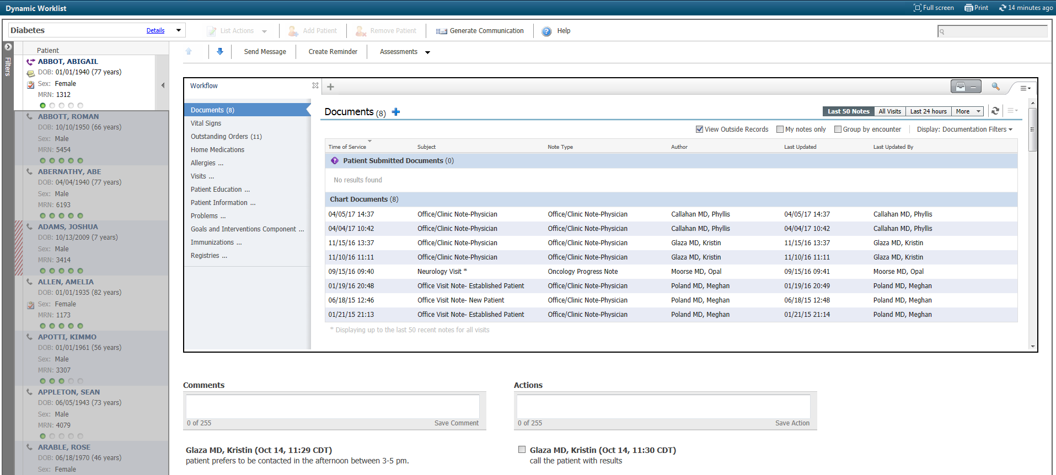
Links to the Chart:

Slide 27
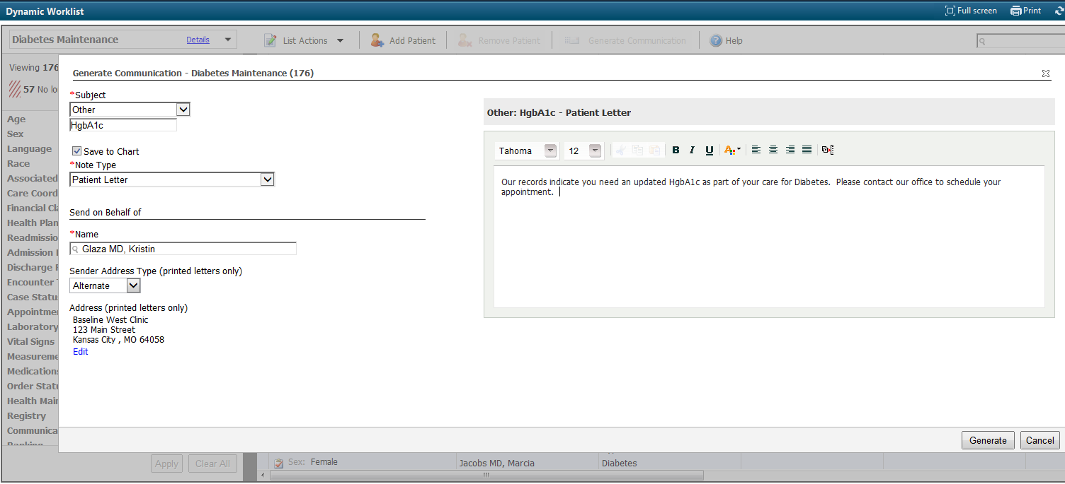
Dynamic Worklist: Creating Patient Communication

Slide 28
Survey results: Pre-Education, Dec 20, 2018 (Baseline)
 | Comfortable | Moderately Comfortable | Not Comfortable
PowerChart Structure:
I have organized my MPages and their components , and removed components I don’t use | 2 | 8 | 5
I know how to set up the contextual view (documentation on the right) | 5 | 6 | 4
I know how to change filters on the various M-page components | 2 | 3 | 11
I can accurately identify the banner bar, tool bars, table of contents (dark side), and MPage menu. | 7 | 7 | 1
I know the benefits of using the Workflow M-Page instead of going back/forth to the “Dark Side” | 2 | 9 | 4
I have configured my toolbars to meet my needs | 2 | 8 | 5
Note Creation:
I know the difference between the workflow M-page and a Note | 7 | 3 | 5
I am comfortable moving back and forth between the workflow M-page and the note without fear of losing work. | 2 | 4 | 9
I know how to use system auto-text for documenting (/) | 7 | 5 | 3
I have created personal auto-text (.) | 8 | 4 | 3
I have made a shortcut to pull nursing documentation into my note | 3 |  | 12
I have created auto-text that includes Smart Templates | 3 | 4 | 7
I know how to alter the title of a note | 5 | 3 | 6
 | Comfortable | Moderately Comfortable | Not Comfortable
Documentation Tools:
I know the difference between a diagnosis and a problem | 3 | 4 | 8
I know how to maintain a current problems list | 3 | 5 | 7
I know how to mark in error a problem on the patient’s problem list so it will no longer be part of their chart. |  | 4 | 11
I know how to free-text (Centricity-like) comments to the Family History, Social History, and Problems |  | 2 | 13
I have added items to the Family History Quick Selection section | 1 | 5 | 9
I know how to update the Social History through modify and add | 2 | 4 | 9
Message Center:
I have assigned proxies in my message center to my partners | 8 | 6 | 1
I have set up messaging favorites for pools and colleagues | 5 | 6 | 4
I know when and how to use between the visit encounters | 2 | 5 | 8
I have set up my between-the-visit encounter locations | 2 | 1 | 12
Ordering:
I have created favorites on my quick orders pages | 2 | 3 | 10
I know how to “borrow” someone else’s quick orders folder favorites so I can use them. |  |  | 15
I routinely use Quick Orders and make use of Order Sentences | 1 | 1 | 13
MModal:
I routine use MModal | 5 | 3 | 5
I have created commands to insert text | 1 | 3 | 8
I know how to use the next field button and command | 1 | 2 | 9
I know how to create auto-text that are MModal optimized | 1 | 1 | 10

Slide 29
Survey results: 5th Educational Session, March 20, 2019
 | Comfortable | Moderately Comfortable | Not Comfortable
PowerChart Structure:
I have organized my MPages and their components , and removed components I don’t use | 7 | 1 | 1
I know how to set up the contextual view (documentation on the right) | 7 | 2 | 1
I know how to change filters on the various M-page components | 7 |  | 1
I can accurately identify the banner bar, tool bars, table of contents (dark side), and MPage menu. | 8 | 1
I know the benefits of using the Workflow M-Page instead of going back/forth to the “Dark Side” | 8 |  | 1
I have configured my toolbars to meet my needs | 6 | 1 | 2
I know how to access the CCD | 4 | 3 | 2
Note Creation:
I know the difference between the workflow M-page and a Note | 9
I am comfortable moving back and forth between the workflow M-page and the note without fear of losing work. | 7 | 1 | 1
I know how to use system auto-text for documenting (/) | 8 | 2
I have created personal auto-text (.) | 8 | 1
I have made a shortcut to pull nursing documentation into my note | 4 | 4 | 1
I have created auto-text that includes Smart Templates | 5 | 3 | 1
I know how to alter the title of a note | 7 | 1 | 1
 | Comfortable | Moderately Comfortable | Not Comfortable
Documentation Tools:
I know the difference between a diagnosis and a problem | 5 |  | 4
I know how to maintain a current problems list | 5 | 3 | 1
I know how to mark in error a problem on the patient’s problem list so it will no longer be part of their chart. | 3 | 3 | 3
I know how to free-text (Centricity-like) comments to the Family History, Social History, and Problems | 4 | 2 | 3
I have added items to the Family History Quick Selection section | 4 | 3 | 3
I know how to update the Social History through modify and add | 4 | 2 | 3
Message Center:
I have assigned proxies in my message center to my partners | 9
I have set up messaging favorites for pools and colleagues | 7 | 1 | 1
I know when and how to use between the visit encounters | 3 | 5 | 2
I have set up my between-the-visit encounter locations | 3 | 4 | 3
I feel comfortable using the reply and delete buttons without fear of losing documentation | 5 | 3 | 1
I know the difference between co-signature and proposed orders | 6 | 1 | 2
I know how to use the trash and sent items to review old messages | 5 |  | 4
I know when to use the in-between encounter workflow | 4 | 2 | 3
I know how to use the message journal to track down a message | 2 | 3 | 3
I know how to send a reminder to my message center | 6 | 1 | 2
I know how to send a reminder to the patient’s chart (pop-up) | 6 | 2 | 1
I know the difference between messages and documents, and understand the lifespan of a message | 6 | 1 | 2
MModal:
I have created commands to insert text | 1 | 3 | 6
I know how to use the next field button and command | 1 | 3 | 5
I know how to create auto-text that are MModal optimized | 1 | 2 | 6
Ordering:
I have created favorites on my quick orders pages | 5 | 1 | 3
I know how to “borrow” someone else’s quick orders folder favorites so I can use them. | 4 | 1 | 4
I routinely use Quick Orders and make use of Order Sentences | 4 | 3 | 2

