Slide 1
Provider Cerner Education Session 5
Eastern Maine Medical Center
Dr. Michael Ross

Slide 2
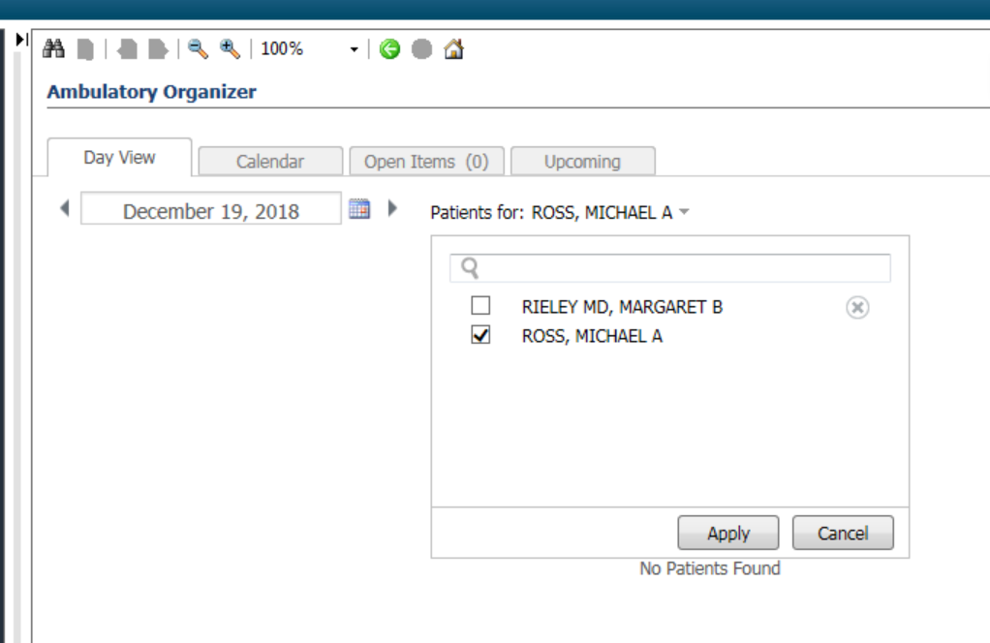
Test Patients for Use
Go to Ambulatory organizer/Home
Search for Ross, Michael in the calendar; you will see my calendar for filled with test patients.
Pick a test patient from the schedule for use today.
We will use this as a source of Test patient’s with Ambulatory encounters for future sessions as well.

Slide 3
Overview: Topics to be Addressed Today
Provider and Patient Letters:
Smart Templates:
Autotext: Basics and Advanced
Mmodal Training:

Slide 4
Patient Letter

Slide 5
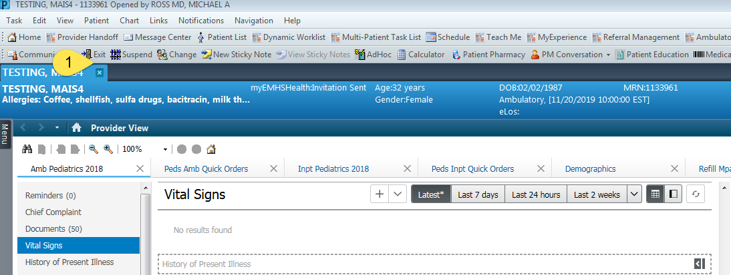
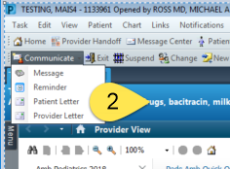
Patient Letter:
Used to produce letter for patient
Letter templates exist within the system using /let autotext.
Create your own templates as you see fit to supplement.

Slide 6
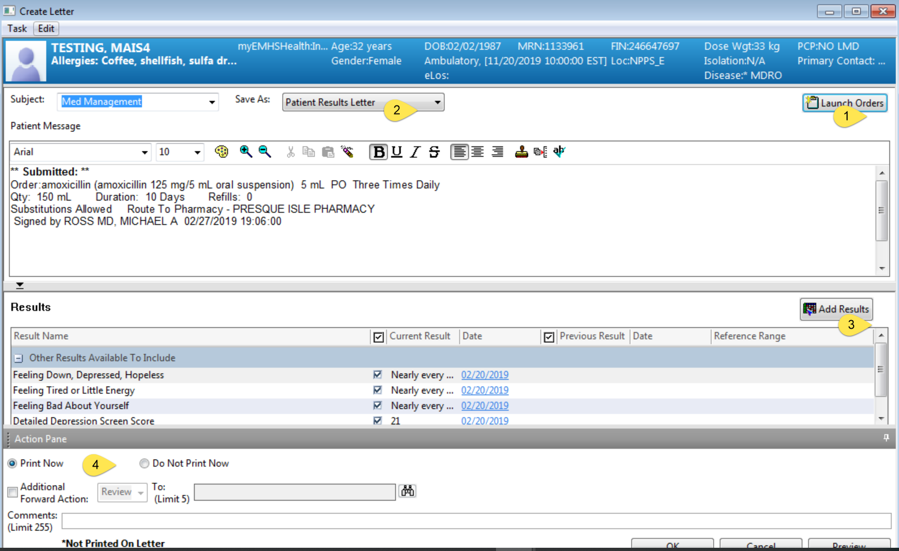
Patient Letter
Can add orders (including prescriptions) and labs
Change type of letter
Multiselect labs to include
Print, or send to office staff
on your behalf.

Slide 7
Provider Letter/Provider-to-provider communication

Slide 8
Provider Letter
Preferred method of sharing clinical content with colleagues
Suggest using this instead of just forwarding notes
Allows delegation to office staff
Draws attention to the most pertinent clinical area

Slide 9
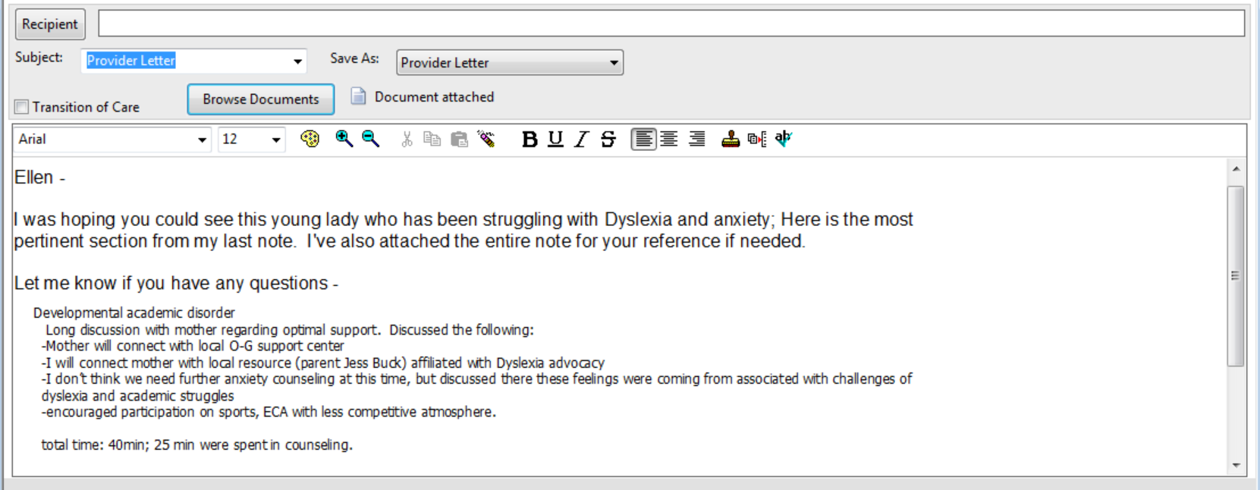
Example of Provider-to-provider communication:

Slide 10
Using Smart Templates and Autotext:

Slide 11
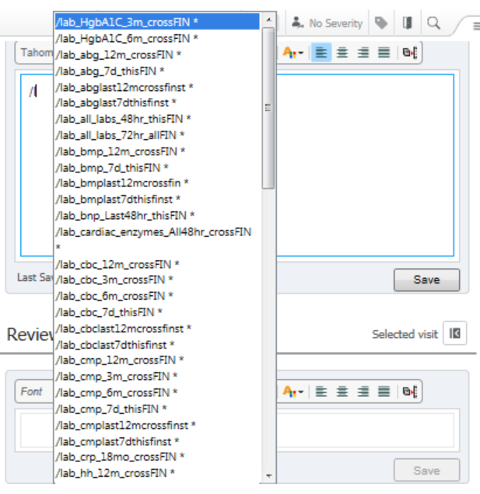
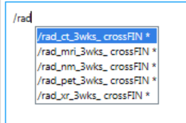
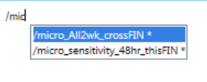
Smart Templates (Also Known As .Imissinsertingthingslikewedidincentricity)
Smart Templates bring labs, rad, micro, and other content into your note.
Can be used in both the M-page and the document.
Generally are organized by if they pull from this encounter (thisFIN) or across encounters (crossFIN). This has implications for inpatient/ambulatory use.
Smart Templates are built out as free-standing, or can be manipulated into Autotexts

Slide 12
Most Useful Smart Templates:
/vitals
/lab
/card
/micro
HPI elements accessible for Autotext building: Age, Birth date, Current Date and Time, Discharge Medications, Gender , Marital status, MU Future Appointments, Primary Care Physician, etc:
Smart Templates can be combined with autotext to create a detailed initial HPI

Slide 13
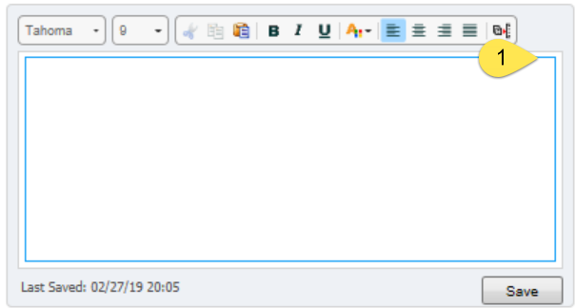
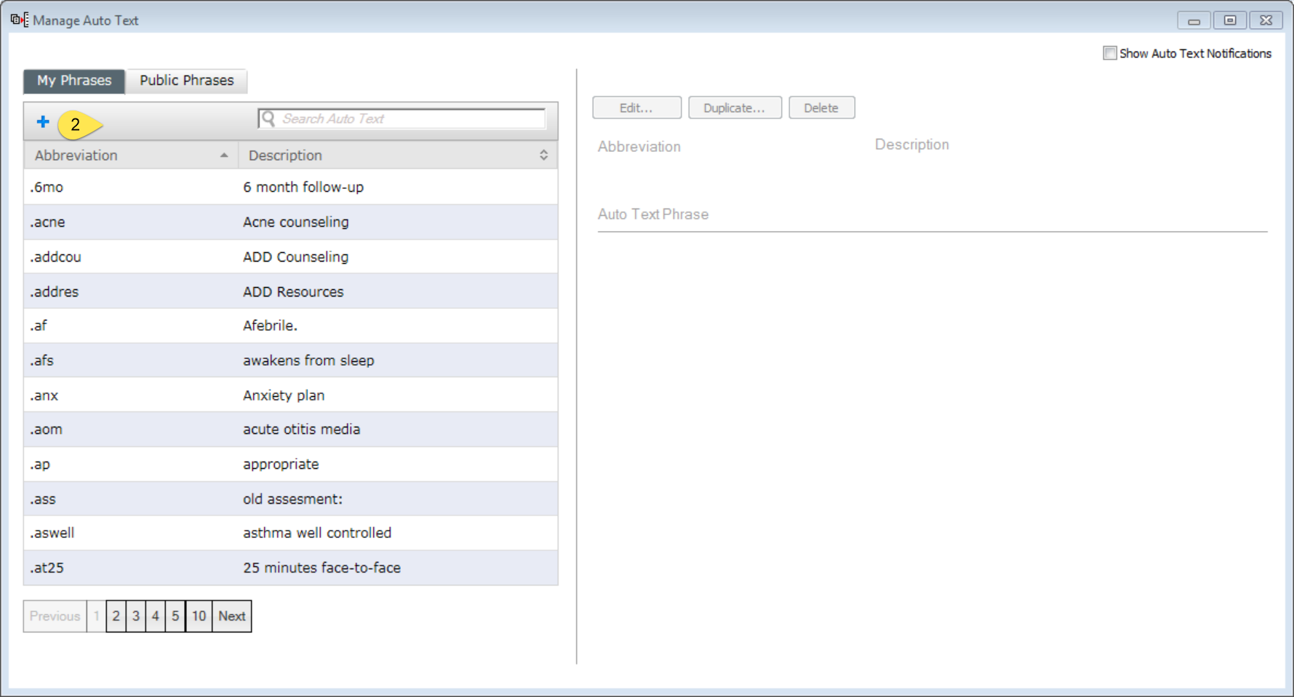
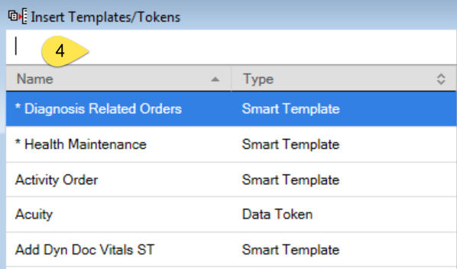
How to build smart-template-embedded Autotext:

Slide 14
Create your smart template-embedded Autotext:
There are some smart templates that are available only for autotext insertion: pathology and rheumatology in particular.

Slide 15
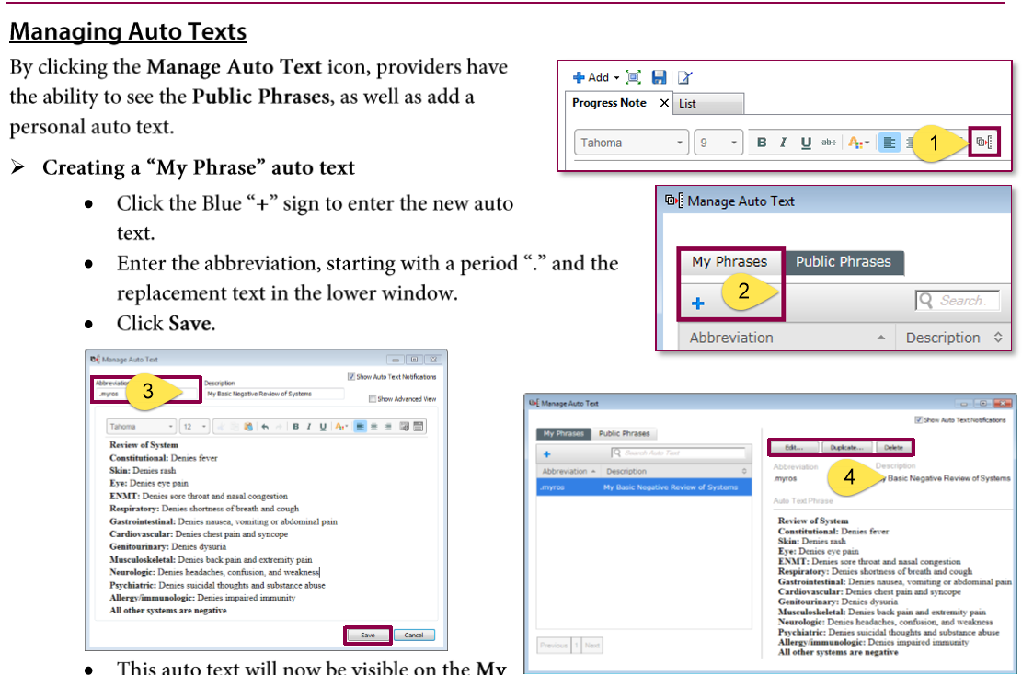
Autotext Basics:
Video Link:

Slide 16
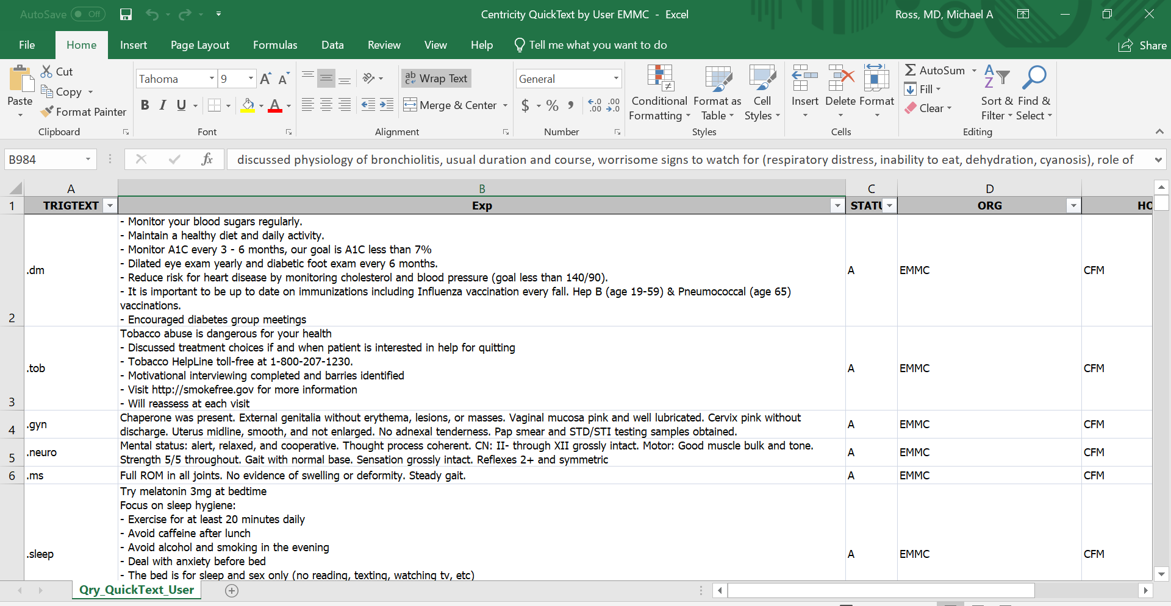
Advanced Autotext uses:
Autotext has no limit: Can add multiple pages of content
Letters
Community resources
Patient Instructions
Locations of care
Dropdowns/configuration/defaults
Smart Templates
Provider-facing content
Patient facing content
Use the Centricity Autotext as a base
(Included in email)

Slide 17
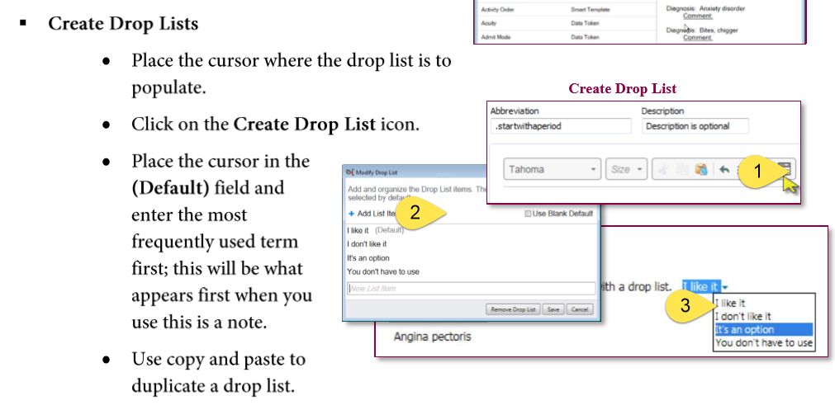
Using Autotext Dropdowns:

Slide 18
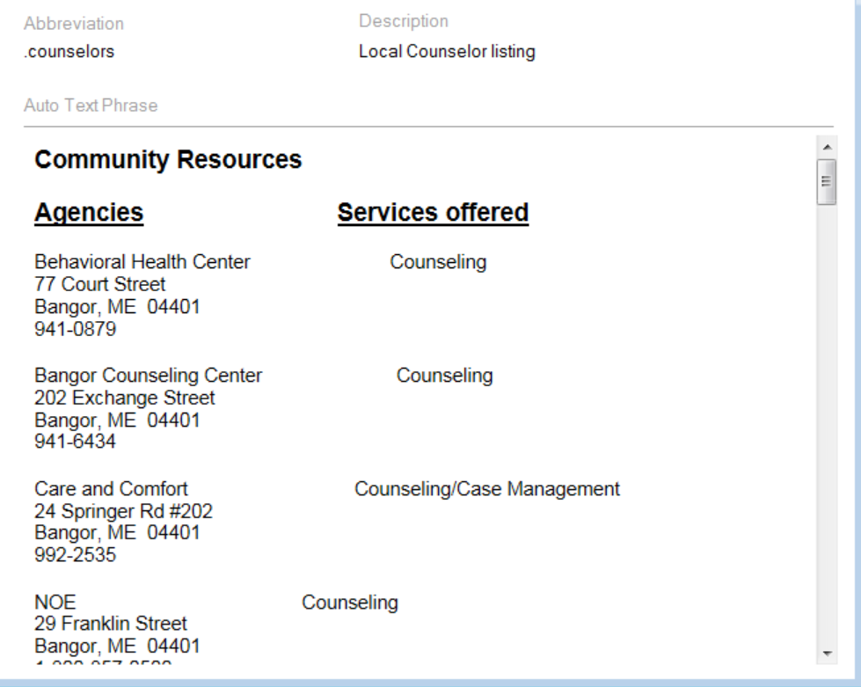
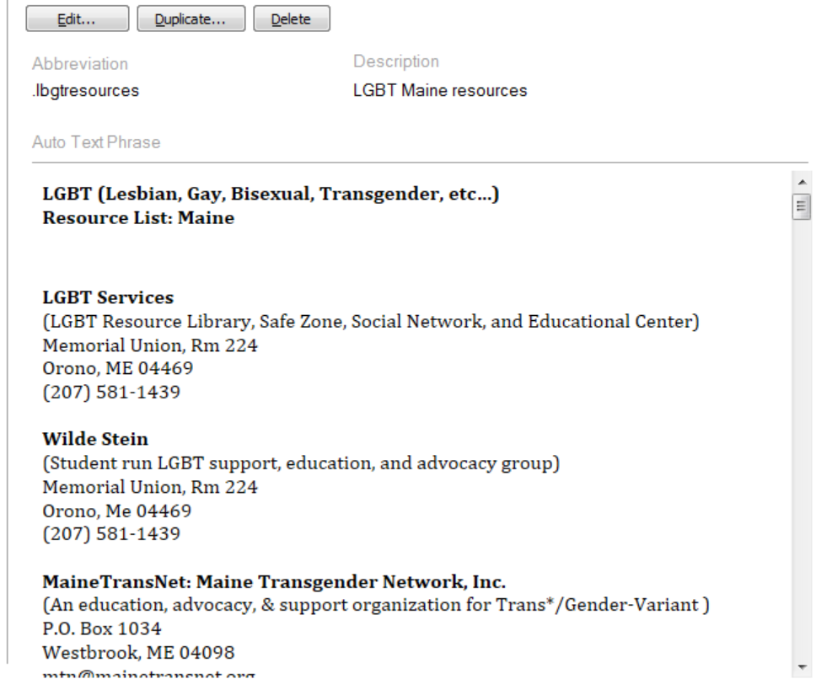
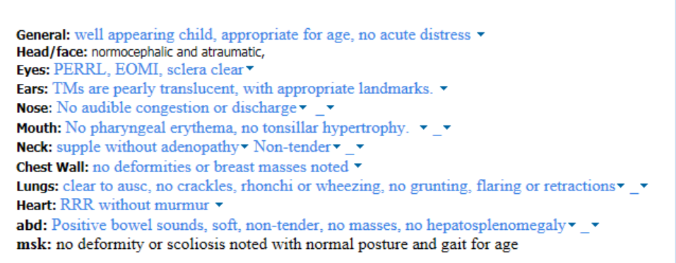
Autotext example:

Slide 19
Best Method for Sharing Autotext:
Utilize Message Center:
Least amount of clicks
Doesn’t require the user to go into the Autotext tool each time:
Video link:

Slide 20
Autotext Building Session: (Copy/paste from Centricity Autotexts to supplement)

Slide 21
Mmodal and Autotext pairing:

Slide 22
Survey results: 4 Educational Sessions, Feb 26, 2019
 | Comfortable | Moderately Comfortable | Not Comfortable
PowerChart Structure:
I have organized my MPages and their components , and removed components I don’t use | 7 | 3 | 2
I know how to set up the contextual view (documentation on the right) | 9 | 1 | 2
I know how to change filters on the various M-page components | 3 | 7 | 1
I can accurately identify the banner bar, tool bars, table of contents (dark side), and MPage menu. | 9 | 2
I know the benefits of using the Workflow M-Page instead of going back/forth to the “Dark Side” | 7 | 4 | 1
I have configured my toolbars to meet my needs | 4 | 7 | 1
I know how to access the CCD | 2 | 6 | 3
Note Creation:
I know the difference between the workflow M-page and a Note | 9 | 3
I am comfortable moving back and forth between the workflow M-page and the note without fear of losing work. | 7 | 3 | 1
I know how to use system auto-text for documenting (/) | 10 | 2
I have created personal auto-text (.) | 10 | 1 | 1
I have made a shortcut to pull nursing documentation into my note | 3 | 2 | 6
I have created auto-text that includes Smart Templates | 3 | 5 | 3
I know how to alter the title of a note | 10 | 1
 | Comfortable | Moderately Comfortable | Not Comfortable
Documentation Tools:
I know the difference between a diagnosis and a problem | 10 | 2
I know how to maintain a current problems list | 8 | 3 | 1
I know how to mark in error a problem on the patient’s problem list so it will no longer be part of their chart. | 5 | 6 | 1
I know how to free-text (Centricity-like) comments to the Family History, Social History, and Problems | 3 | 4 | 5
I have added items to the Family History Quick Selection section | 3 | 3 | 6
I know how to update the Social History through modify and add | 2 | 4 | 5
Message Center:
I have assigned proxies in my message center to my partners | 9 | 2 | 1
I have set up messaging favorites for pools and colleagues | 7 | 1 | 4
I know when and how to use between the visit encounters | 6 | 5 | 1
I have set up my between-the-visit encounter locations | 6 | 3 | 2
I feel comfortable using the reply and delete buttons without fear of losing documentation | 10 | 1 | 1
I know the difference between co-signature and proposed orders | 7 | 4 | 1
I know how to use the trash and sent items to review old messages | 7 | 4 | 2
I know when to use the in-between encounter workflow | 6 | 5 | 1
I know how to use the message journal to track down a message | 4 | 6 | 2
I know how to send a reminder to my message center | 8 | 3 | 1
I know how to send a reminder to the patient’s chart (pop-up) | 6 | 3 | 3
I know the difference between messages and documents, and understand the lifespan of a message | 8 | 2 | 2
MModal:
I have created commands to insert text | 4 | 2 | 6
I know how to use the next field button and command | 4 | 2 | 6
I know how to create auto-text that are MModal optimized | 2 | 3 | 7
Ordering:
I have created favorites on my quick orders pages | 6 | 4 | 2
I know how to “borrow” someone else’s quick orders folder favorites so I can use them. | 3 | 4 | 5
I routinely use Quick Orders and make use of Order Sentences | 3 | 6 | 4

Slide 23
Survey results: Pre-Education, Dec 20, 2018 (Baseline)
 | Comfortable | Moderately Comfortable | Not Comfortable
PowerChart Structure:
I have organized my MPages and their components , and removed components I don’t use | 2 | 8 | 5
I know how to set up the contextual view (documentation on the right) | 5 | 6 | 4
I know how to change filters on the various M-page components | 2 | 3 | 11
I can accurately identify the banner bar, tool bars, table of contents (dark side), and MPage menu. | 7 | 7 | 1
I know the benefits of using the Workflow M-Page instead of going back/forth to the “Dark Side” | 2 | 9 | 4
I have configured my toolbars to meet my needs | 2 | 8 | 5
Note Creation:
I know the difference between the workflow M-page and a Note | 7 | 3 | 5
I am comfortable moving back and forth between the workflow M-page and the note without fear of losing work. | 2 | 4 | 9
I know how to use system auto-text for documenting (/) | 7 | 5 | 3
I have created personal auto-text (.) | 8 | 4 | 3
I have made a shortcut to pull nursing documentation into my note | 3 |  | 12
I have created auto-text that includes Smart Templates | 3 | 4 | 7
I know how to alter the title of a note | 5 | 3 | 6
 | Comfortable | Moderately Comfortable | Not Comfortable
Documentation Tools:
I know the difference between a diagnosis and a problem | 3 | 4 | 8
I know how to maintain a current problems list | 3 | 5 | 7
I know how to mark in error a problem on the patient’s problem list so it will no longer be part of their chart. |  | 4 | 11
I know how to free-text (Centricity-like) comments to the Family History, Social History, and Problems |  | 2 | 13
I have added items to the Family History Quick Selection section | 1 | 5 | 9
I know how to update the Social History through modify and add | 2 | 4 | 9
Message Center:
I have assigned proxies in my message center to my partners | 8 | 6 | 1
I have set up messaging favorites for pools and colleagues | 5 | 6 | 4
I know when and how to use between the visit encounters | 2 | 5 | 8
I have set up my between-the-visit encounter locations | 2 | 1 | 12
Ordering:
I have created favorites on my quick orders pages | 2 | 3 | 10
I know how to “borrow” someone else’s quick orders folder favorites so I can use them. |  |  | 15
I routinely use Quick Orders and make use of Order Sentences | 1 | 1 | 13
MModal:
I routine use MModal | 5 | 3 | 5
I have created commands to insert text | 1 | 3 | 8
I know how to use the next field button and command | 1 | 2 | 9
I know how to create auto-text that are MModal optimized | 1 | 1 | 10

