Slide 1
Provider Cerner Education Session 4
Eastern Maine Medical Center
Dr. Michael Ross & Danielle Gendreau

Slide 2
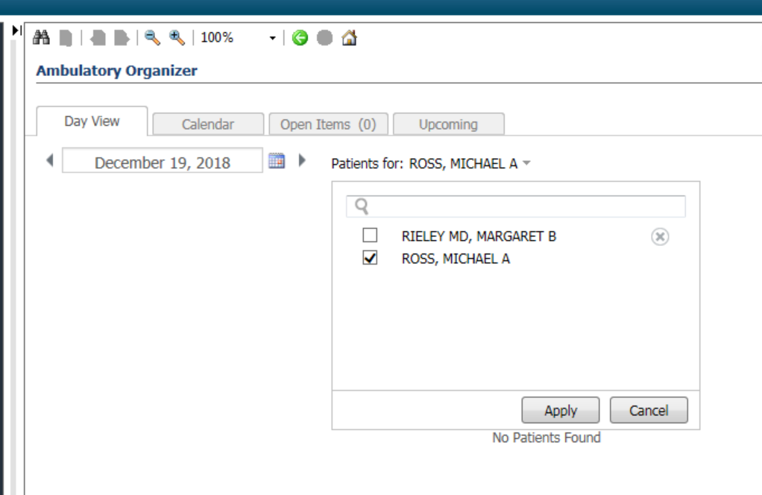
Test Patients for Use
Go to Ambulatory organizer/Home
Search for Ross, Michael in the calendar; you will see my calendar for today filled with test patients.
Pick a test patient from the schedule for use today.
We will use this as a source of Test patient’s with Ambulatory encounters for future sessions as well.

Slide 3
Overview: Topics to be Addressed Today
Medications and Prescriptions:
Med compliance/Reconciliation
Med changes during reconciliation
Efficient refills during a visit
New medications during a visit
Freetext meds
Pharmacy changes
Refilling meds via the message Center
Med Proposals in message center
Medication Filters
Medication Snapshot
Mmodal Training:
Feedback and Build:
ServiceNow changes
Survey results

Slide 4
The Star of Today’s Class:

Slide 5
Different Roles for Medication Reconciliation:
MA Role:
-Remove vastly out of date medications (i.e. old antibiotics)
-Check and document compliance of all chronic medications
-Sign off and send to provider
Note: It is not within the MAs scope of licensure to remove medications a patient has been prescribed and is not taking.
Provider Role:
-Review current medications
-Decide the status of the medication:
-continue
-refille
-stop
-correct
-acknowledge anything not directly continued/prescribed/discontinued.

Slide 6
Demo Example: Starring your MA/Provider dyad

Slide 7
Completing Medication Reconciliation
From the workflow page, select Home Medications.
Click Outpatient.
Continue, D/C or Create new Rx as applicable for each med.
Address compliance meds as applicable.
Address any In-Office Meds by always selecting Continue.
Click Sign.
= Complete Med Rec
= Partial Med Rec (Need to Continue In-Office Meds)

Slide 8
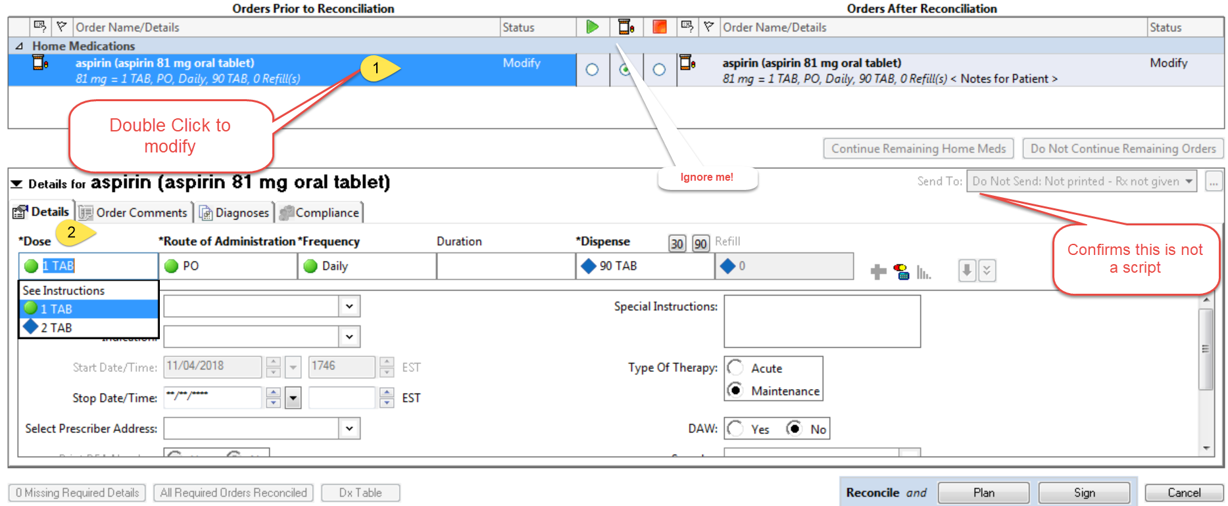
Changing a medication dose during med reconciliation.

Slide 9
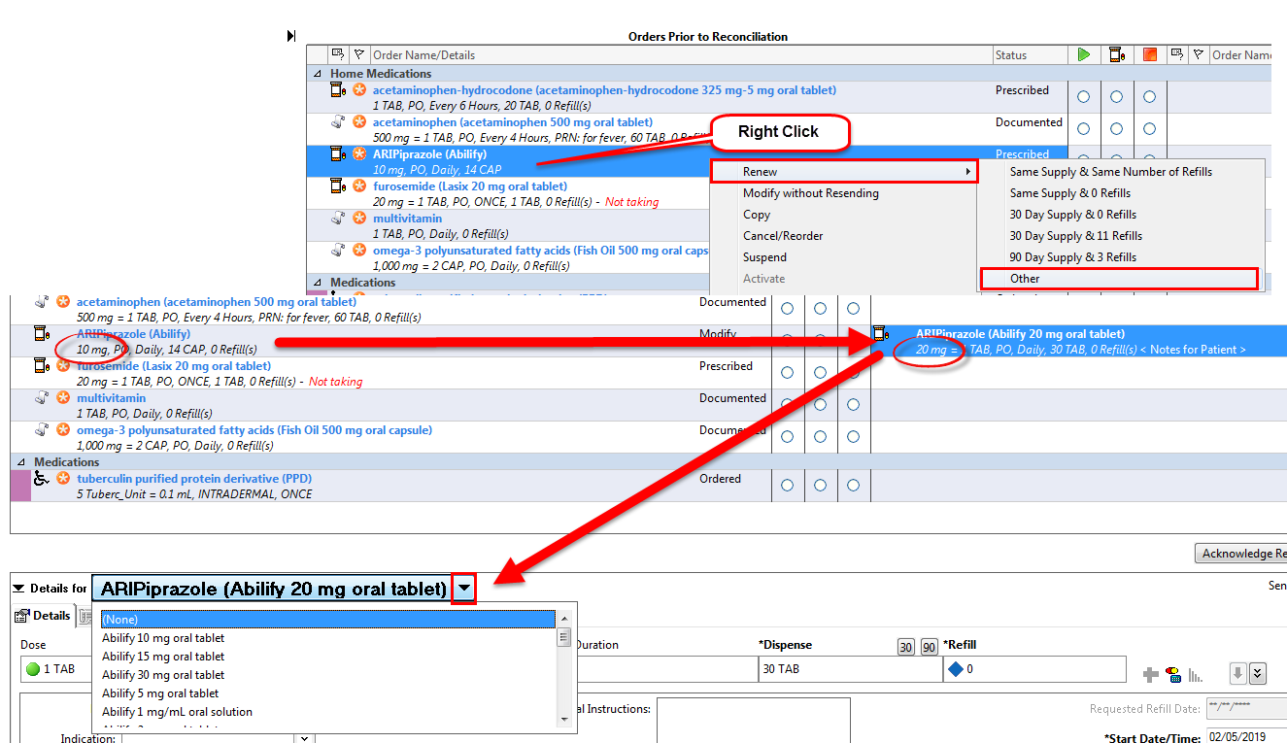
Prescription Refills During an Office Visit
Same dose, instructions and dispense amount:
Different dose, instructions and/or dispense amount:

Slide 10
Adding New Medications During an Office Visit
From Med Rec screen:
Click the +Add button
Search for medication
Use Order Sentences
From Workflow Page:
Home Medications component
Click + sign
Search for medication
Use Order Sentences

Slide 11
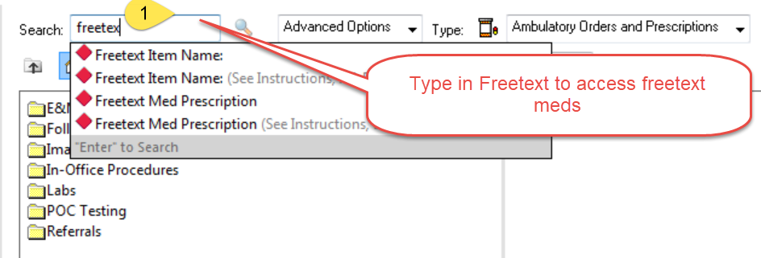
Freetext Medications:

Slide 12
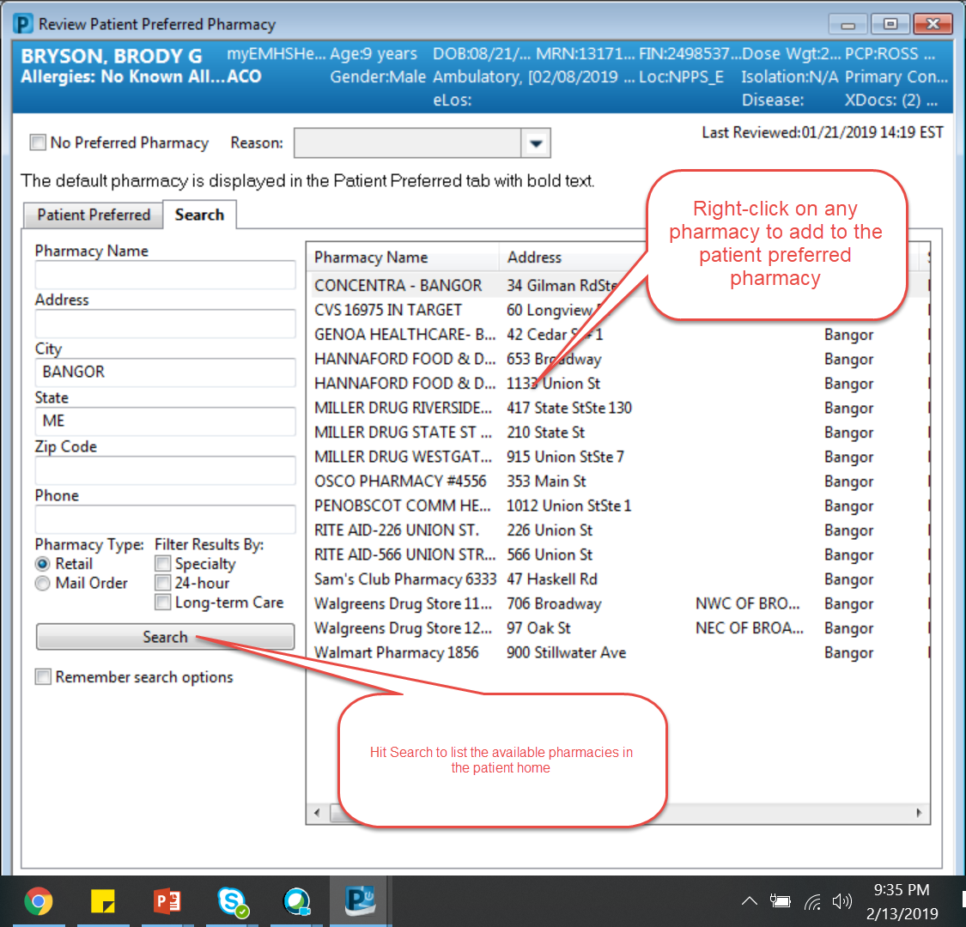
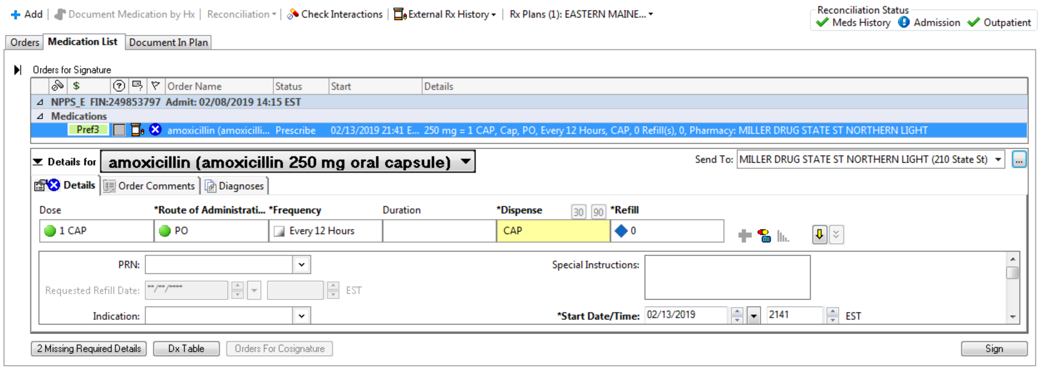
Pharmacy changes:
From the Banner Bar or during prescription writing:

Slide 13
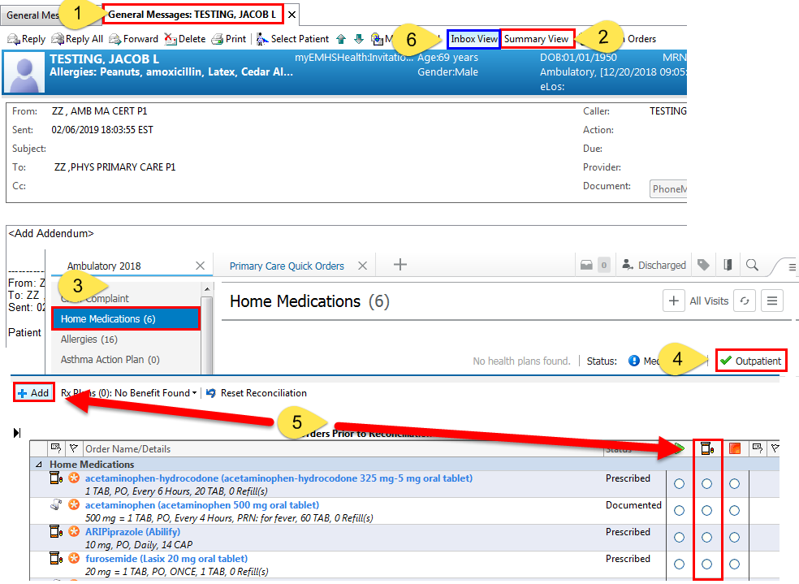
Prescribing/Refilling Medications from a Message Center Message
Double click on Message
Select Summary View to bring you to the Workflow page
Navigate to Home Medications
Click on Outpatient
Add new meds using the +Add, button or refill existing med using then Create New Rx radio button
Select Inbox View to return to message

Slide 14
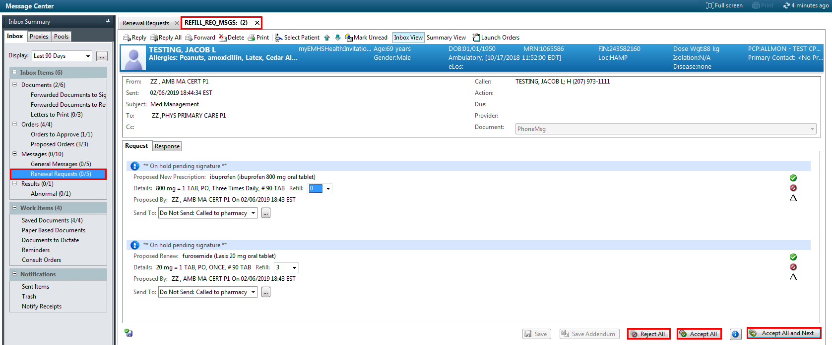
Addressing Proposed Medications/eRx Renewals
Medication proposals will fall under Renewal Requests or eRx Renewals in Message Center
= Accepts this proposal only
= Rejects this proposal only
= Accepts this proposal only, with modifications. This will prompt the order details window to open for modifications
= Rejects all proposals in the message
= Accepts all proposals in the message
= Accepts all proposals in the message and moves to the next proposal message

Slide 15
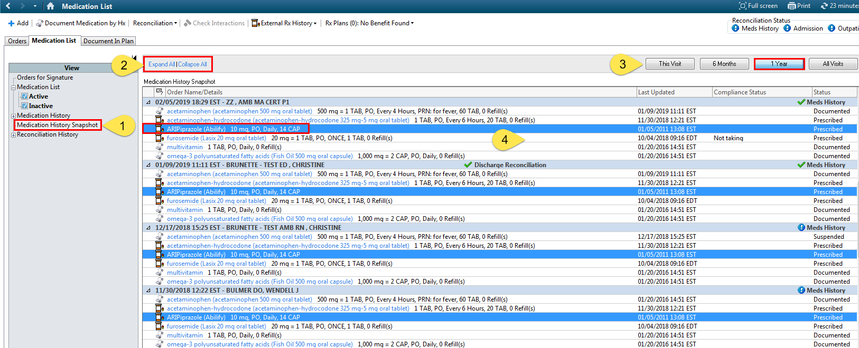
Reviewing Prior Medication: Using the Medication History Snapshot
Select Medication History Snapshot
Select Expand All
Select timeframe
Select medication you want to look at history of Rx

Slide 16
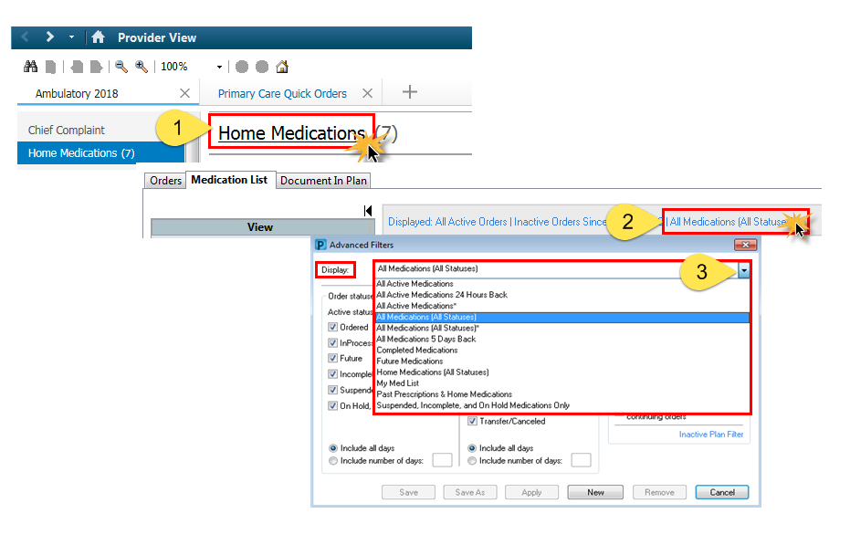
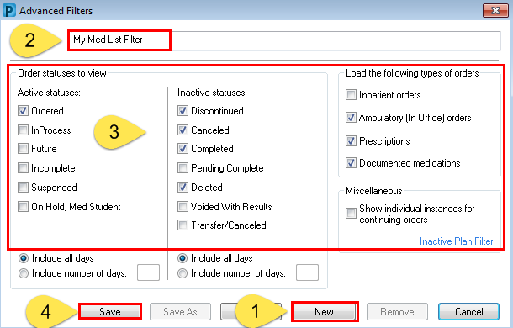
Medication History and Filtering Options
Click on Home Medications
Click on the blue hyperlink
Click the drop down arrow to reveal available filters
To Create Your Own Filter:
Click the New button
Name your filter
Select the options you would like included
Click Save

Slide 17
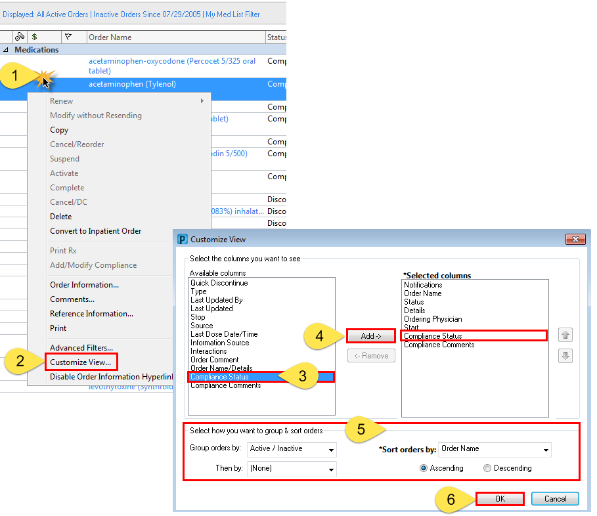
Customizing View
Customizing your view will allow you to select the columns you want to see in view.
Right click anywhere in the med list
Select Customize View
Select columns from the left
Click Add to move to the right
Select Group/Sort orders
Click Ok

Slide 18
Mmodal Training:

Slide 19
Tickets and Feedback:

Slide 20
Your Feedback Matters

Slide 21
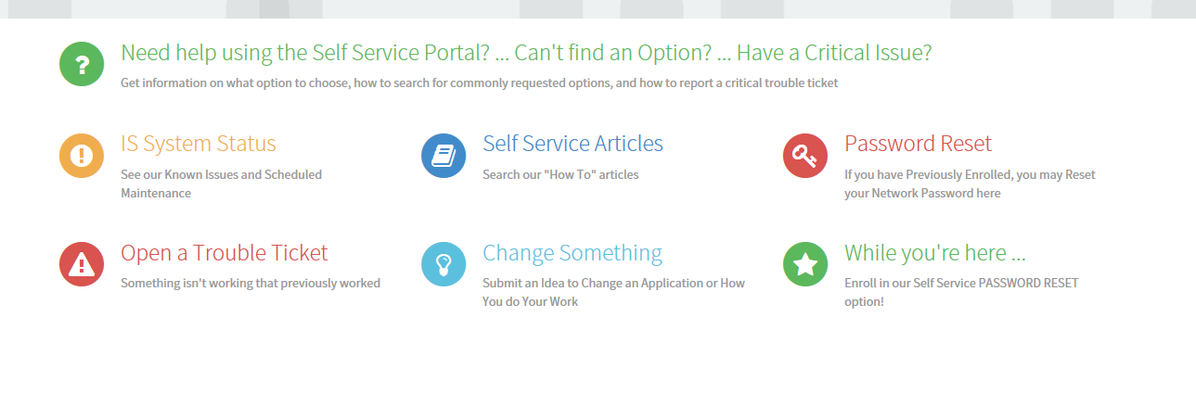
Service now: Current

Slide 22
Options
Change something or New Clinical / Business Requests
Make suggestions:
Change Something or New Clinical / Business Request
Change Something or New Clinical Request
Make Suggestions:
Submit an Idea to Change an Application or How you do your work
Submit an Idea to Change an Application Clinical / Business or How you do your work

Slide 23
Planned changes:
Changed to Read
* Change to Director, leader, provider, or on behalf of any of the above

Slide 24
Old
Reword – see the next slide
Attention: This form should ONLY be used for NON-ROUTINE submissions
Some examples of Non-Routine submissions are suggesting a new application, a new workflow or significant change to the way your area functions, or a change to how our organization does business. Non-Routine submissions are subjected to leadership review and are therefore not processed in an expedited manner.
If you need to submit a ROUTINE request:
Click here to return to the homepage, then use the SEARCH box at the top center of the Portal homepage and type in keywords to see options. Click here to access the HELP option for assistance, or contact our IS Service Desk at (207) 973-7728.
Examples of ROUTINE Requests:
Request for new access to an application, request for a W Drive folder or access to one, requesting a new keyboard or desk phone, requesting provider demographics updates, registration / schedule changes, asking for new software to be installed, requesting an MRN, chart, or FIN combine, requesting a document correction or for updates to voicemail options, and more.

Slide 25
Proposed new verbiage
Does this need to removed or remain
This form should be used for new clinical or business requests
When submitting a business idea for review, please ensure you fully describe your idea using the SMART approach. If this involves a change to Cerner or other currently operating clinical systems, please describe the clinical justification including references where appropriate.
If you need to submit a ROUTINE request:
Click here to return to the homepage, then use the SEARCH box at the top center of the Portal homepage and type in keywords to see options. Click here to access the HELP option for assistance, or contact our IS Service Desk at (207) 973-7728.
Examples of ROUTINE Requests:
Request for new access to an application, request for a W Drive folder or access to one, requesting a new keyboard or desk phone, requesting provider demographics updates, registration / schedule changes, asking for new software to be installed, requesting an MRN, chart, or FIN combine, requesting a document correction or for updates to voicemail options, and more.

Slide 26
Survey results: Pre-Education, Dec 20, 2018 (Baseline)
 | Comfortable | Moderately Comfortable | Not Comfortable
PowerChart Structure:
I have organized my MPages and their components , and removed components I don’t use | 2 | 8 | 5
I know how to set up the contextual view (documentation on the right) | 5 | 6 | 4
I know how to change filters on the various M-page components | 2 | 3 | 11
I can accurately identify the banner bar, tool bars, table of contents (dark side), and MPage menu. | 7 | 7 | 1
I know the benefits of using the Workflow M-Page instead of going back/forth to the “Dark Side” | 2 | 9 | 4
I have configured my toolbars to meet my needs | 2 | 8 | 5
Note Creation:
I know the difference between the workflow M-page and a Note | 7 | 3 | 5
I am comfortable moving back and forth between the workflow M-page and the note without fear of losing work. | 2 | 4 | 9
I know how to use system auto-text for documenting (/) | 7 | 5 | 3
I have created personal auto-text (.) | 8 | 4 | 3
I have made a shortcut to pull nursing documentation into my note | 3 |  | 12
I have created auto-text that includes Smart Templates | 3 | 4 | 7
I know how to alter the title of a note | 5 | 3 | 6
 | Comfortable | Moderately Comfortable | Not Comfortable
Documentation Tools:
I know the difference between a diagnosis and a problem | 3 | 4 | 8
I know how to maintain a current problems list | 3 | 5 | 7
I know how to mark in error a problem on the patient’s problem list so it will no longer be part of their chart. |  | 4 | 11
I know how to free-text (Centricity-like) comments to the Family History, Social History, and Problems |  | 2 | 13
I have added items to the Family History Quick Selection section | 1 | 5 | 9
I know how to update the Social History through modify and add | 2 | 4 | 9
Message Center:
I have assigned proxies in my message center to my partners | 8 | 6 | 1
I have set up messaging favorites for pools and colleagues | 5 | 6 | 4
I know when and how to use between the visit encounters | 2 | 5 | 8
I have set up my between-the-visit encounter locations | 2 | 1 | 12
Ordering:
I have created favorites on my quick orders pages | 2 | 3 | 10
I know how to “borrow” someone else’s quick orders folder favorites so I can use them. |  |  | 15
I routinely use Quick Orders and make use of Order Sentences | 1 | 1 | 13
MModal:
I routine use MModal | 5 | 3 | 5
I have created commands to insert text | 1 | 3 | 8
I know how to use the next field button and command | 1 | 2 | 9
I know how to create auto-text that are MModal optimized | 1 | 1 | 10

Slide 27
Survey results: 3 Educational Sessions, Feb 12, 2019
 | Comfortable | Moderately Comfortable | Not Comfortable
PowerChart Structure:
I have organized my MPages and their components , and removed components I don’t use | 11 | 4
I know how to set up the contextual view (documentation on the right) | 9 | 4 | 2
I know how to change filters on the various M-page components | 7 | 4 | 3
I can accurately identify the banner bar, tool bars, table of contents (dark side), and MPage menu. | 12 | 2
I know the benefits of using the Workflow M-Page instead of going back/forth to the “Dark Side” | 9 | 6 | 1
I have configured my toolbars to meet my needs | 8 | 7
I know how to access the CCD | 5 | 5 | 5
Note Creation:
I know the difference between the workflow M-page and a Note | 11 | 2 | 1
I am comfortable moving back and forth between the workflow M-page and the note without fear of losing work. | 10 | 4 | 1
I know how to use system auto-text for documenting (/) | 13 | 1 | 1
I have created personal auto-text (.) | 13 | 1 | 1
I have made a shortcut to pull nursing documentation into my note | 4 | 3 | 8
I have created auto-text that includes Smart Templates | 7 | 1 | 7
I know how to alter the title of a note | 12 | 1 | 2
 | Comfortable | Moderately Comfortable | Not Comfortable
Documentation Tools:
I know the difference between a diagnosis and a problem | 8 | 2 | 6
I know how to maintain a current problems list | 8 | 6 | 1
I know how to mark in error a problem on the patient’s problem list so it will no longer be part of their chart. | 8 | 4 | 3
I know how to free-text (Centricity-like) comments to the Family History, Social History, and Problems | 6 | 4 | 4
I have added items to the Family History Quick Selection section | 8 | 2 | 5
I know how to update the Social History through modify and add | 6 | 3 | 5
Message Center:
I have assigned proxies in my message center to my partners | 11 | 2 | 2
I have set up messaging favorites for pools and colleagues | 12 | 2 | 1
I know when and how to use between the visit encounters | 7 | 6 | 2
I have set up my between-the-visit encounter locations | 5 | 6 | 3
I feel comfortable using the reply and delete buttons without fear of losing documentation | 10 | 2 | 1
I know the difference between co-signature and proposed orders | 6 | 7 | 2
I know how to use the trash and sent items to review old messages | 6 | 4 | 5
I know when to use the in-between encounter workflow | 6 | 5 | 4
I know how to use the message journal to track down a message | 5 | 3 | 7
I know how to send a reminder to my message center | 8 | 4 | 3
I know how to send a reminder to the patient’s chart (pop-up) | 7 | 3 | 5
I know the difference between messages and documents, and understand the lifespan of a message | 9 | 1 | 4
MModal:
I have created commands to insert text | 4 | 1 | 11
I know how to use the next field button and command | 2 | 1 | 11
I know how to create auto-text that are MModal optimized | 3 | 2 | 9
Ordering:
I have created favorites on my quick orders pages | 6 | 4 | 4
I know how to “borrow” someone else’s quick orders folder favorites so I can use them. | 3 | 6 | 4
I routinely use Quick Orders and make use of Order Sentences | 4 | 4 | 8

