Slide 1
Provider Cerner Education Session 3
Eastern Maine Medical Center
Dr. Michael Ross

Slide 2
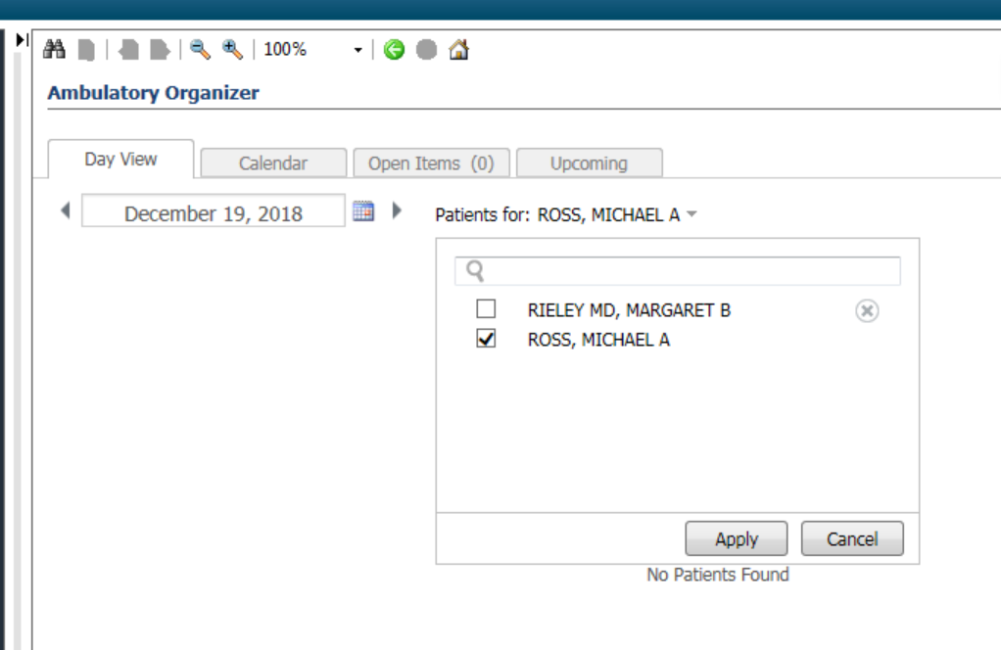
Test Patients for Use
    Go to Ambulatory organizer/Home
    Search for Ross, Michael in the calendar; you will see my calendar for today filled with test patients.
    Pick a test patient from the schedule for use today.
    We will use this as a source of Test patient’s with Ambulatory encounters for future sessions as well.

Slide 3
Overview: Topics to be Addressed Today
Ordering
    Ordering foundation
    Using Quick-Order pages
    Setting up quick-order page
    Charge orders
    Procedure/referral orders
    Future orders, recurrent orders, and adding diagnosis
    Adding favorites and favorites demos
    Protocols
Documentation Tools
    Family History
    Social History
    Problem Lists
    Procedure History

Slide 4
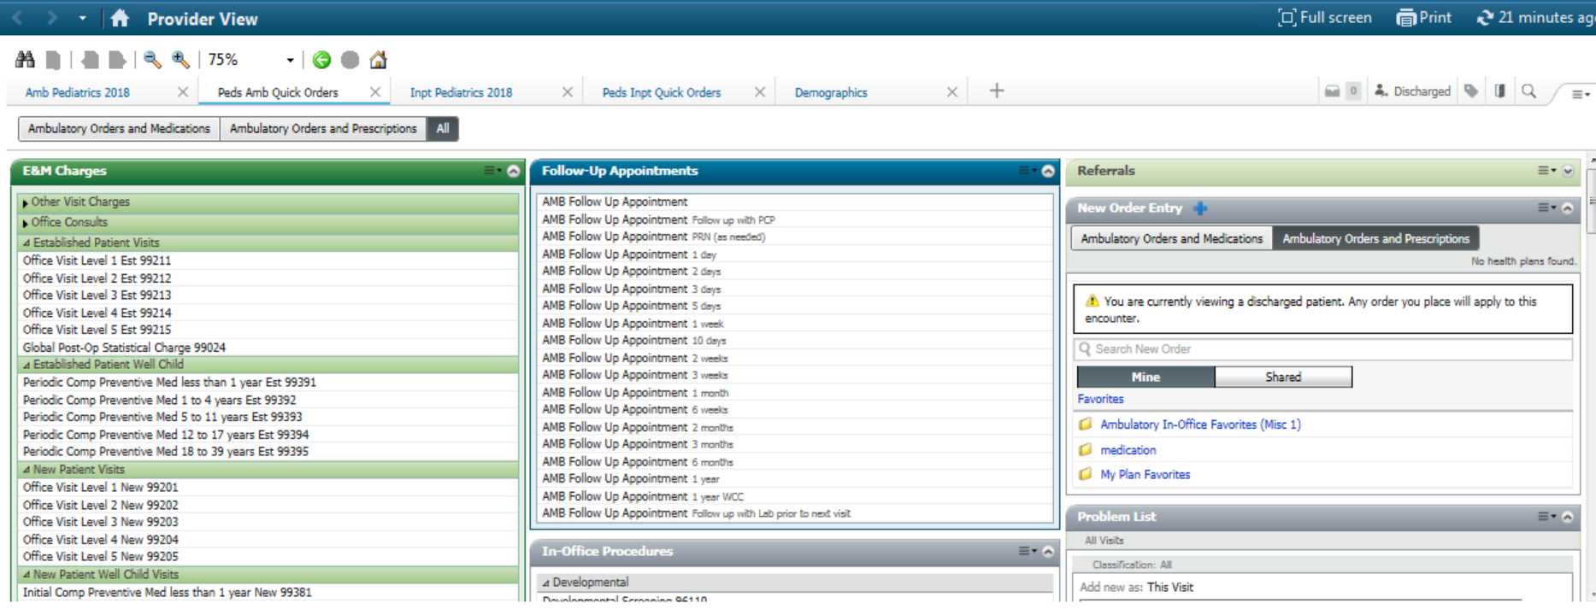
Quick Order Pages
Quick order page is the preferred method of ordering labs, imaging tests, referrals, billing, and in-office testing.
Each quick-order page virtual views the correct order types to the office. Using the quick-order page will ensure that the correct type of order is placed.
Quick order pages were built with provider input (some more than others).
Use of order favorites can make quick-order pages faster.

Slide 5
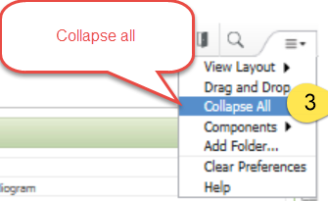
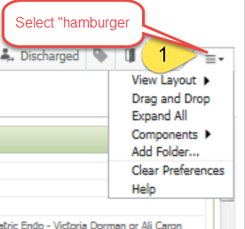
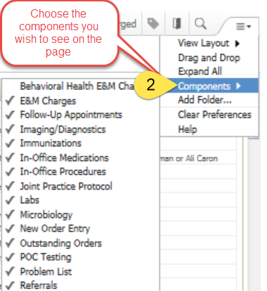
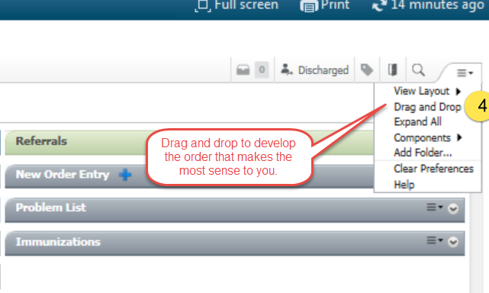
Setting up your Quick Order Page
Let’s do this now.

Slide 6
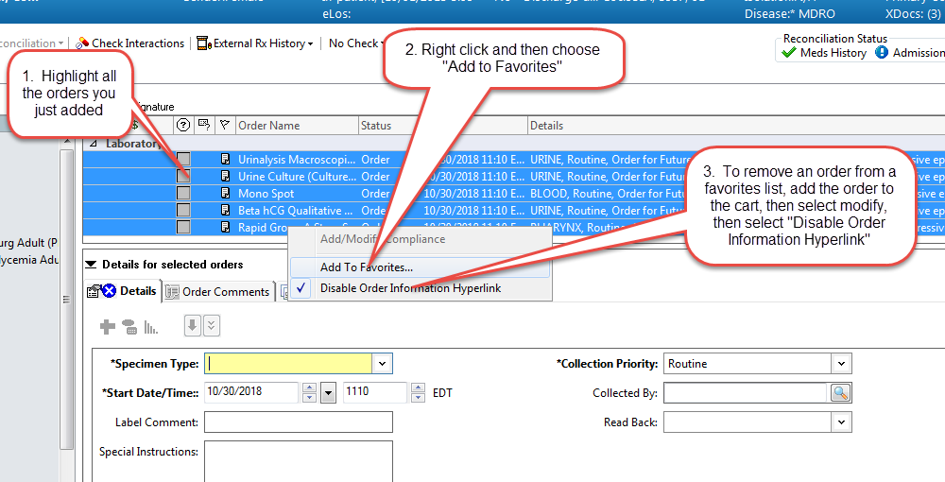
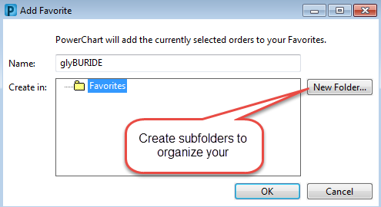
Adding Favorites:
  Add Orders not on QOP via search
  Click the shopping Cart
  Click Modify Orders
  Highlight the order you want to add as a favorite
  Right-click the Click, select add to favorites
  Cancel all the orders
  Create subfolders

Slide 7
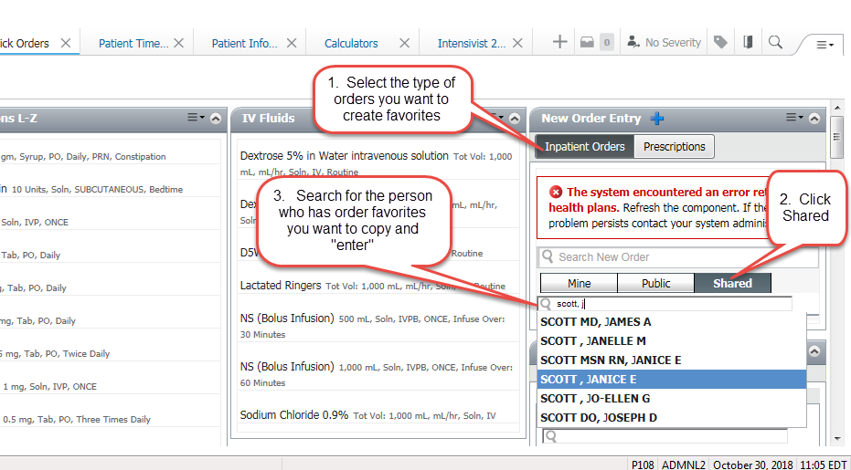
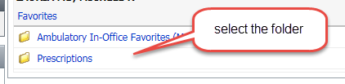
Sharing Quick Orders Favorites with Peers:
Go to Quick Orders Mpage
    Under New Order Entry, click “Shared”
    Search for the person’s name you want to borrow from
    Select the folder you want to copy from
    Place desired orders
    Go into your cart and select /modify/add to favorites

Slide 8
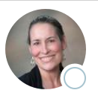

Order Favorite Set Up Examples from the Medical Staff
During this time please explore order favorites and swap with colleagues

Slide 9
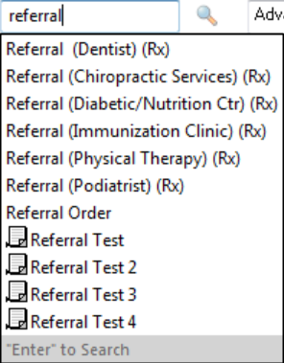
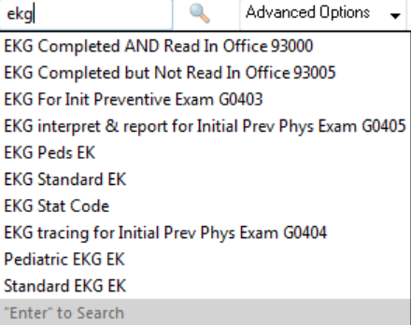
Avoid frequent use of the search bar for routine orders
The entire catalog of orders is available when using the search box.
  Some orders are not meant for the ambulatory environment (i.e. inpatient/outpatient/Rx./INPT orders).
  Inpatient orders placed may result in your office never seeing them.
  In general, only use the search bar for esoteric orders that are rarely used (80/20 rule).

Slide 10
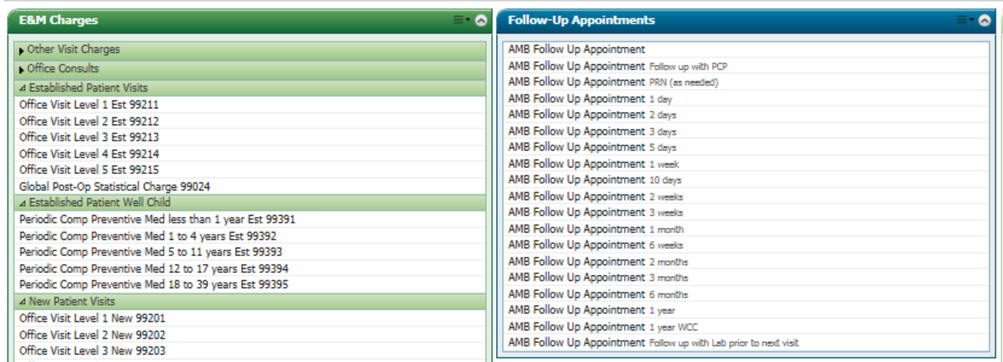
Charges and Follow Up Orders:
Best to group these early on the quickorders page (top left) for completion at the conclusion of our visits.
Checkout staff should be checking these orders at the time of depart, in order to coordinate follow-up office visits.
Use the blank “follow-up appointment ” to insert a custom follow-up time not available on the dropdown list.

Slide 11
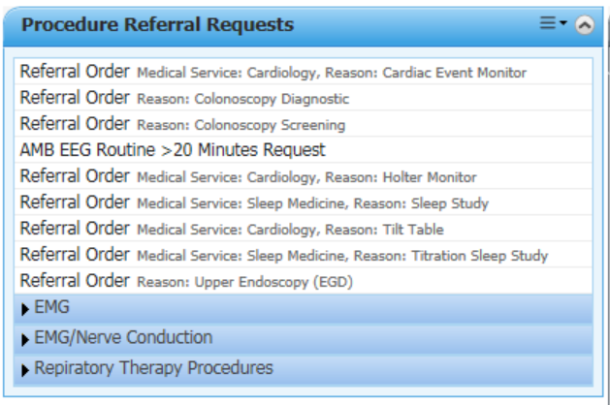
Procedural Referral orders:
  Referral orders are utilized in 2 ways
  Consultation for expert opinion
  Coordination of procedures to be done by consultant.
  (Examples: PFTs, Colonoscopy, EMG, etc)
  Most procedure requests have an associated referral order.
  Specific Information about the procedure should be indicated within instructions field associated with the procedure request.
  Primary Care has it’s own procedure referral request section. Pediatrics has them mixed in within their referrals.

Slide 12
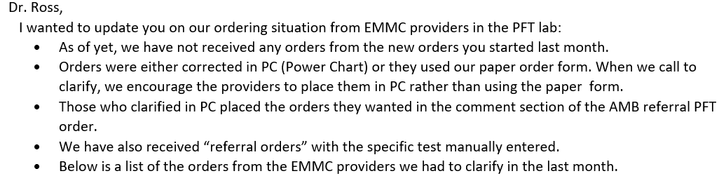
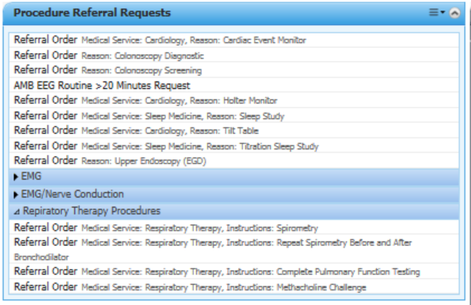
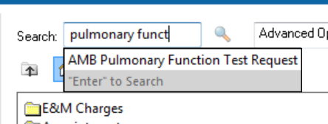

Example: Pulmonary Function Testing
Yes:
No:

Slide 13
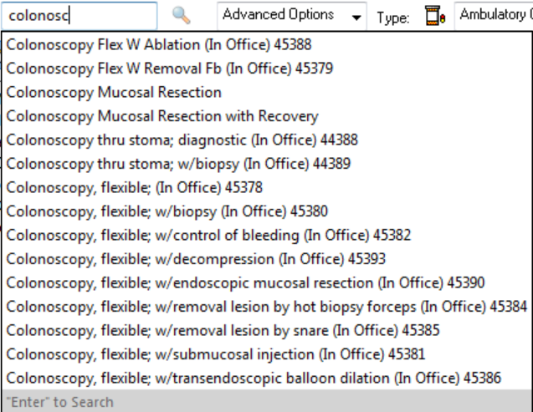
Remember: Avoid searching procedure names directly within Cerner
Cerner is a system-wide record.
Orders exist within the catalog that are specifically designed for multiple inpatient and practice operations.
Procedure orders within the catalog are designed for coordination between the proceduralist and the hospital.
Ordering these directly leads to confusion by the referral staff.
We should order them from the procedure request quickorders.

Slide 14
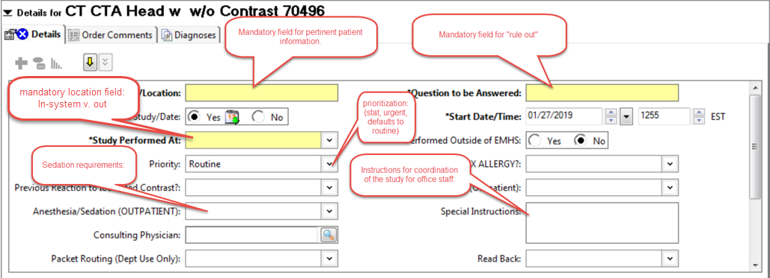
Ordering Fields Basics
Just like in Centricity: Yellow = Mandatory field.

Slide 15


Never change the default order to “No” for a future visit:
This will activate the order, and make it “in process”; this is akin to saying:
The blood has already been analyzed.
The X-ray has already been performed.
The Colon has been scoped.
The gallbladder has already been imaged.
I am Groot.
You get my drift.
Leave it alone.

Slide 16

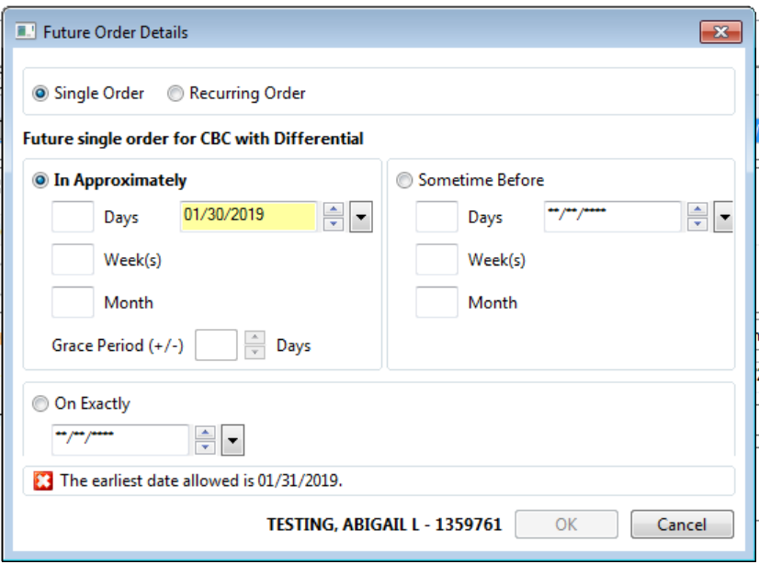
Future and repeat ordering:
Allows single and recurring orders to be placed following specific intervals
Approximate or specific times available
If you don’t specify a grace period, a grace period of +/- 7 days will be used by lab

Slide 17
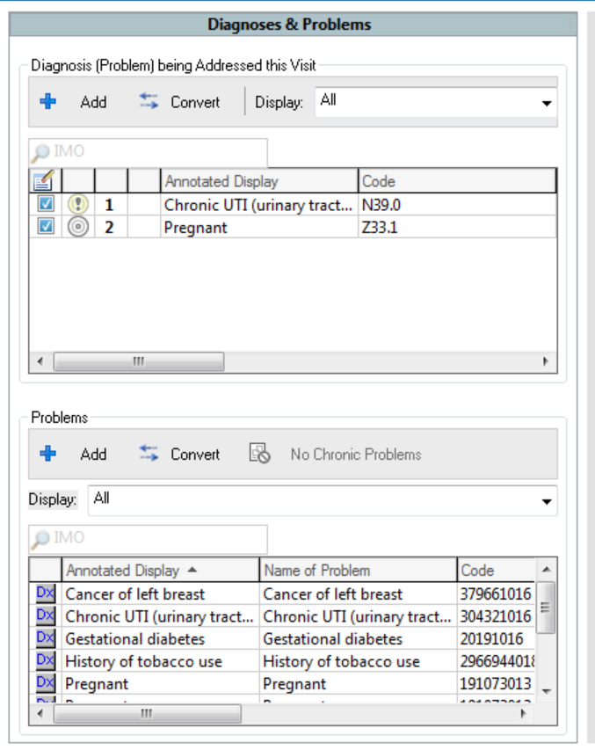
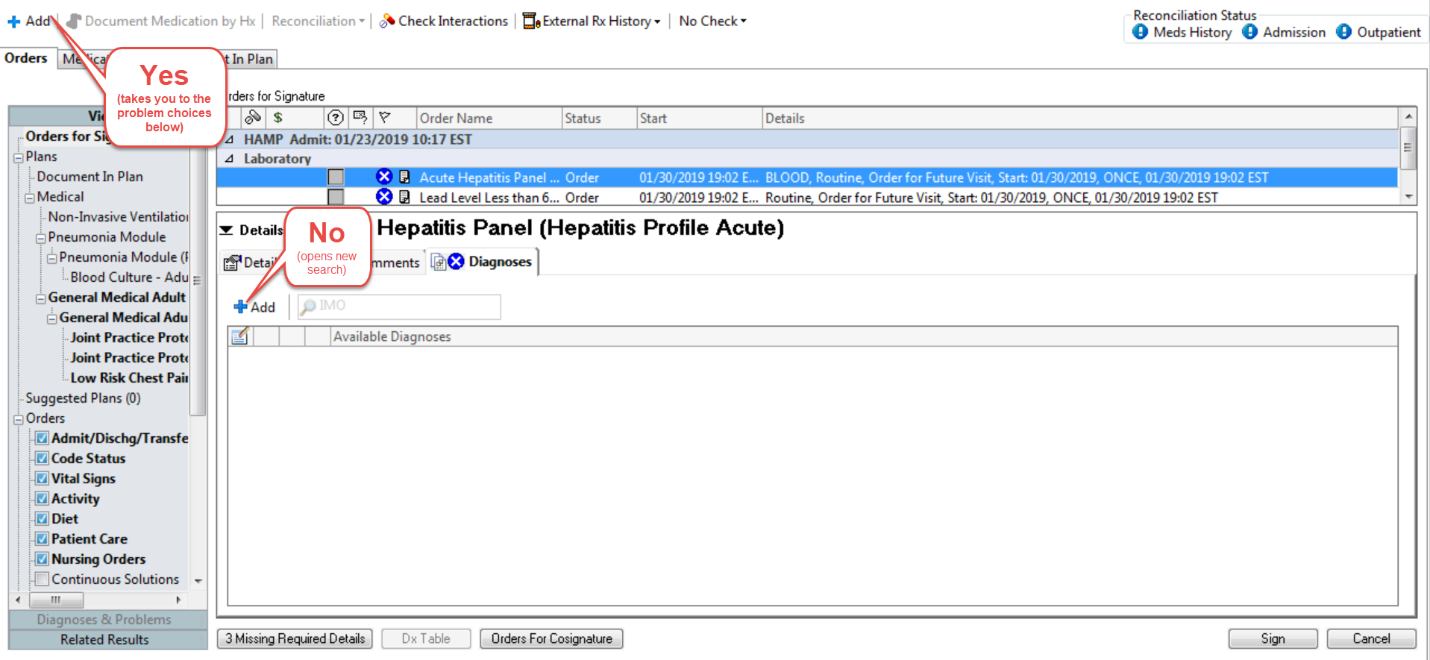
Where did the patient’s problem list go?

Slide 18
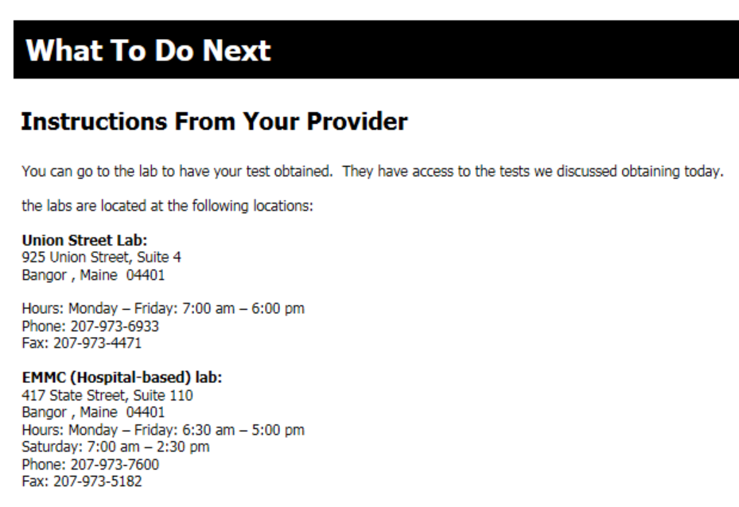
Printing orders: Discouraged
In general, we do not recommend you print your patient’s order requisitions(*).
We recommend you provide your patients a Patient Visit Summary, which lists the active orders available.
A lab autotext can be helpful: see my example
(*) – Labs drawn in an office lab do need to have a printed requisition accompany them with the courier.

Slide 19
Reviewing Orders already placed
    Best way to save ourselves work: don’t re-order labs already ordered:
    Orders are considered “Live and Actionable” throughout the system for a period of one year.
    Duplicate orders were common in Centricity because it was a closed system: The patient requisition was the “message” to the lab that orders were pending. If the patient never went to get labs/Radiology, orders were labs never received.
    All orders in Cerner are sent to the lab electronically. It behooves us all to review currently live orders within the chart before re-ordering to reduce phone calls from the lab regarding “which order to satisfy”.
    Work is being done with the lab to set expectations for Auto-decline duplicate lab orders.

Slide 20
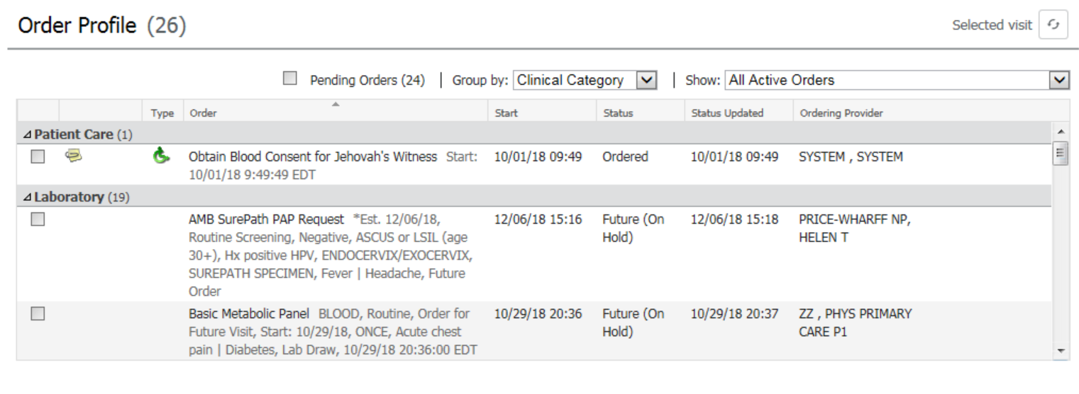
Using the Order Profile Component
    Review the Order profile prior to ordering labs/radiology.
    Orders that are already on the patient’s order profile do not need to be re-ordered; just direct the patient to the lab.
    Pearl: Referral orders won’t show up under active orders because they are considered “completed” by Cerner once the appointment has been scheduled. To check prior referrals, select

Slide 21
Protocols, Proposals, JPPs and PCPs

Slide 22
Provider v. Proposed v. Protocol Orders
Provider Order
  An order for a medical action to be performed, placed by a Provider.
  Example: CBC, Obtain a Strep Swab, X-ray, MRI of head
    Electronically Signed at the time of ordering.
    Considered Actionable as soon as it is placed.
    Performed by:
      Physician
      Nurse Practitioners
      Physician Assistants
Proposed Order
  A “pre-order” that requires a provider signature before it can be acted upon.
  Example: CBC, CMP, X-ray, CT Scans
    Requires a provider co-signature within 48 hours, or sooner if action is needed.
    Not live or actionable until co-signed.
    Performed by:
      Certified clerical
      MA
      LPN
      RN
Protocol Order
  An order that follows specific criteria, as written within an approved Joint Practice Protocol or Patient Care Protocol.
    Considered live and Actionable as soon as it is placed.
    Requires a provider co-signature within 48 hours.
    Limited to details/conditions within the applicable Joint Practice Protocol/Patient Care Protocol.
    Performed by:
      Certified clerical
      MA
      LPN
      RN

Slide 23
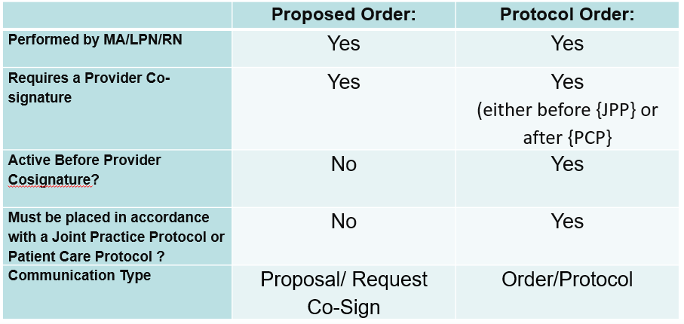
Proposed v. Protocol Orders

Slide 24
JPP v. PCP
Joint Practice Protocol (JPP)
  A licensed independent practitioner (LIP) signed list of prn orders which members of the clinical care team may initiate based on specific criteria.
    A Pre-Activated set of prn orders that can be used under specific circumstances.
    Requires a provider signature once yearly.
    Orders entered under a JPP are entered by MA as an order via the “protocol” communication type, and are actionable immediately.
    Extensive adoption in Centricity.
    Formal vetting process before use.
Patient Care Protocol (PCP)
  A protocol for the care of a specific patient condition or situation which designates the actions members of clinical care team may take based on specific criteria. The protocol may designate the clinical staff and orders that can be entered in a “Protocol” Ordering mode.
    Orders placed under a PCP are entered as an order via “need co-signature” communication type, and are actionable immediately.
    Orders require a provider signature, which can be within a 48 hour time period.
    Formal vetting process before use.

Slide 25
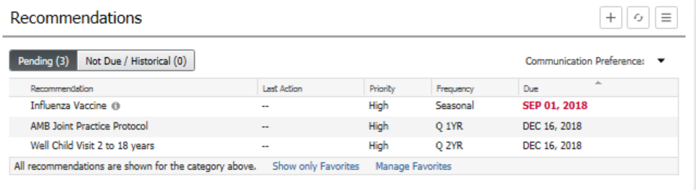
JPP and the Recommendations Component
If the JPP has not been signed, it will be available to be ordered:
Select to order

Slide 26
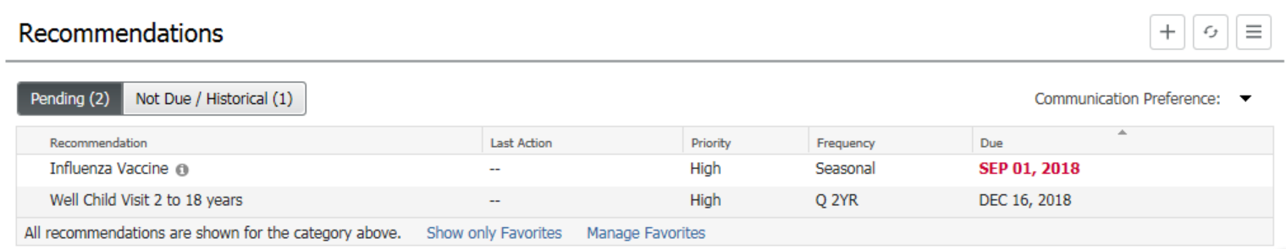
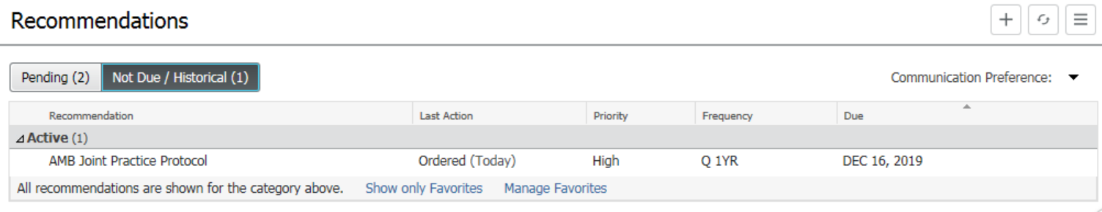
JPP and the Recommendations Component
JPP Absence means it has been ordered
Will be visible in Historical recommendations

Slide 27
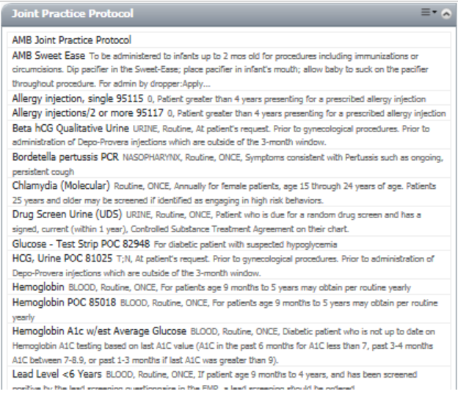
JPP and the Recommendations Component
Powerplan reference
Once placed, JPP orders available on Quick-order M-Page
Available
Orderables

Slide 28
Clinical Examples: Protocol Cases: Tools for Team Based Care

Slide 29
Scenario #1: Protocol Order
Frank presents to the Pediatrician’s office with his 8 year old son (Frank Jr.) who has a Sore Throat, abdominal pain, fever and headache, without cough/coryzal symptoms.
Upon recognizing the presentation as aligning with the Joint Practice Protocol, the Medical Assistant obtains a Rapid Strep swab, and runs the in-office strep test. The MA documents a negative Rapid strep, and places a protocol order for the follow-up throat culture. She sends the culture to the lab.
The Provider examines the patient, provides a preliminary diagnosis of a suspected viral pharyngitis, and discharges the patient home.

Slide 30
Scenario #2: Proposed Order
Frank Jr.’s Strep Culture returns positive. An office RN is notified of the positive culture result via the message center pool.
The RN reviews the patient’s allergies, and their listed pharmacy preference. Having worked for years with the provider, they know the provider will order amoxicillin for the positive strep culture. They propose this medication to the provider.
The provider checks the accurate dose, confirms that the patient is not allergic to the medication, and signs the proposed order. Upon signature, the amoxicillin is electronically sent to the pharmacy.
Frank Sr. is notified by the office via the Portal that his son’s Strep Culture has turned positive, and that an Amoxicillin prescription is waiting for him at the pharmacy.

Slide 31
Documentation Tools

Slide 32
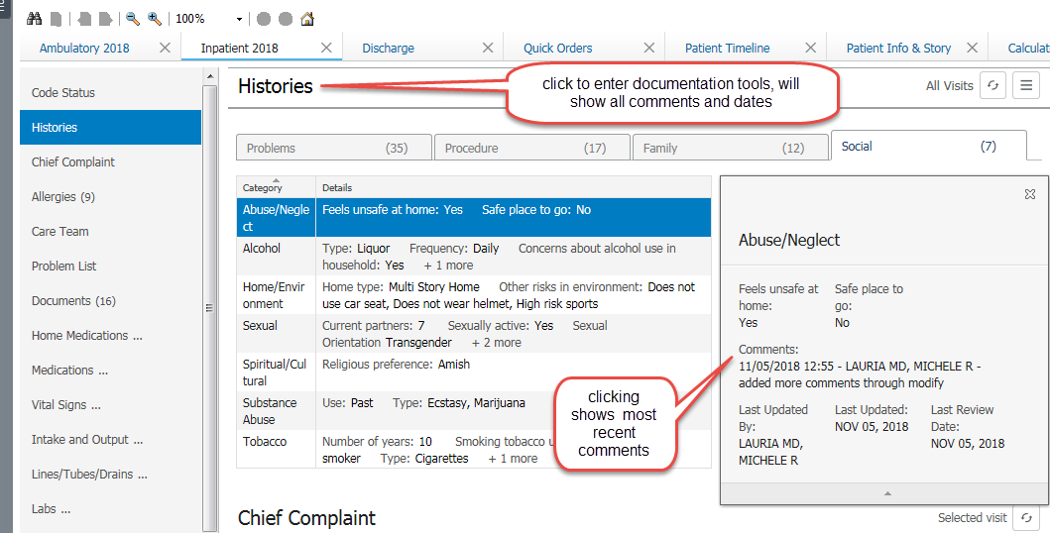
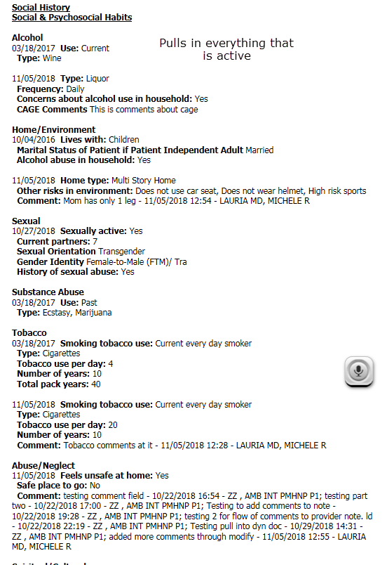
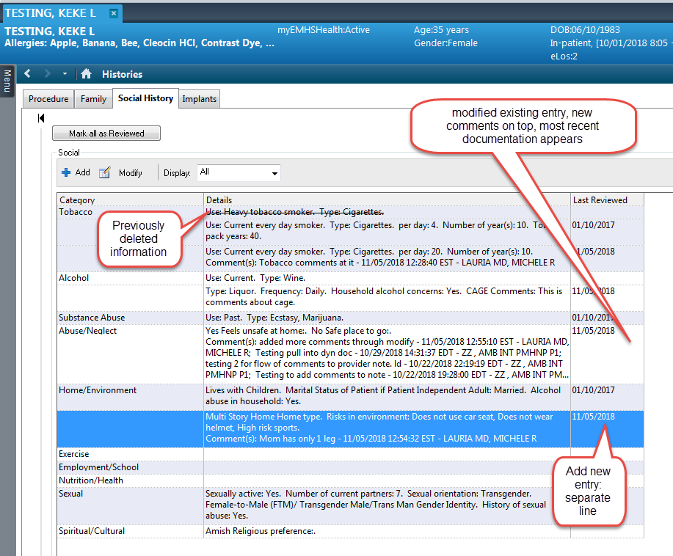
Social History
You can view current social history in the WF MPage: click a row to expand
To document click “Histories”
  If social is open in the MPage, you land in social in the tool
Modify updates an existing entry
Add creates a new entry
You can choose to view “all” or “active” entries
Recommend:
“Mark as Reviewed“ if nothing is changed. Date on line updates
“Modify” to update small items
“Add” if major changes, legacy tool retired.

Slide 33
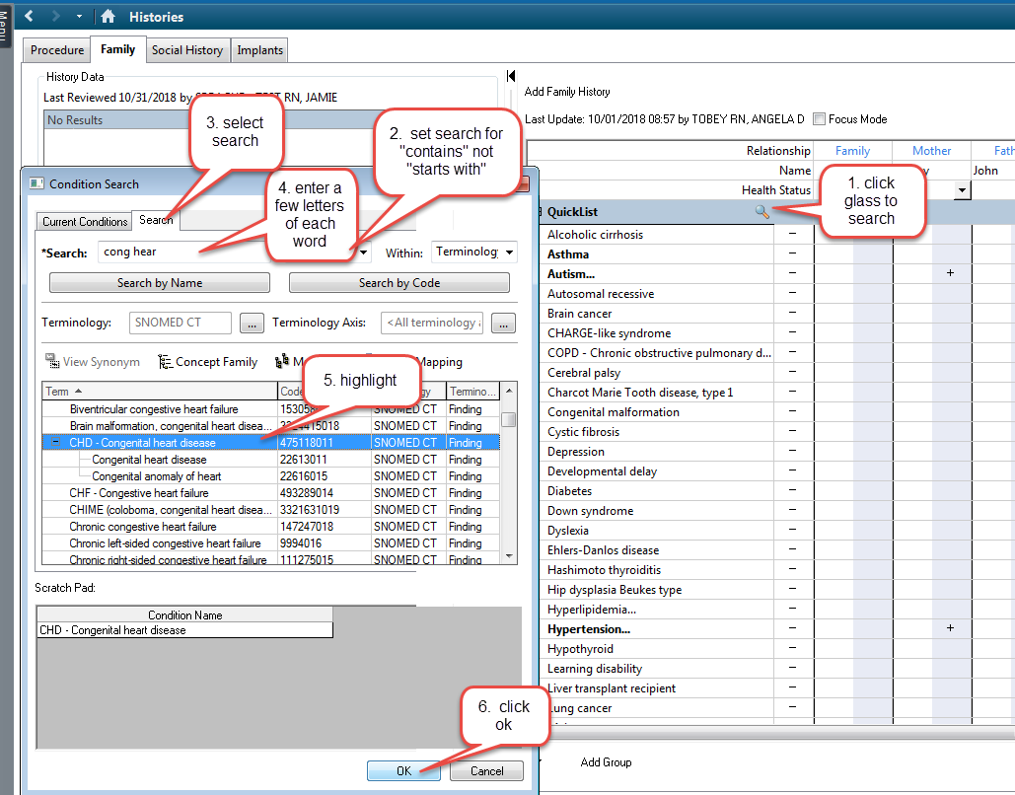
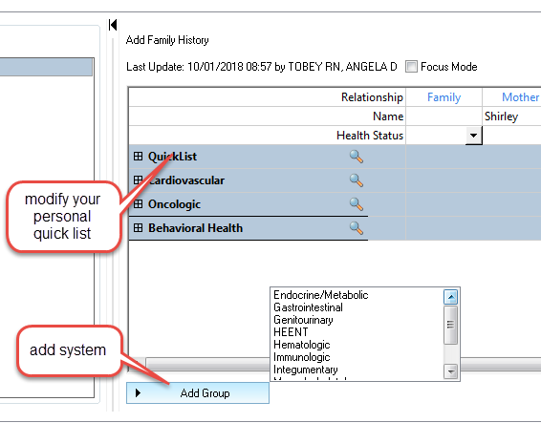
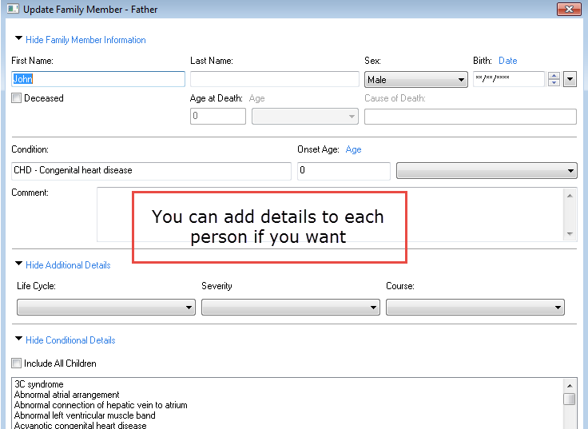
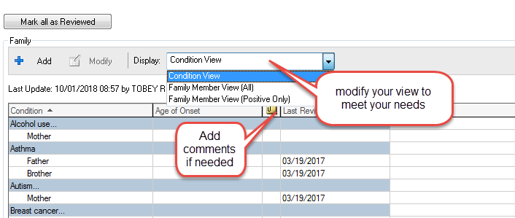
Family History
Select the system lists that make sense for you
Add to your quick list: Unique to you
Never select all negative, populates every field
Select system lists

Slide 34
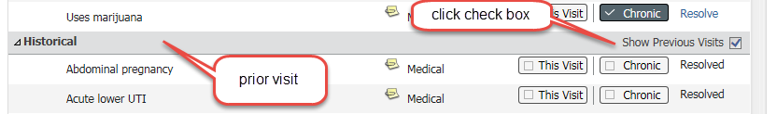
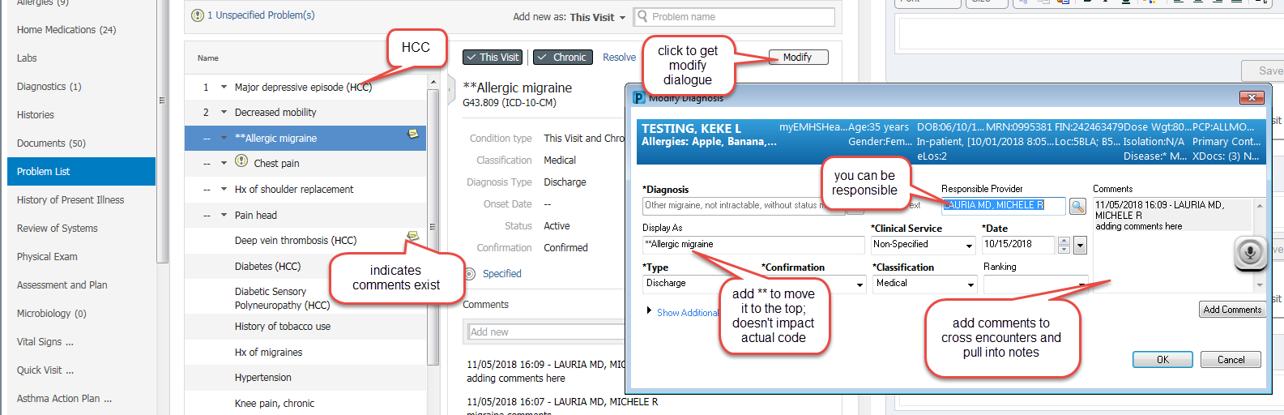
Problem List
“This visit”: specific to an encounter, can be associated with orders
  Displays in order selected
  Can reorder with drop downs
“Chronic”: Diagnoses which cross encounters
  Problems display alphabetically
Comments: if entered with “chronic “selected will cross encounters and displays in notes
Un checking “this visit” and “chronic” removes items from the list
  To restore, click historic at the bottom of the pane
  You will see every problem & diagnosis with comments preserved

Slide 35
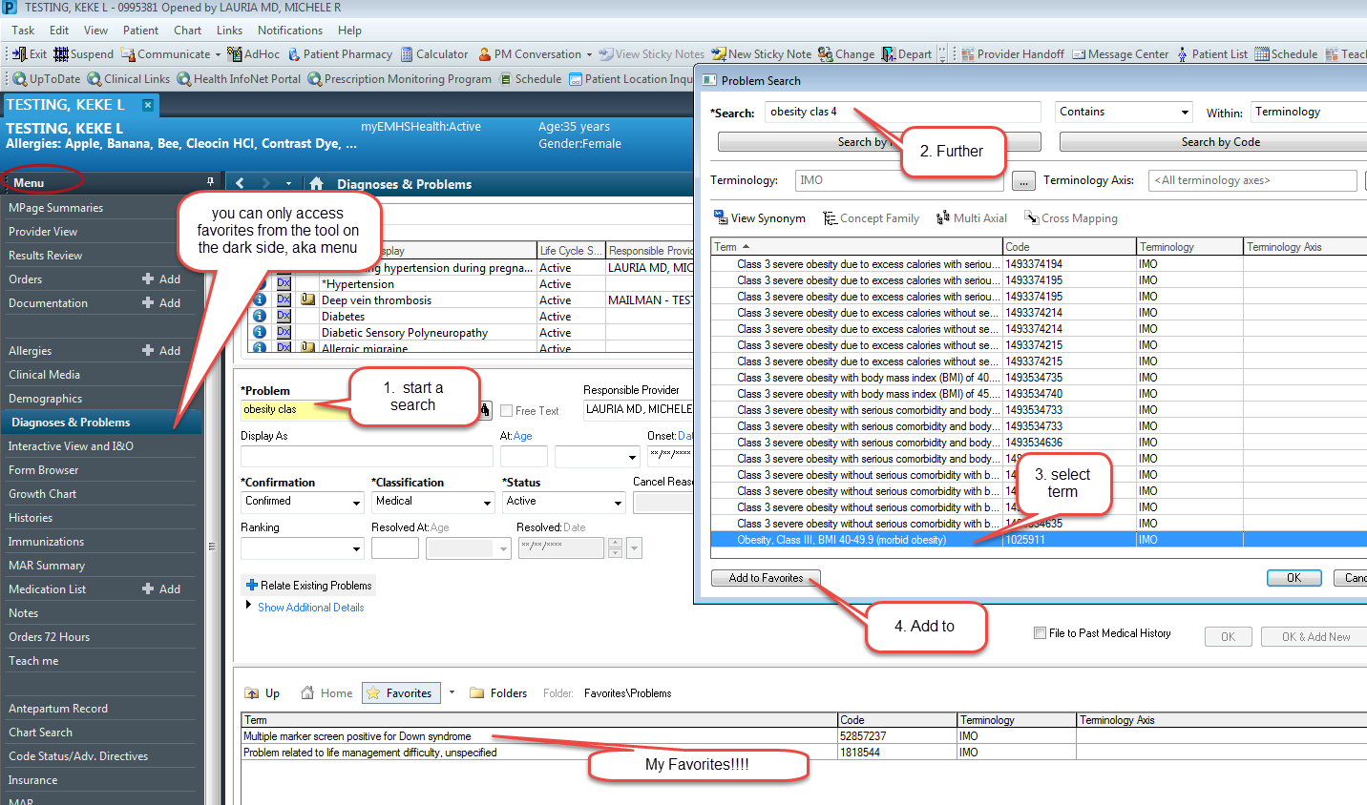
Problem List Favorites
Can’t be done in MPages
Useful for common items
Difficult to find items
Can add comments
Can change display names
My Favorites!!!!

Slide 36
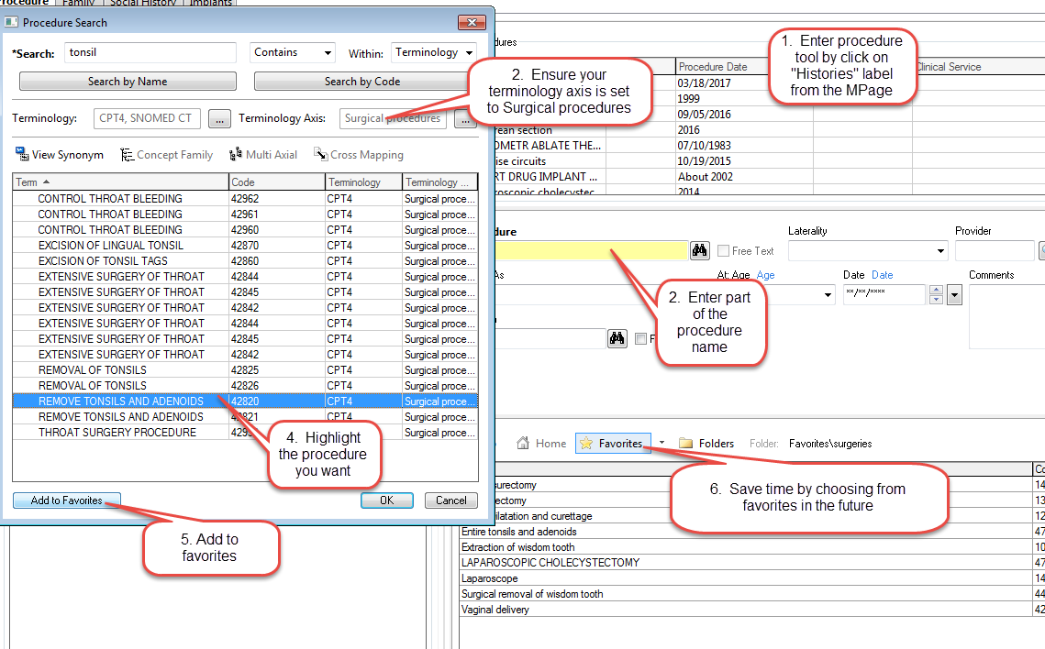
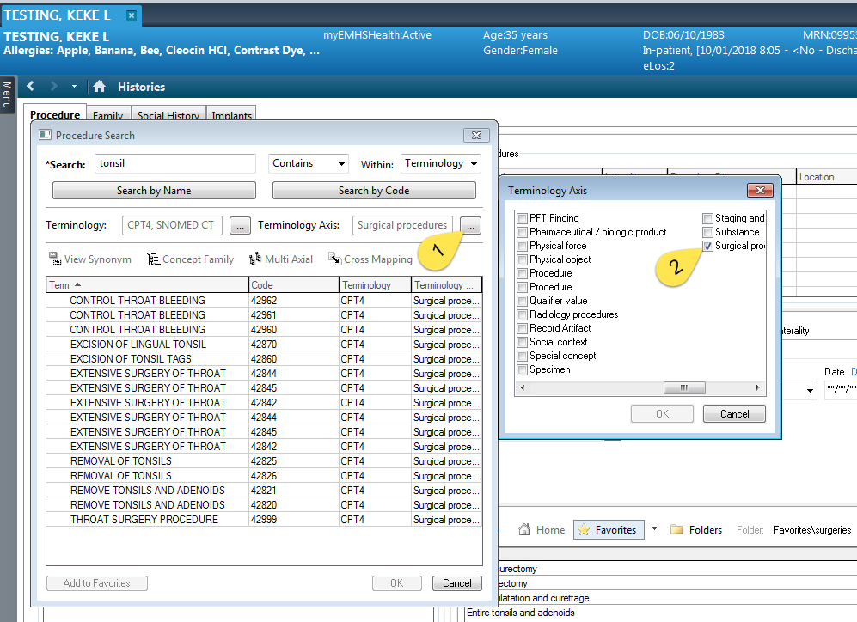
Procedure History
Set your terminology axis to Surgical Procedures
Save common procedures as a favorite
Default your display to show favorites by clicking the star then exit

Slide 37
Survey results: Pre-Education, Dec 20, 2018 (Baseline)
 | Comfortable | Moderately Comfortable | Not Comfortable
PowerChart Structure:
I have organized my MPages and their components , and removed components I don’t use | 2 | 8 | 5
I know how to set up the contextual view (documentation on the right) | 5 | 6 | 4
I know how to change filters on the various M-page components | 2 | 3 | 11
I can accurately identify the banner bar, tool bars, table of contents (dark side), and MPage menu. | 7 | 7 | 1
I know the benefits of using the Workflow M-Page instead of going back/forth to the “Dark Side” | 2 | 9 | 4
I have configured my toolbars to meet my needs | 2 | 8 | 5
Note Creation:
I know the difference between the workflow M-page and a Note | 7 | 3 | 5
I am comfortable moving back and forth between the workflow M-page and the note without fear of losing work. | 2 | 4 | 9
I know how to use system auto-text for documenting (/) | 7 | 5 | 3
I have created personal auto-text (.) | 8 | 4 | 3
I have made a shortcut to pull nursing documentation into my note | 3 |  | 12
I have created auto-text that includes Smart Templates | 3 | 4 | 7
I know how to alter the title of a note | 5 | 3 | 6
 | Comfortable | Moderately Comfortable | Not Comfortable
Documentation Tools:
I know the difference between a diagnosis and a problem | 3 | 4 | 8
I know how to maintain a current problems list | 3 | 5 | 7
I know how to mark in error a problem on the patient’s problem list so it will no longer be part of their chart. |  | 4 | 11
I know how to free-text (Centricity-like) comments to the Family History, Social History, and Problems |  | 2 | 13
I have added items to the Family History Quick Selection section | 1 | 5 | 9
I know how to update the Social History through modify and add | 2 | 4 | 9
Message Center:
I have assigned proxies in my message center to my partners | 8 | 6 | 1
I have set up messaging favorites for pools and colleagues | 5 | 6 | 4
I know when and how to use between the visit encounters | 2 | 5 | 8
I have set up my between-the-visit encounter locations | 2 | 1 | 12
Ordering:
I have created favorites on my quick orders pages | 2 | 3 | 10
I know how to “borrow” someone else’s quick orders folder favorites so I can use them. |  |  | 15
I routinely use Quick Orders and make use of Order Sentences | 1 | 1 | 13
MModal:
I routine use MModal | 5 | 3 | 5
I have created commands to insert text | 1 | 3 | 8
I know how to use the next field button and command | 1 | 2 | 9
I know how to create auto-text that are MModal optimized | 1 | 1 | 10

Slide 38
Survey results: 2 Educational Sessions, Jan 28, 2019
 | Comfortable | Moderately Comfortable | Not Comfortable
PowerChart Structure:
I have organized my MPages and their components , and removed components I don’t use | 10 | 6 | 5
I know how to set up the contextual view (documentation on the right) | 13 | 5 | 2
I know how to change filters on the various M-page components | 6 | 6 | 5
I can accurately identify the banner bar, tool bars, table of contents (dark side), and MPage menu. | 14 | 6
I know the benefits of using the Workflow M-Page instead of going back/forth to the “Dark Side” | 10 | 6 | 3
I have configured my toolbars to meet my needs | 10 | 8 | 3
I know how to access the CCD | 7 | 8 | 4
Note Creation:
I know the difference between the workflow M-page and a Note | 12 | 5 | 2
I am comfortable moving back and forth between the workflow M-page and the note without fear of losing work. | 9 | 5 | 5
I know how to use system auto-text for documenting (/) | 14 | 5 | 1
I have created personal auto-text (.) | 16 | 2 | 2
I have made a shortcut to pull nursing documentation into my note | 7 | 6 | 7
I have created auto-text that includes Smart Templates | 5 | 3 | 12
I know how to alter the title of a note | 14 | 3 | 2
 | Comfortable | Moderately Comfortable | Not Comfortable
Documentation Tools:
I know the difference between a diagnosis and a problem | 7 | 6 | 7
I know how to maintain a current problems list | 9 | 7 | 5
I know how to mark in error a problem on the patient’s problem list so it will no longer be part of their chart. | 6 | 7 | 7
I know how to free-text (Centricity-like) comments to the Family History, Social History, and Problems | 6 | 3 | 9
I have added items to the Family History Quick Selection section | 6 | 4 | 9
I know how to update the Social History through modify and add | 6 | 3 | 11
Message Center:
I have assigned proxies in my message center to my partners | 14 | 5 | 1
I have set up messaging favorites for pools and colleagues | 12 | 3 | 3
I know when and how to use between the visit encounters | 9 | 9 | 2
I have set up my between-the-visit encounter locations | 6 | 4 | 9
I feel comfortable using the reply and delete buttons without fear of losing documentation | 13 | 5 | 2
I know the difference between co-signature and proposed orders | 10 | 2 | 6
I know how to use the trash and sent items to review old messages | 13 | 3 | 4
I know when to use the in-between encounter workflow | 7 | 9 | 5
I know how to use the message journal to track down a message | 6 | 11 | 3
I know how to send a reminder to my message center | 13 | 3 | 3
I know how to send a reminder to the patient’s chart (pop-up) | 9 | 6 | 4
I know the difference between messages and documents, and understand the lifespan of a message | 10 | 6 | 5
MModal:
I routine use MModal
I have created commands to insert text | 4 | 3 | 13
I know how to use the next field button and command | 4 | 4 | 12
I know how to create auto-text that are MModal optimized | 2 | 3 | 14
Ordering:
I have created favorites on my quick orders pages | 5 | 8 | 7
I know how to “borrow” someone else’s quick orders folder favorites so I can use them. | 2 | 3 | 15
I routinely use Quick Orders and make use of Order Sentences | 6 | 4 | 11

