Slide 1
Provider Cerner Education Session 2
Eastern Maine Medical Center
Dr. Michael Ross

Slide 2
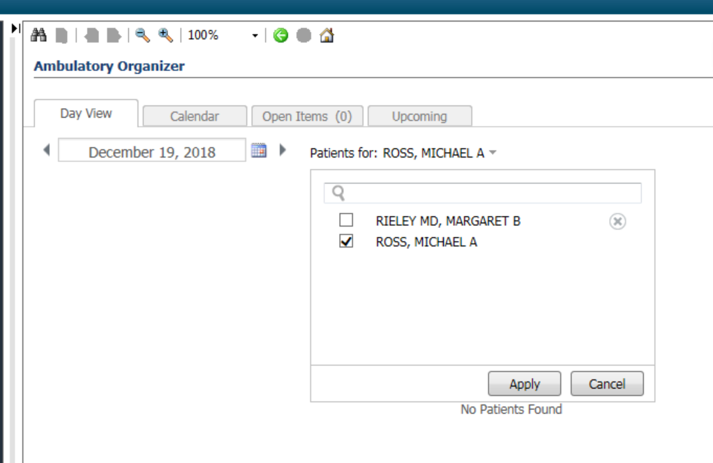
Test Patients for use:
Go to Ambulatory organizer/Home
Search for Ross,Michael in the calendar; you will see my calendar for today filled with test patients.
Pick a test patient from the schedule for use today.
We will use this as a source of Test patient’s with Ambulatory encounters for future sessions as well.

Slide 3
Overview:
Topics to be address today:
Message Center: In Depth setup and workflow review
Centricity CCD use in practice

Slide 4
Message Center:

Slide 5
Message Center Overview
Inbox Summary: Access any message or result in the Message Center. Message Center notifications are divided into categories or folders; the number adjacent to the category name indicates the number of Inbox items in that category that are unread.
Summary Pane: lists the individual Inbox items (messages, documents and so forth) contained in the folders in the Inbox Summary. Double-clicking an Inbox item in the Summary Pane opens the workspace for that item.
Message Center users have the ability to sort the view by each column.

Slide 6
Suggested User Preferences:

Slide 7
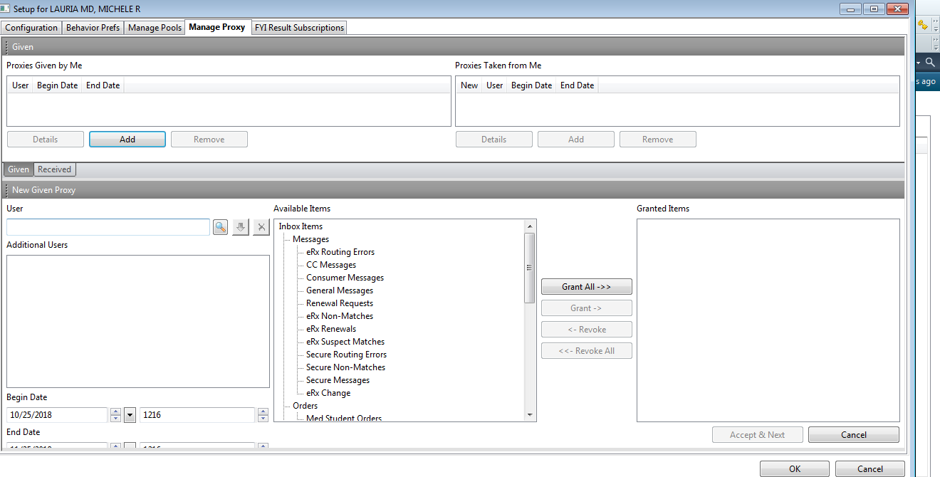
Mastering Message Center: Functions and Proxies
Click add, then control what your proxies can do
Users are still appropriately limited by their privileges

Slide 8
Preferences
Consider selecting default delete/complete checkbox

Slide 9
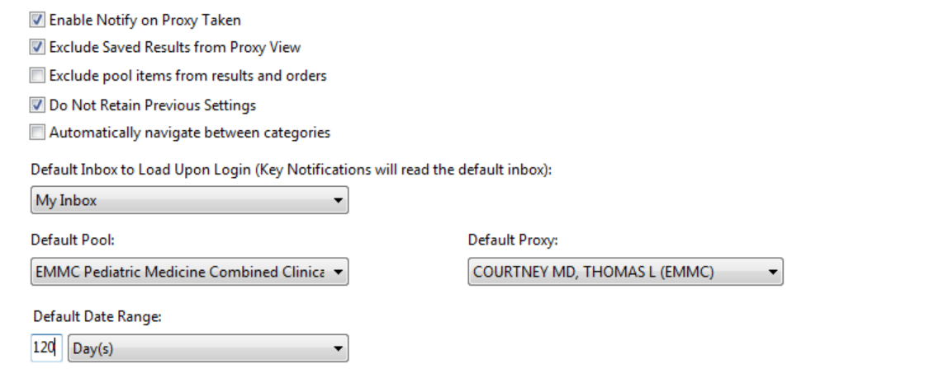
Preferences
If you set to the combined clinical pool, you will see all Portal messages to the office.
Set to the individual you most commonly cover/supervise in the office
Consider setting if you perform more supervisory role than patient care

Slide 10
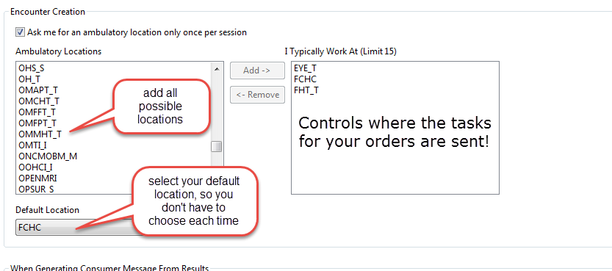
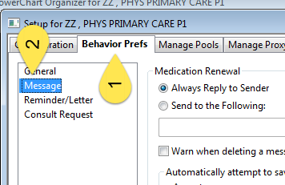
Setting between encounter location for orders:
Choose all possible encounter locations
Set a default location
Choose inbox & manage config
Controls where order related tasks go (i.e. scheduling within your office)

Slide 11
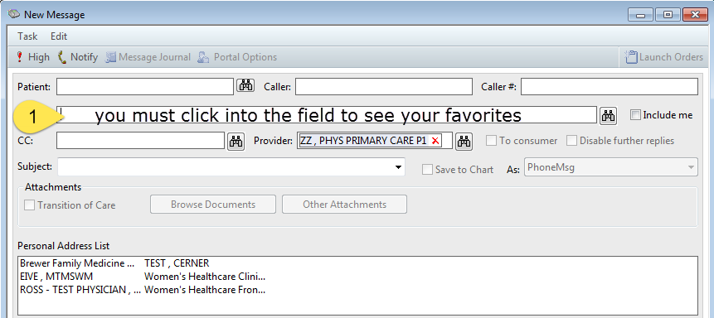
Selecting Favorite Pools
To see your favorites: pools and people mixed
Open Message Center, click binoculars
Search for the pool, in sequence, right click to add
Removing a favorited pool

Slide 12
Inbox Items: General
Documents: Chart elements to be saved or already scanned, pending review/signature into chart.
Orders: Orders requiring signature, either ones that have already been acted upon via a Patient Care Protocol, or proposed orders that require your signature to become activated.
Messages: Intra-office or intra-system communication that is not yet fully part of the chart. Always converted to a document and incorporated into the chart.
Results: Directly interfaced information that flows from lab and radiology through Cerner to you for your review and action

Slide 13
Work Items and Navigation
Saved Documents: Documents in process, for later completion.
Reminders: Content sent to prompt action for the future: Sendable from both within the M-page, as well as within messaging. Can be attached to the chart or to the message Center. Can be sent to different members of the healthcare Team.
Consultant Orders: Specialist use.
Sent Items: Items already sent from your Message Center to others. Useful for tracking old conversations.
Trash: Items you have already addressed; mentally rename as “committed/saved to the chart”. Also useful for tracking old conversations.
Notify Receipts: Message Receipt ability.

Slide 14
Documents Section
Purpose: Provider Review of content that has already been committed to the patient’s medical record or is in need of provider review.
Examples
Scanned documents pending signature.
Results that are not directly interfaced (i.e. results that are scanned).
Outside records.
Forwarded completed notes from the patient’s chart.
Forwarded committed messages from the patient’s chart.

Slide 15
Signing/refusing vs. Communicating
The bottom toolbar (action pane) is for Provider action on the status of the document in front of you: to sign or refuse the document.
Do not use this to send results to non-providers for action
The top Communicate button is for communication to the patient, within the office, or via letter:

Slide 16
Example
Sign or refuse the content
Forwarding only to act on refusal, not for staff action.

Slide 17
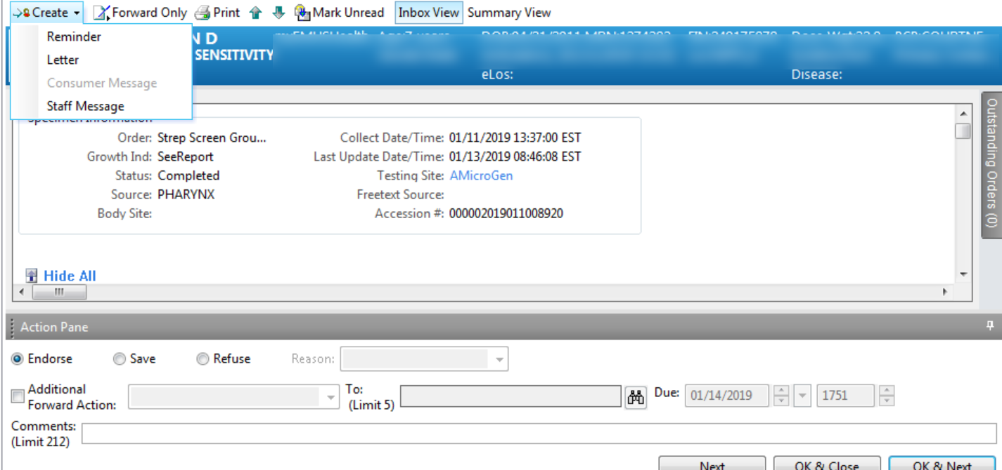
Results
Contains all interfaced content sent to the system.
Scanned results are not included. They are in the Documents section.
How we communicate the result to the patient.
Where providers acknowledge receipt of the result.

Slide 18
Staff/Consumer Message
Patient results are included in the forwarded message to staff/patient.
Type additional notes for communication in the message body.
You can send a reminder regarding the result back to you or others using the reminder function.

Slide 19
Messages: More complex than anticipated
Lifecycle of a Message
Created > Replied/Forwarded > Replied ( n times) > DELETED > turns into a Chart Document
All messages connected to a patient name are always saved to the chart as a chart document. Major difference between flags and messages.
Delete: Removes the message from your desktop. Mentally rename this button “remove” because that is more accurate about what it does. If you’re done with the message and don’t wish to add any more content to the message, you remove it by Deleting it.
Append: Anything you type into a message before hitting reply will be added to the message, and turn on the append button. Think of append as “sending to the chart”. Use Append if you want to time/date stamp when you reviewed an action, kind of how you would use .sign and send in Centricity.

Slide 20
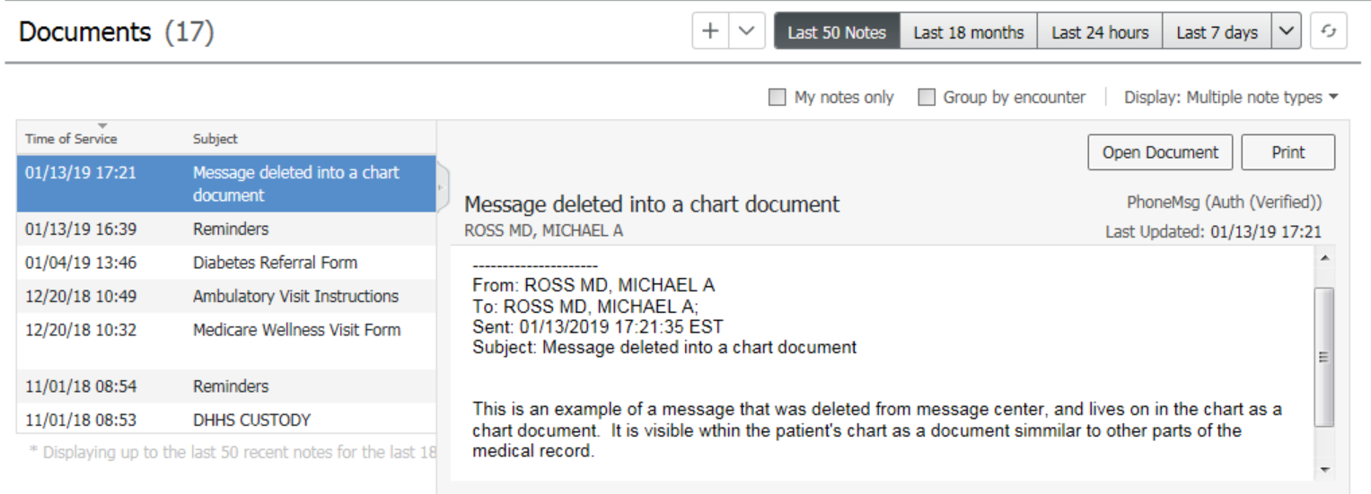
Prior Message, once converted to a document:
Once deleted, messages show up as documents

Slide 21
What if we ended the message too soon?
If you DELETED (REMOVED) a message by mistake, it will be in the Trash.
If you SENT it and want to see what happened to it, you can retrieve it from Sent items.
In both instances, you can revive the Message by creating a new Message/Reminder from the old one.

Slide 22
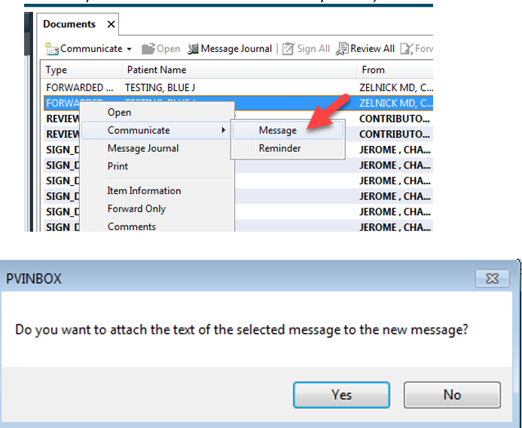
Forwarding from Sent/Trash
To Forward/send the Document to yourself or others, right click. This turns the Document back into a Message containing the Document information.

Slide 23
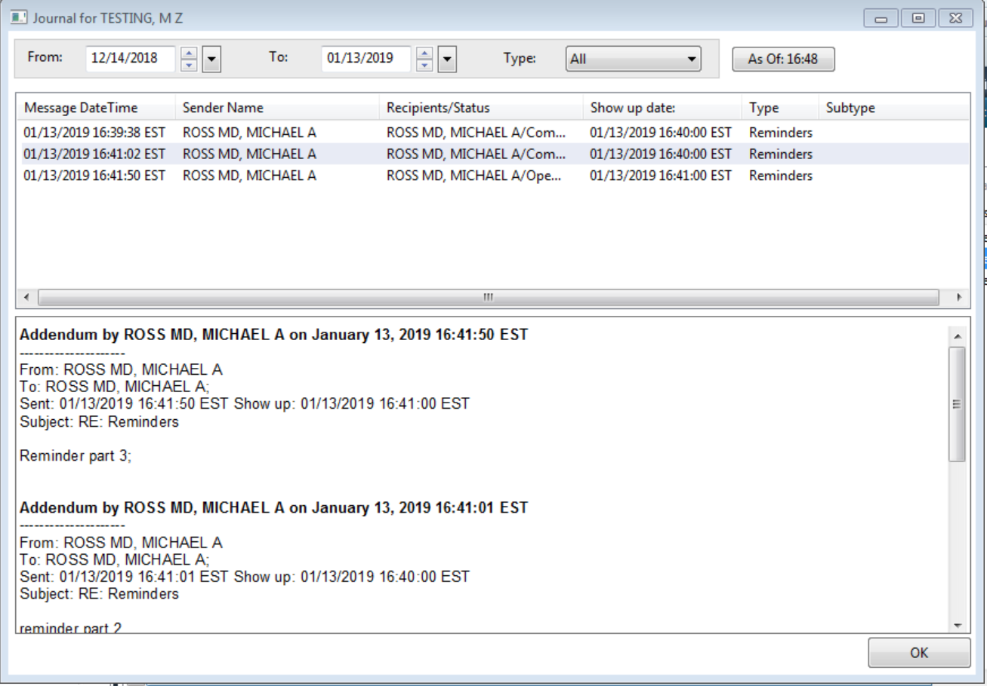
Message Journal
The message Journal can be used to determine if a message already exists in a patient’s chart, or can track responses on a message stream.

Slide 24
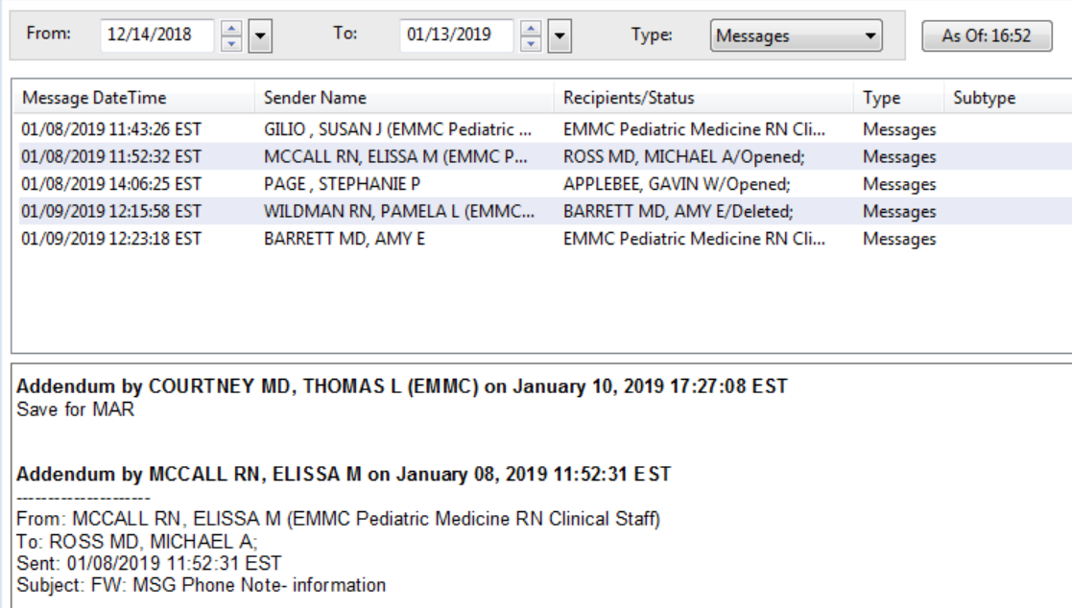
Message Journal
When in a message, the message journal shows existing message streams within the patient’s chart available for review:

Slide 25
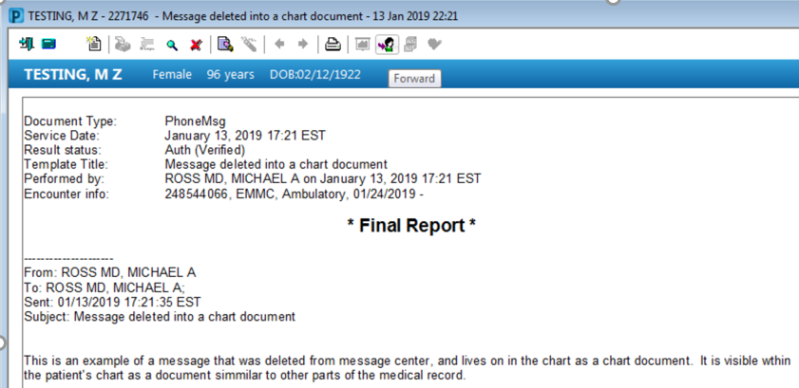
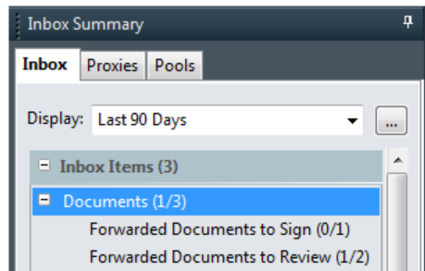
What if additional content needs to be added to a chart document without access?
Whenever possible, staff to start a new message.
If this is not feasible, staff can modify and forward chart documents, but this will be sent to the documents of message center.

Slide 26
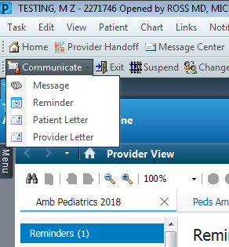
Reminders:
Both launch a reminder message
Designed to be used as electronic prompts for patient care or for chart notification of completed activities.
Launchable from the reminders component or from the Message Center.
Adjustable date and adjustable time when due.
Default reminder is to the recipient’s inbox (message center).
Can also create within the chart as a pop-up.
Demo:
Select if a chart pop-up or a message reminder

Slide 27
In-Between Encounter Workflow:

Slide 28
What is an in-between encounter?
Cerner is encounter-based: Every potential action that could lead to an associated charge must be associated with an encounter.
This is a fundamental part of the system, and harkens back to it’s initial focus as a hospital-based product. It is also associated with the way Cerner sends information to the right staff for further processing of work (referral coordination, pre-authoriazation, image scheduling, etc)

Slide 29
Workflow:
Office staff answering phones should generally start an in-between encounter when creating the message center note.
Unless providers are starting the phone note ourselves, we generally don’t need to start an in-between encounter.
In situations where no in-between encounter was started, the orders will default to the last encounter.
There are warnings that can prevent orders from being placed on some encounters (Lab, Rad), but not other office visits.
Pearls:
New Medications or refills never need an in-between encounter.
Referrals, imaging, or labs obtained between patient visits should be placed on an in-between encounter.
You can check the type of encounter you are in via the toolbar.

Slide 30
Creating an In-Between Encounter:

Slide 31
Utilizing the CCD to the fullest capacity:

Slide 32
Clinical Care Document:
2 Types of CCDs:
“General” CCD: Summary of the patient Centricity chart
“PAMI Gap” CCD: Summary of the content from the date of the base CCD to the Gap.
Contains a direct copy of content from the Patient’s Centricity record:
Allergies
Medications
Codified Family History
Codified Social History
Every problem Assessments ever made

Slide 33
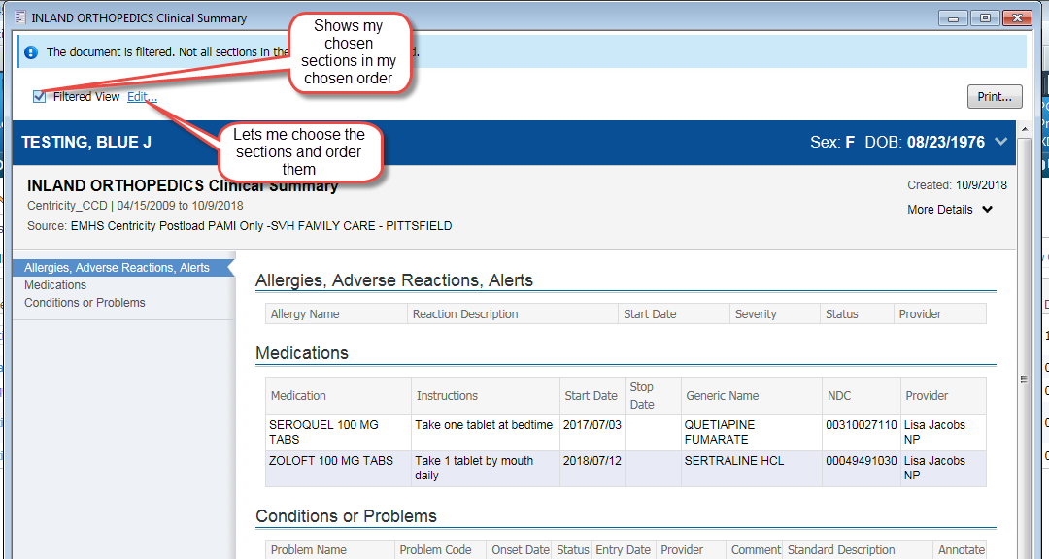
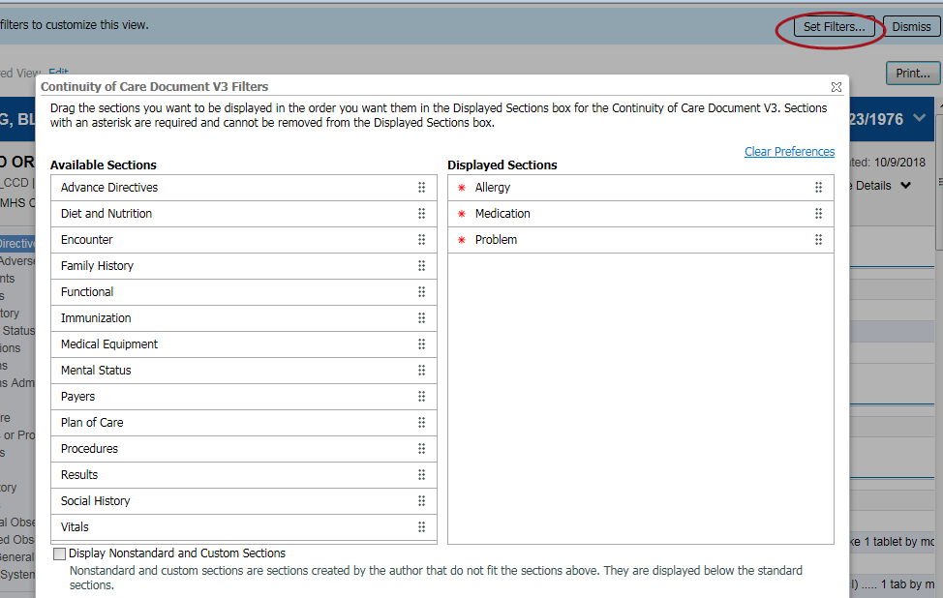
CCD – Personalizing your view
Drag and drop sections

Slide 34
Centricity Assessments in Cerner

Slide 35
Example of shortcut + cut-paste with Centricity patient follow-up:
Create an “assessment” shortcut.
Use in concert with your “hpi_intake” shortcut
Paste the last assessment from the CCD into the HPI
Consider italicizing the text for easier review

Slide 36
 | Comfortable | Moderately Comfortable | Not Comfortable
PowerChart Structure:
I have organized my MPages and their components , and removed components I don’t use | 2 | 8 | 5
I know how to set up the contextual view (documentation on the right) | 5 | 6 | 4
I know how to change filters on the various M-page components | 2 | 3 | 11
I can accurately identify the banner bar, tool bars, table of contents (dark side), and MPage menu. | 7 | 7 | 1
I know the benefits of using the Workflow M-Page instead of going back/forth to the “Dark Side” | 2 | 9 | 4
I have configured my toolbars to meet my needs | 2 | 8 | 5
Note Creation:
I know the difference between the workflow M-page and a Note | 7 | 3 | 5
I am comfortable moving back and forth between the workflow M-page and the note without fear of losing work. | 2 | 4 | 9
I know how to use system auto-text for documenting (/) | 7 | 5 | 3
I have created personal auto-text (.) | 8 | 4 | 3
I have made a shortcut to pull nursing documentation into my note | 3 |  | 12
I have created auto-text that includes Smart Templates | 3 | 4 | 7
I know how to alter the title of a note | 5 | 3 | 6
 | Comfortable | Moderately Comfortable | Not Comfortable
Documentation Tools:
I know the difference between a diagnosis and a problem | 3 | 4 | 8
I know how to maintain a current problems list | 3 | 5 | 7
I know how to mark in error a problem on the patient’s problem list so it will no longer be part of their chart. |  | 4 | 11
I know how to free-text (Centricity-like) comments to the Family History, Social History, and Problems |  | 2 | 13
I have added items to the Family History Quick Selection section | 1 | 5 | 9
I know how to update the Social History through modify and add | 2 | 4 | 9
Message Center:
I have assigned proxies in my message center to my partners | 8 | 6 | 1
I have set up messaging favorites for pools and colleagues | 5 | 6 | 4
I know when and how to use between the visit encounters | 2 | 5 | 8
I have set up my between-the-visit encounter locations | 2 | 1 | 12
Ordering:
I have created favorites on my quick orders pages | 2 | 3 | 10
I know how to “borrow” someone else’s quick orders folder favorites so I can use them. |  |  | 15
I routinely use Quick Orders and make use of Order Sentences | 1 | 1 | 13
MModal:
I routine use MModal | 5 | 3 | 5
I have created commands to insert text | 1 | 3 | 8
I know how to use the next field button and command | 1 | 2 | 9
I know how to create auto-text that are MModal optimized | 1 | 1 | 10

Slide 37
 | Comfortable | Moderately Comfortable | Not Comfortable
PowerChart Structure:
I have organized my MPages and their components , and removed components I don’t use | 5 | 4 | 4
I know how to set up the contextual view (documentation on the right) | 7 | 2 | 4
I know how to change filters on the various M-page components | 3 | 4 | 6
I can accurately identify the banner bar, tool bars, table of contents (dark side), and MPage menu. | 9 | 3 | 1
I know the benefits of using the Workflow M-Page instead of going back/forth to the “Dark Side” | 7 | 3 | 3
I have configured my toolbars to meet my needs | 3 | 6 | 4
Note Creation:
I know the difference between the workflow M-page and a Note | 10 | 2 | 1
I am comfortable moving back and forth between the workflow M-page and the note without fear of losing work. | 5 | 7 | 1
I know how to use system auto-text for documenting (/) | 10 | 1 | 2
I have created personal auto-text (.) | 11 |  | 2
I have made a shortcut to pull nursing documentation into my note | 1 | 3 | 9
I have created auto-text that includes Smart Templates | 3 | 2 | 8
I know how to alter the title of a note | 9 | 2 | 2
 | Comfortable | Moderately Comfortable | Not Comfortable
Documentation Tools:
I know the difference between a diagnosis and a problem | 8 | 1 | 4
I know how to maintain a current problems list | 8 | 3 | 2
I know how to mark in error a problem on the patient’s problem list so it will no longer be part of their chart. | 2 | 2 | 9
I know how to free-text (Centricity-like) comments to the Family History, Social History, and Problems |  | 1 | 12
I have added items to the Family History Quick Selection section | 2 | 2 | 9
I know how to update the Social History through modify and add |  | 4 | 9
Message Center:
I have assigned proxies in my message center to my partners | 9 | 2 | 1
I have set up messaging favorites for pools and colleagues | 6 | 2 | 4
I know when and how to use between the visit encounters | 1 | 4 | 7
I have set up my between-the-visit encounter locations | 2 | 1 | 8
Ordering:
I have created favorites on my quick orders pages | 1 | 4 | 7
I know how to “borrow” someone else’s quick orders folder favorites so I can use them. |  | 1 | 11
I routinely use Quick Orders and make use of Order Sentences | 2 | 6 | 4
MModal:
I routine use MModal | 6 | 2 | 4
I have created commands to insert text | 3 | 1 | 8
I know how to use the next field button and command | 2 | 1 | 9
I know how to create auto-text that are MModal optimized | 2 |  | 10

