Slide 1
EMMC Provider Training:
Michael Ross, MD

Slide 2
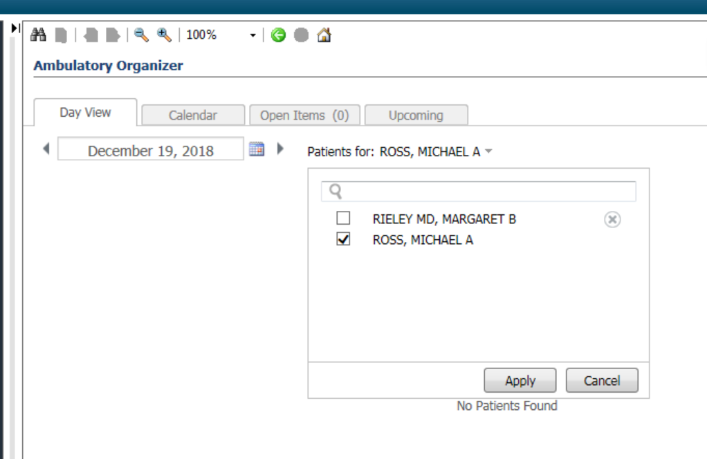
Test Patients for use:
Go to Ambulatory organizer/Home
Search for me in calendar; you will see my calendar filled with test patients.
Pick a test patient from the schedule for use today.
We will use this as a source of Test patient’s with Ambulatory encounters for future sessions as well.

Slide 3
Overview:
Topics to address today:
Powerchart structure
Note creation and movement
Documentation tools
Problem List (time permitting)

Slide 4
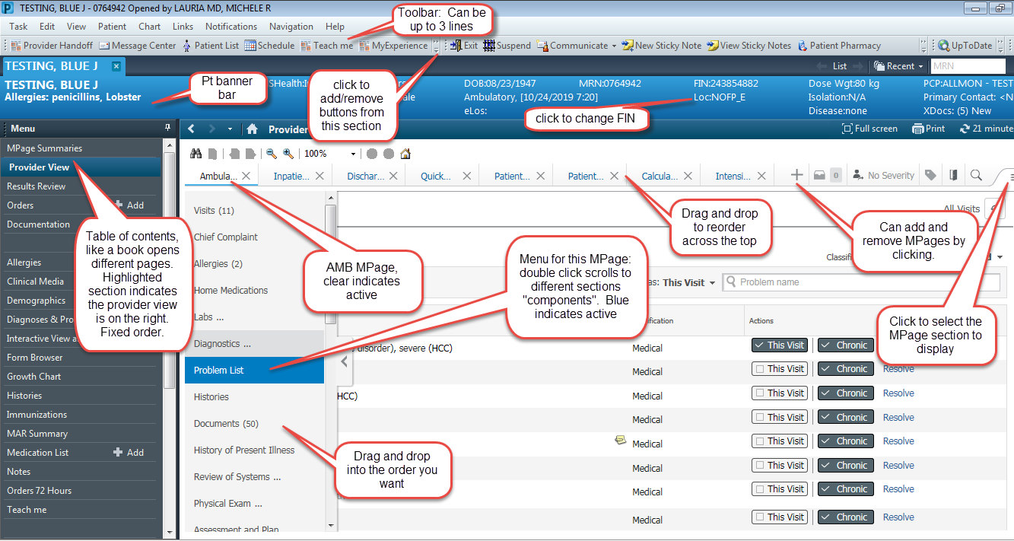
Power Chart Anatomy

Slide 5
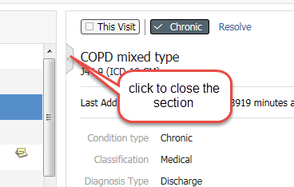
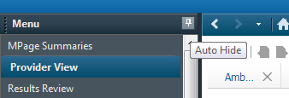

Auto-Hide & Closing
Downward pin: menu is open
Sideways pin: menu only opens when hover over menu

Slide 6
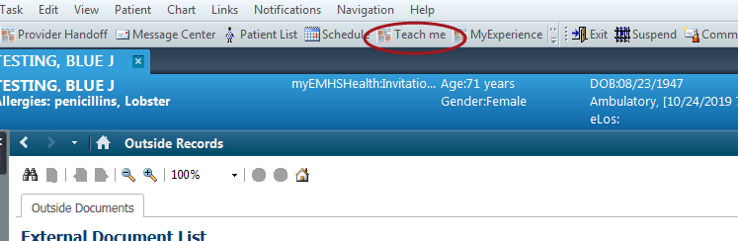
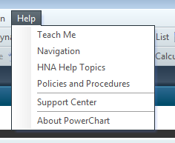
Finding Help
http://ci.emhs.org/home.aspx
Good general reference: More updates to be done in the future:
Definitive Informatics education site: http://ci.emhs.org/home.aspx
Opens “Cerner Standard educational resources”: Good resource

Slide 7
Layout and Personalization:

Slide 8
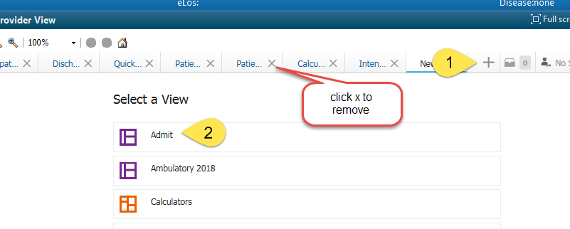
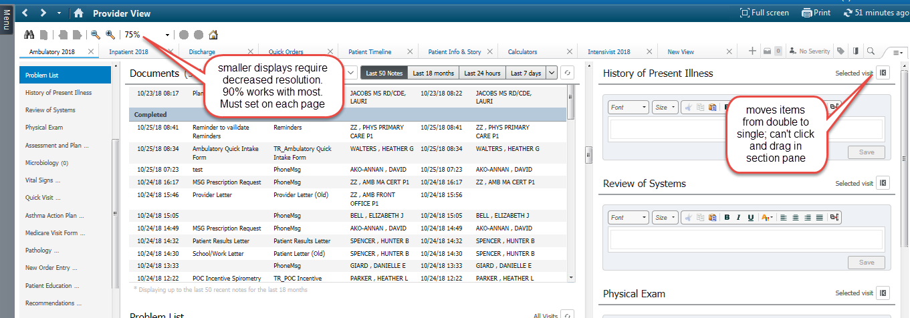
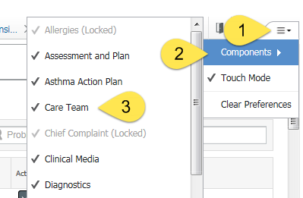
Personalizing your MPage Displays: Click exit to save your changes
1. Choose the MPages to Display
3. Drag and Drop the sections.
4. Create tri-view; permits review and documentation
2. Choose the sections “components”
Components suggested to remove: Goals and Interventions, Health Concerns, New Order Entry, Quick Visits, Clinical Media, Outstanding Orders

Slide 9
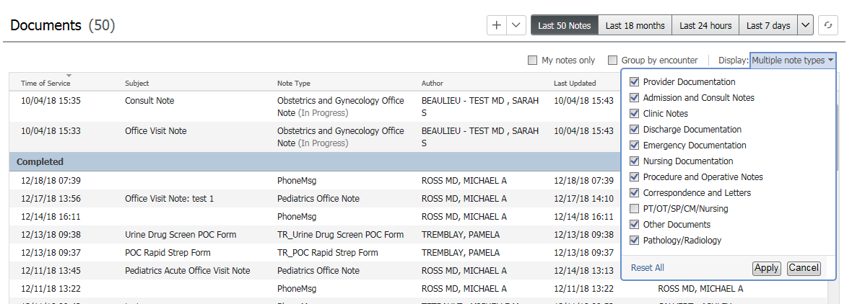
Document filters:
Please make sure you have selected the documents listed above.

Slide 10
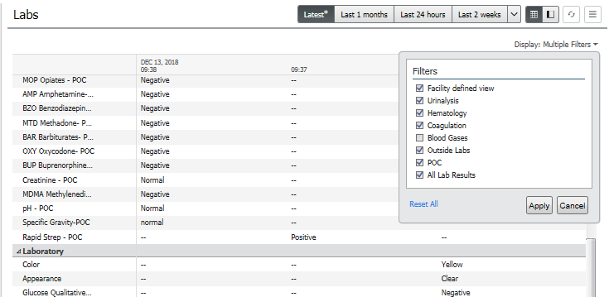
Lab Filters:

Slide 11
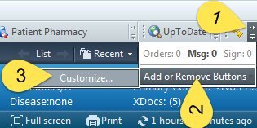
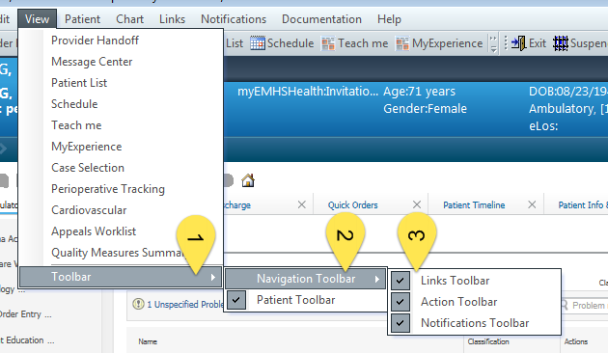
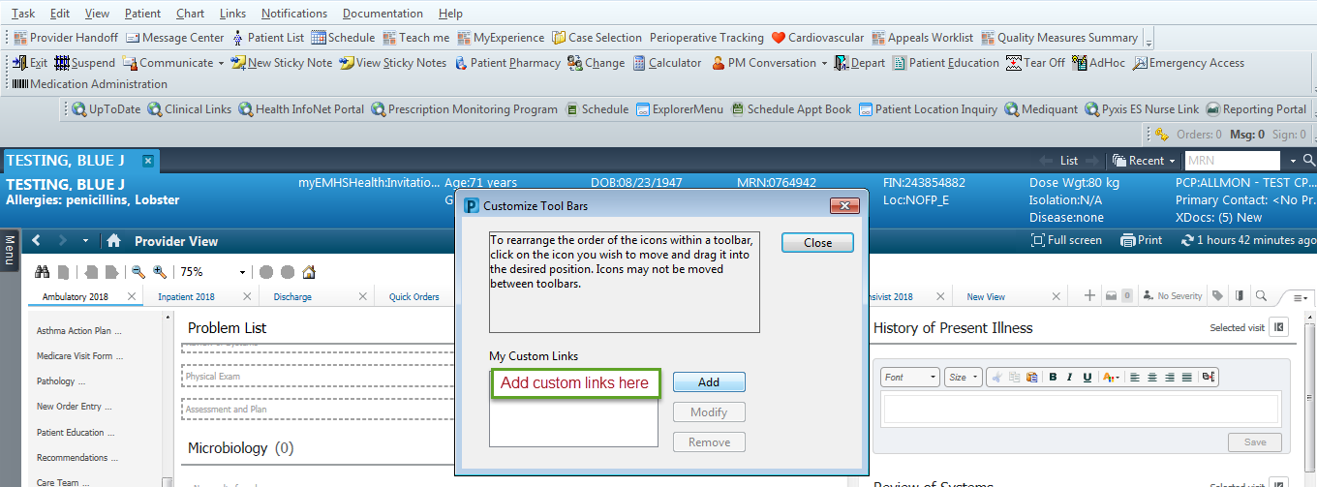

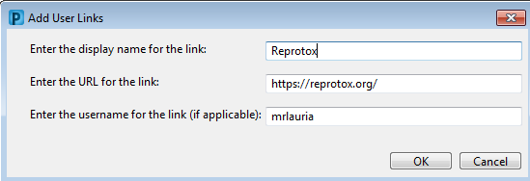
Toolbar: Control what you see: Click Exit to Save
Customize the buttons in all toolbars and their order
Display the toolbars you want
Add Custom Links
To change the number of toolbar lines
Left click and hold on triple dots, drag up and down

Slide 12


Centricity v. Cerner

Slide 13
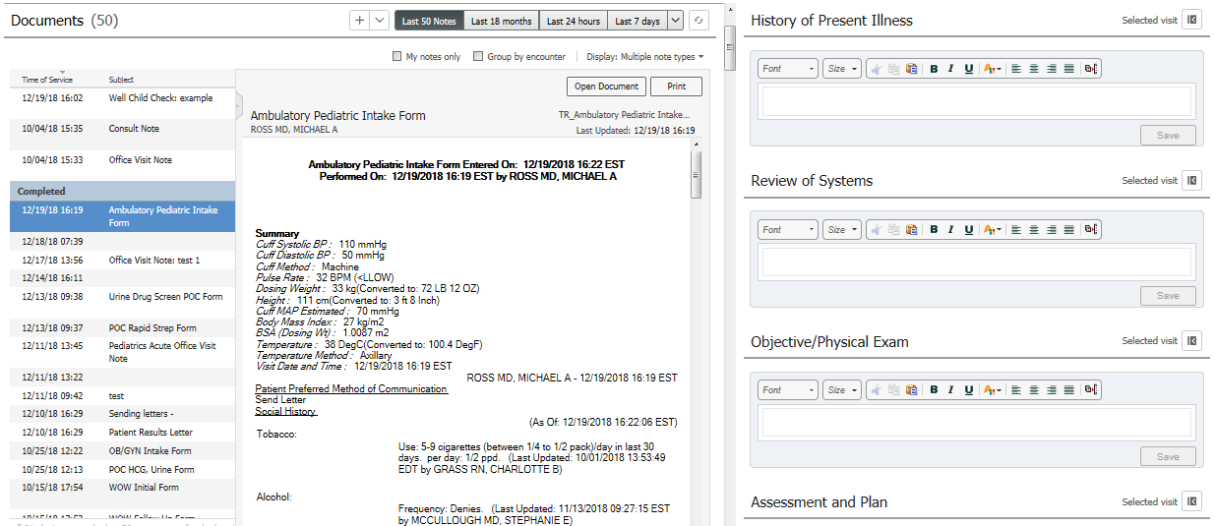
Connecting MA and Provider Documentation:
Pull the Nursing HPI into your note via the /hpi_intake autotext
Pull in the Nursing ROS into your note via the /ros_intake
Drag and Drop from the MA note in the chart into your note.
Let’s make this easier and build a shortcut, to streamline pulling in MA notes!

Slide 14
Mastering Notes:
Review, drag+tag, coordinate patient information
Document in free text sections of MPage
Create your note
Edit sections as appropriate, pull in tags
Sign and/or communicate with others

Slide 15
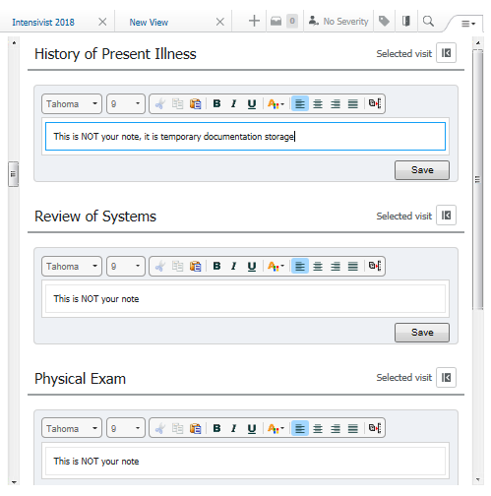
The Cycle of Note Creation
Free text documentation areas of WF MPage
    These do not equal the free text areas of Centricity:
    They are not your note! Consider this the “pre-note”
    Content is specific to the work done during the clinical encounter. Consider this your “lap scratchpad”.
    Textual information flows in one direction from Mpage to Note:
      HPI (Flows to note)
      ROS (Flows to note)
      PE (Flows to note)
      A&P (Flows to note)
      Patient Instructions (flows to Ambulatory Patient Summary)
    Creating a note and saving it in Dyn Doc breaks the textual connection, and clears the component
    Other non-textual areas can still be brought into the note by moving back/forth to the M-page and localized refresh.

Slide 16
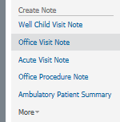
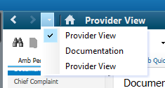

Creating v. Returning to your note:
Returning to a Note:
From M-page to note: within the Chart:
Downward carrot
Creating a Note: (Only once per patient!)
Avoid the “multiple-note-curse”

Slide 17
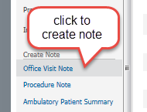
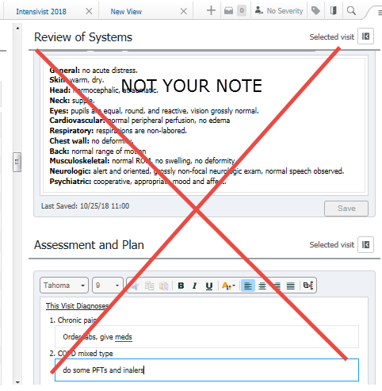
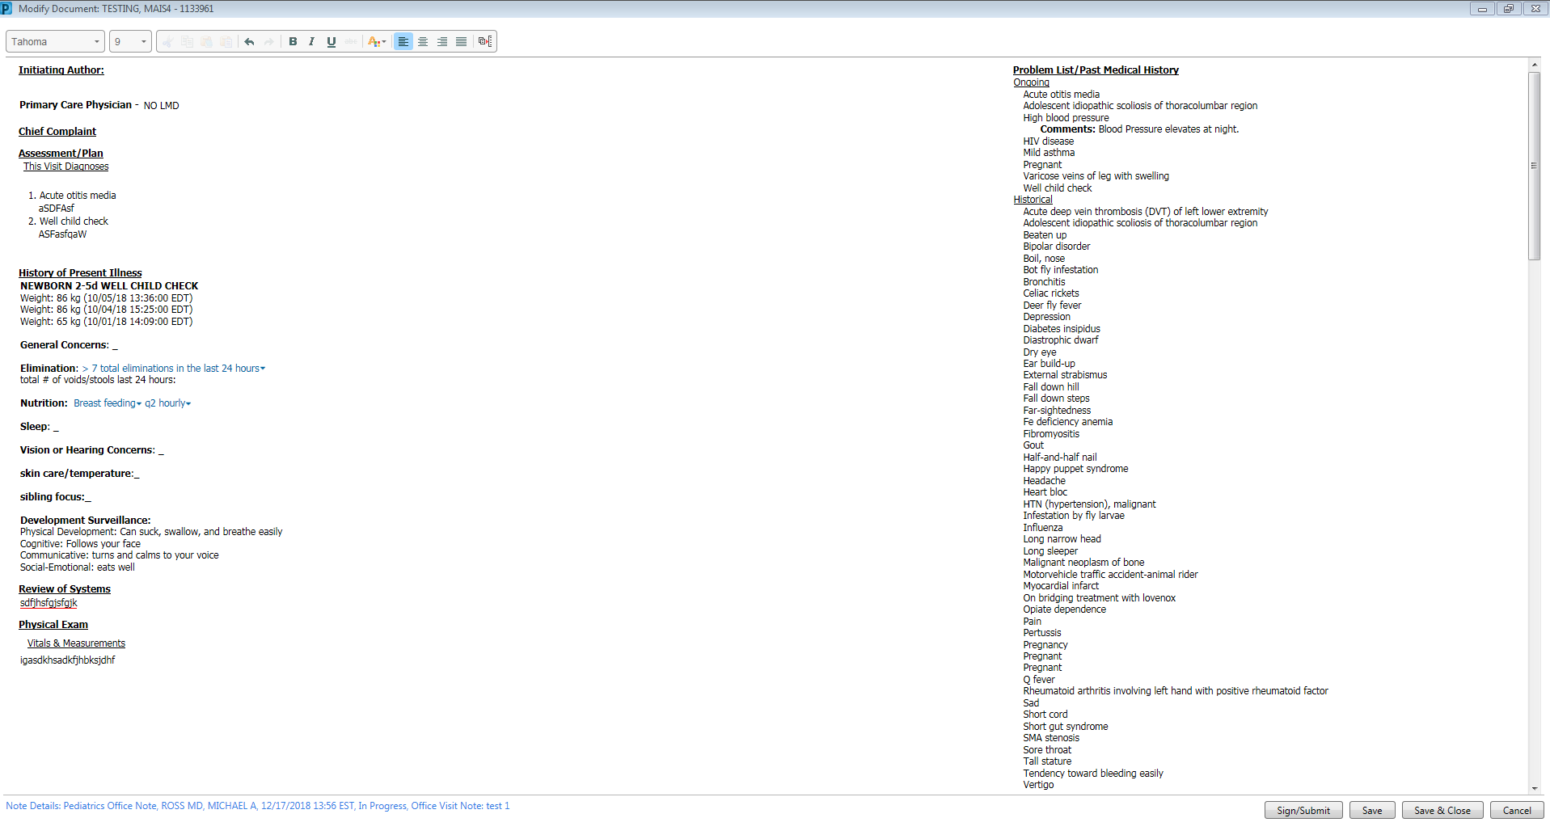
Creating and Saving the Note:
This is your note. that can’t be lost. When you save and close, free text is transferred to the note, and the MPage text boxes are erased, but the note remains.
Clicking save locks in the content a preliminary scratchpad
Save and Close

Slide 18
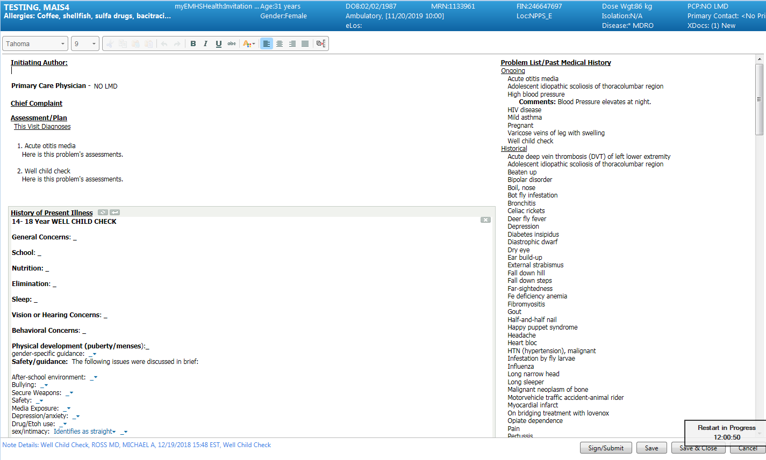
Manipulating your note after creation:
Textual information: Add to the individual note areas.
Mini-refresh:
To pull in specific content on the workflow M-page.

Slide 19
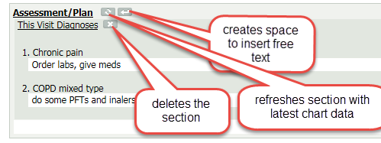
Editing your note:
Sections within the note can be edited

Slide 20
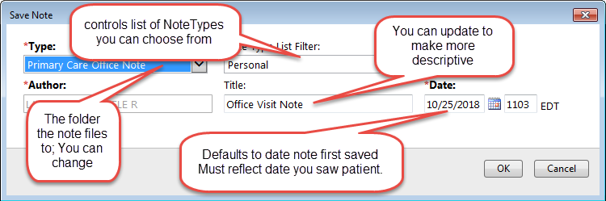
Filing your note:
Properly Filing your note

Slide 21
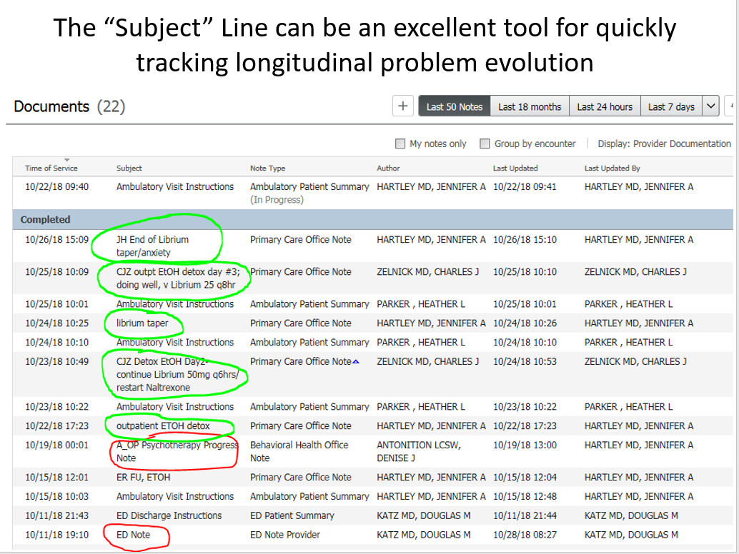
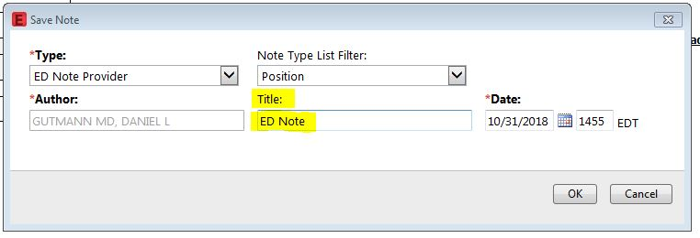
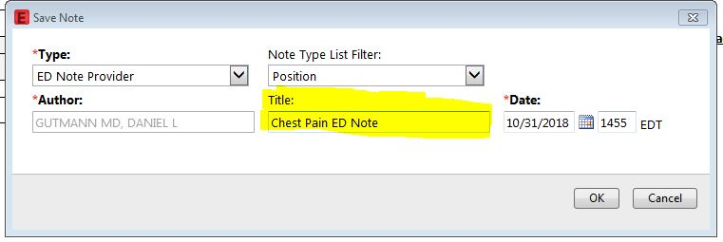
Maximizing the Subject Line

Slide 22
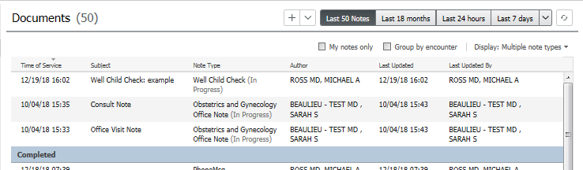
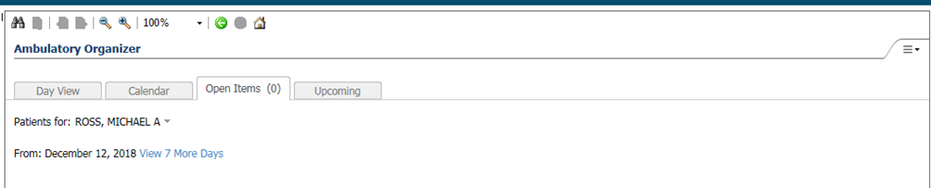
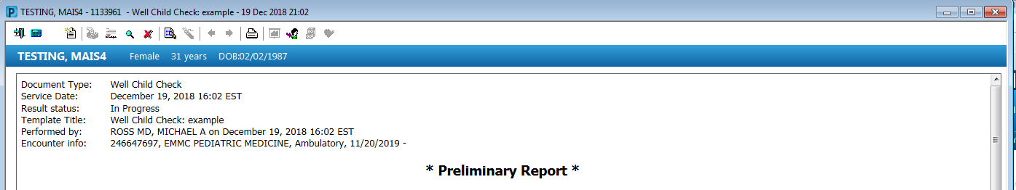
Finalizing (signing) a saved note:
Within the chart:
From the Ambulatory Organizer:

Slide 23
Demo: How it’s all supposed to work:

Slide 24
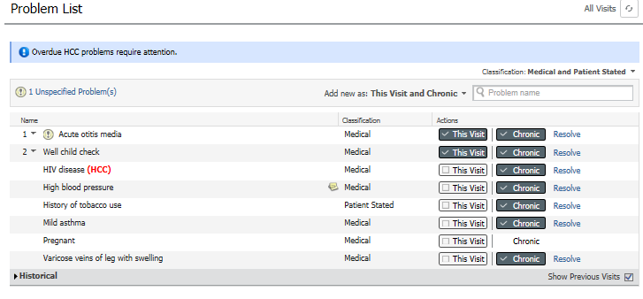
Problem Lists:
Use of the “Add new As” filter: determines if default only this visit to the chart, chronic, or both. Recommend starting with Both, and unselecting chronic for acute conditions.

Slide 25
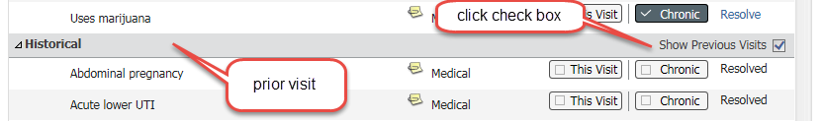
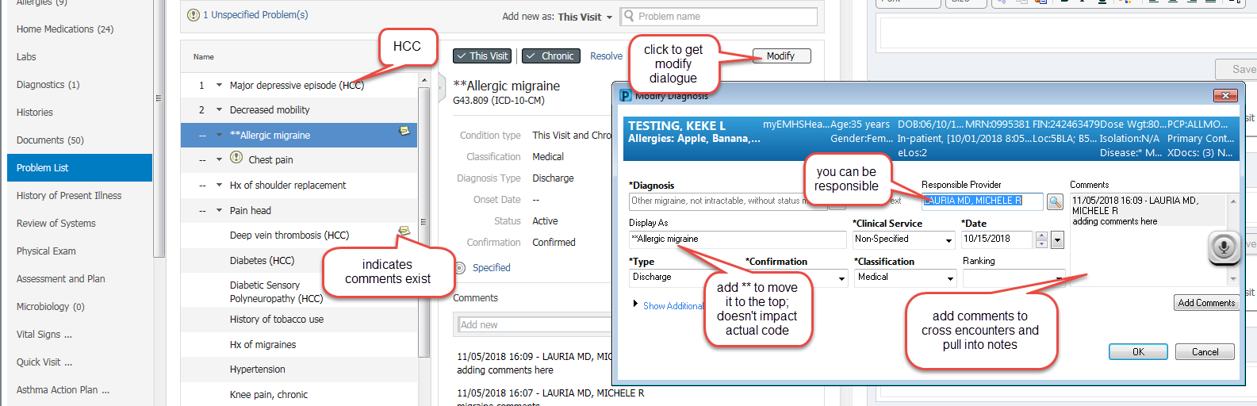
Problem List Management:
“This visit”: specific to an encounter, offered association with orders
  Displays in order selected
  Can reorder with drop downs
“Chronic”: Diagnoses which cross encounters
  Problems display alphabetically
  Use an * to move a problem to the top
Comments: if entered with “chronic “selected will cross encounters and displays in notes
Un checking “this visit” and “chronic” removes items from the list
  To restore, click historic at the bottom of the pane
  You will see every problem & diagnosis with comments preserved

Slide 26
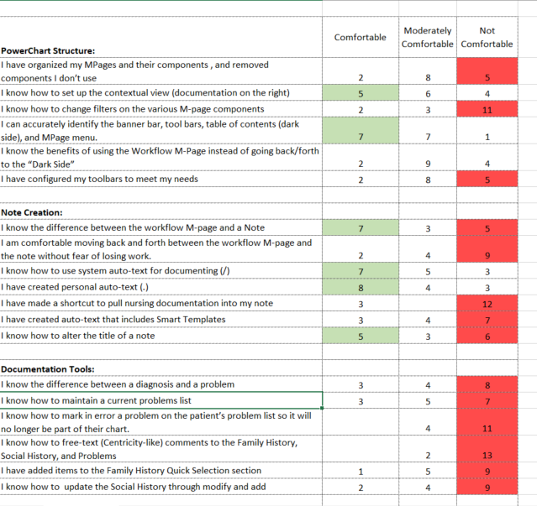
Future Topics:
Goal: Improve comfort and streamline charting:
Interval: every 2 weeks (break for holiday/vacation)
Topics:
-Autotext
-Family, Social, Procedural History
-Ordering and Favorites
-Message Center Use
-Mmodal tips and tricks
Survey Tool to guide our progress

Slide 27

Questions:

