Slide 1
How to create Personal Document Filters Daniel Gutmann, MD MIO Mercy Hospital

Slide 2
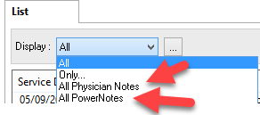
Filtering Cerner Documents
Documents come with 2 default filters:

Slide 3
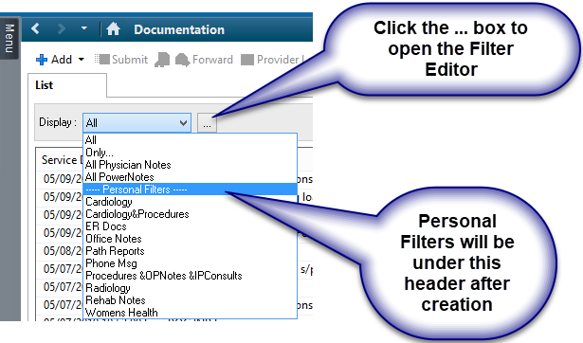
Adding Custom Filters
But you can add your own filters for documents, by function, specialty, location, etc…
This is a list of example Personal Filters
Use this to give you ideas;
The next slides will show how to get started

Slide 4
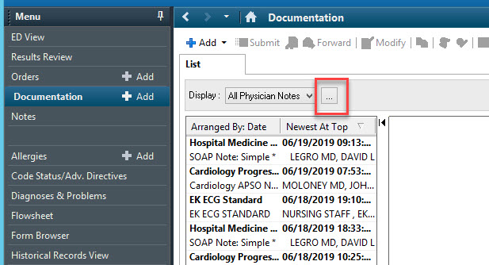
Add a new cardiology filter
A useful filter is cardiology which will show all previous EKGs & Echos
Hit the 3 dot button to make a new personal filter

Slide 5
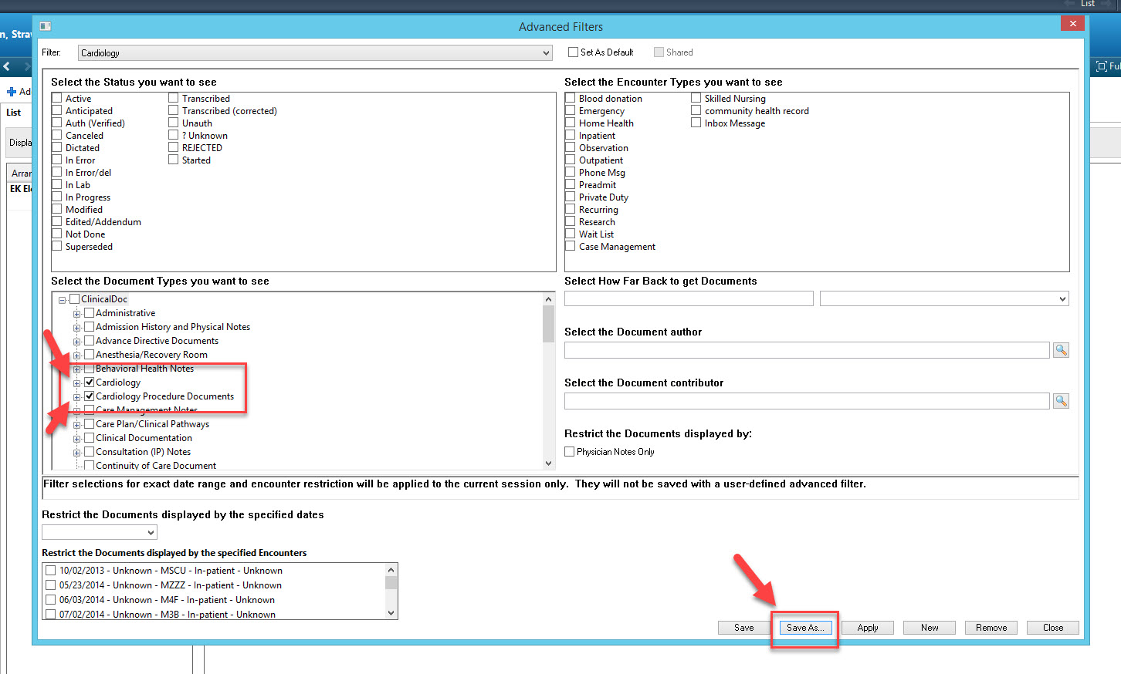
Add a new cardiology filter
Check the Cardiology & Cardiology Procedure box – then Hit the Save as button

Slide 6
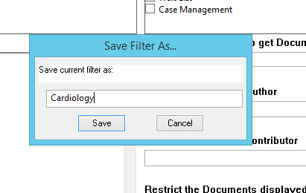
To Create a Filter- steps

Slide 7
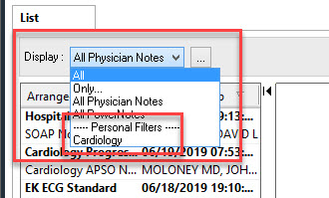
Add a new cardiology filter
This new Personal filter now shows up

Slide 8
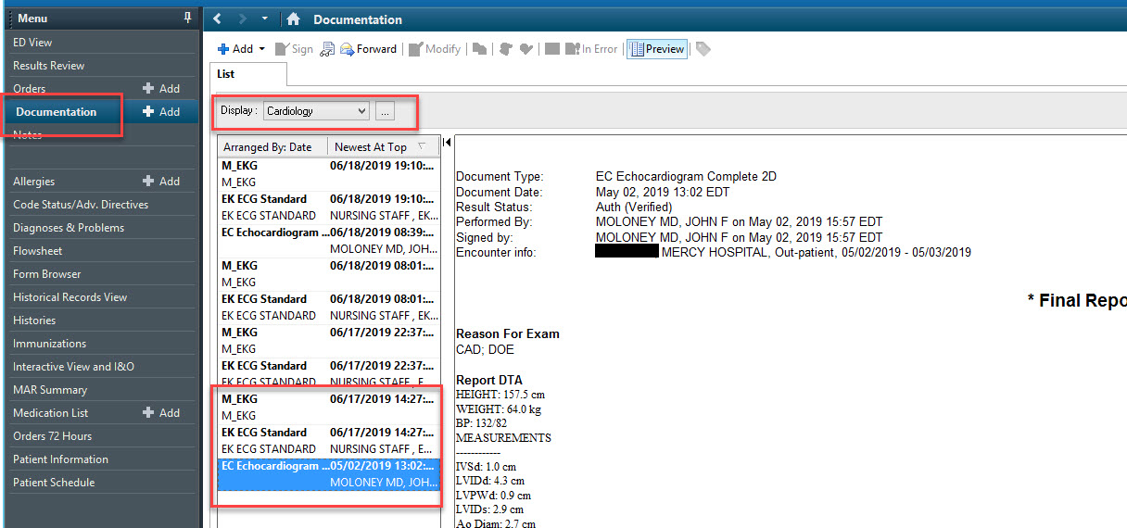
Add a new cardiology filter

Slide 9
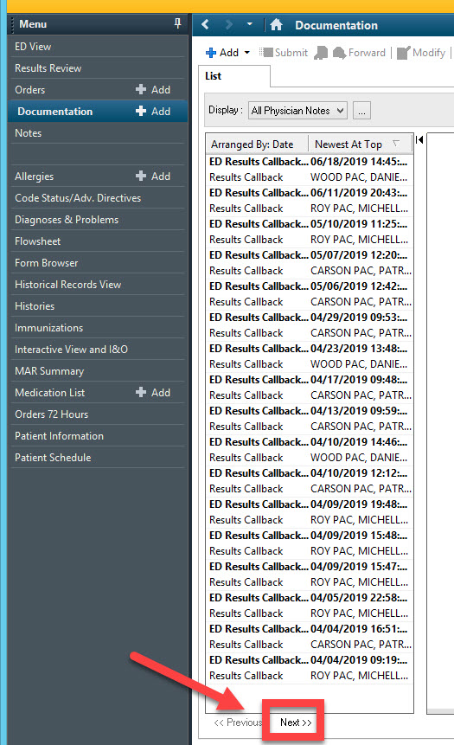
Add a new cardiology filter
Don’t forget the Next button on the bottom if there are a lot of search results

Slide 10
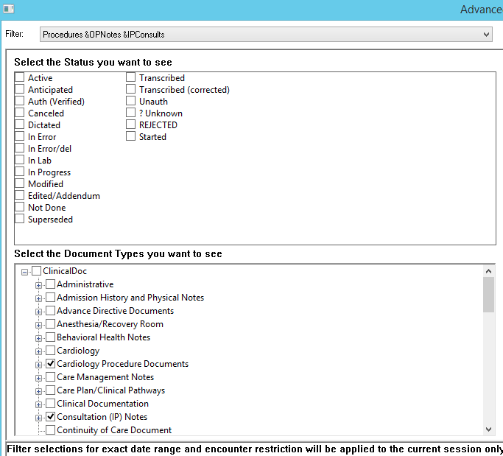
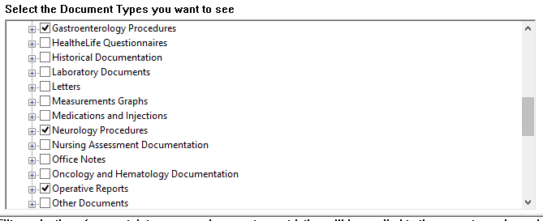
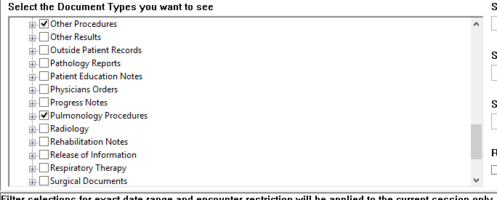
Possible Advanced Filters: “(Almost) All Procedures & Consults”
Click multiple check marks to create a filter to show most of the relevant procedures, IP Consultations and Op Notes
Scroll down and check all these boxes

Slide 11
Add a new cardiology filter
FYI: The filter will stick until you change it.
Always check what filter is set before you begin reviewing documents!!

