Slide 1
Provider Cerner Education Session 5
Eastern Maine Medical Center
Dr. Michael Ross

Slide 2
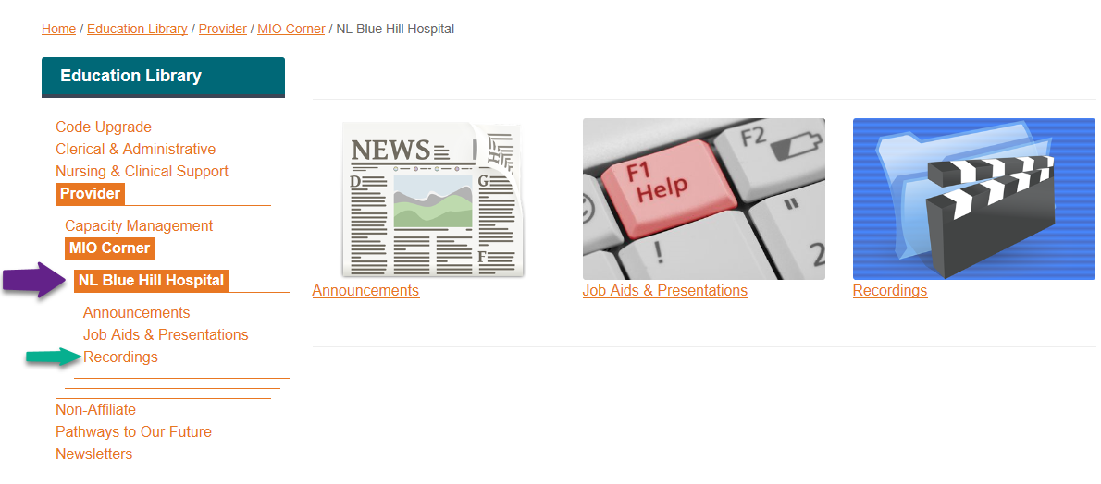
Blue Hill Training Web Page: http://ci.emhs.org/MIO_BlueHill

Slide 3
Curriculum Outline
Week Topics
Navigation, Personalization, Note Creation Overview
Problems (Intro); Revenge of the Message Center, Centricity CCD
Orders and Favorites
Medications, Basic Mmodal
Autotext, Smart Templates, Patient Letters
Recommendations, Patient Care Advisor, Worklists
Family & Soc History, Advanced Mmodal, Q&A

Slide 4
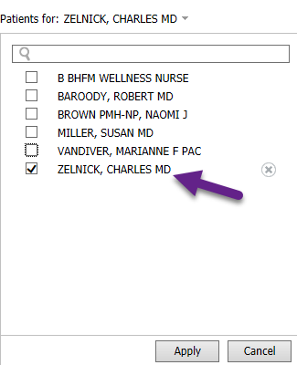
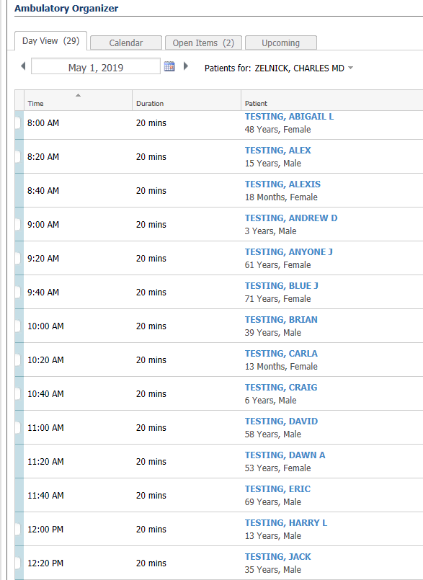
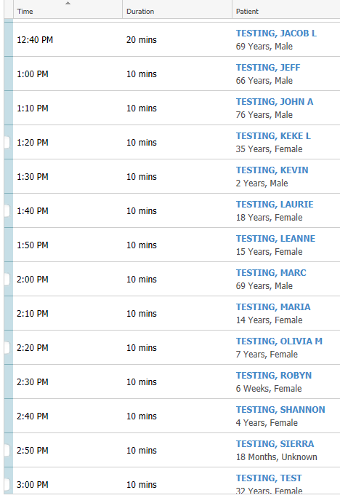
Test Patients for use:
Be sure to use MAY 1st
Go to Ambulatory organizer/Home
Search for me in calendar; you will see my calendar filled with test patients.
Pick a test patient from the schedule for use today.
We will use this as a source of Test patient’s with Ambulatory encounters for future sessions as well.
Dr Z’s ->

Slide 5
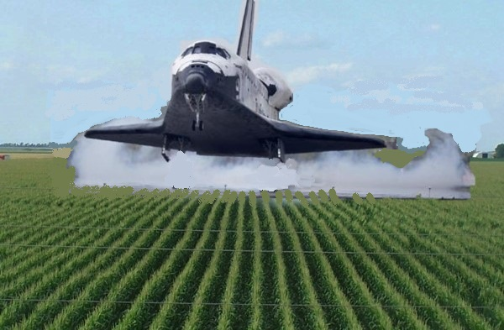
Applying “Working as Designed” to New Environments….
Using Cerner EMR for Ambulatory Care
is like using the Space Shuttle as a Crop Duster:
You have to know what you’re doing! (and set up right!)

Slide 6
Overview: Topics to be Addressed Today
Mmodal Training:
Provider and Patient Letters:
Smart Templates:
Autotext: Basics and Advanced

Slide 7
Mmodal Training:

Slide 8
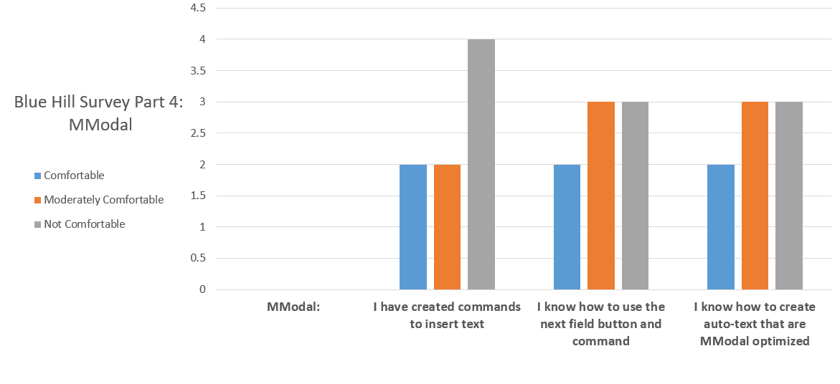

Slide 9
Speech Mike Setup
Be sure Record button is set to “Hold to Talk”
EOL is COMMANDs only!
F1 – leave at “Correct Selection”
Other F buttons can be set to different key combinations

Slide 10
Set up Microphone with Advanced Setup
Add buttons to your Speechmike or Mobile Phone

Slide 11
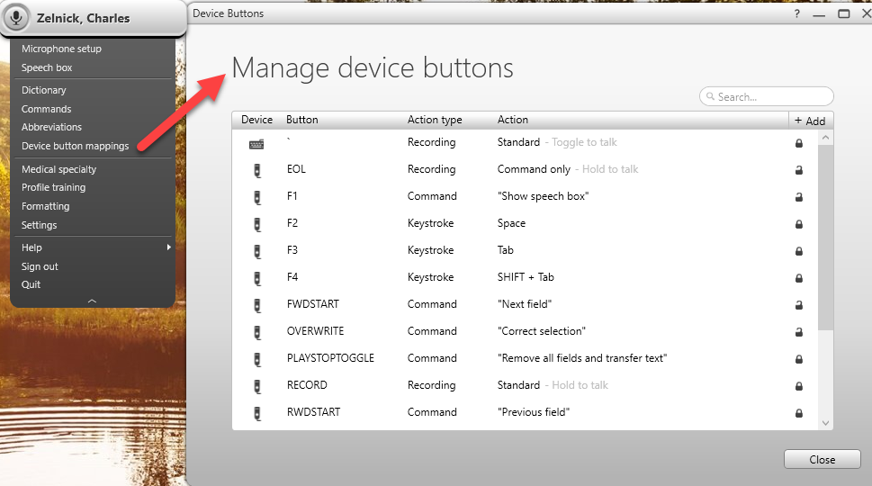

Slide 12
Automated Text and Templates: What to use where…
Limits:
How many commands can you REMEMBER?
What text or templates do you use MOST, and some only rarely, (but you really want to automate because they are long or complex?)
Does the text use DATA from the EMR- i.e. patient name, birthdate, lab values, history elements?
Do you want something you can “edit by exception”

Slide 13
Automated Text and Templates: What to use where…
 | # to Remember | Use Most | DATA from EMR | Edit by Exception
Mmodal Command | 5-10 commands? |  | No |  Yes, use [ ]
Autotext | Prefix = “menu”; potentially 100s |  | Yes, with Smart Templates | ★ Dropdowns are fiddly, o/w delete and retype
MM Command + Autotext | 5-10 Commands |  | Command fires Autotext with Smart Template | Yes, build Autotext to use Mmodal []
Tag and edit | None |  Good to pull in last exam if complex | No | Manual edit
Type it In | None, dropdown menus |  Can be fast for canned text | No | No; Can set up chains but not easy

Slide 14
Creating Commands
1. Highlight the text you would like to save for later use with the mouse or select the text via voice command (such as “Select All”)
2. Hold down the EOL “Command” button; and Say the command “Save this text.” This will open the Command Details box.
3. Dictate or type the command name in the Name field. Dictating is preferred to ensure proper spelling.
a. Use an “action verb” at the beginning of each command name (i.e. "Insert", "Print", “Macro”, “HPI”, “PE”, “ROS”, “Instructions” etc.).
b. Make sure the command is more than one word. (i.e. “PE Vandiver 1”). Best to use a phrase you would never say in straight dictation.
4. Click OK to save the command
5. The exact Name of the command must be dictated to have it execute i.e. “Insert physical exam”, not just “Physical exam”
6. To see all of your personal commands, click on the Control Bar (your name) > Commands or say “Open commands.” Here you can create new commands or edit existing ones.

Slide 15
Build you own Command for “PE Full”.
General: A [ Well developed, well nourished, ] [in no acute distress. Appears stated age.]
Head: [Normocephalic, atraumatic.]
Eyes: [Pupils are equal and reactive to light and accommodation. Conjunctiva are clear. Vision grossly normal.]
Ears: [TMs clear AU, EACS WNL]
Nose: [Patent, without discharge.]
Mouth: [There are no ulcers or lesions noted. No inflammation, no post nasal drip, no plaques nor exudates.]
Neck: [Supple, no adenopathy or thyromegaly.]
Lungs: [Clear to auscultation bilaterally. No rales, rhonchi or wheeze noted. Good air flow in all fields.]
Heart: [Regular rate and rhythm. No murmurs, click, rubs or gallops are noted. ]
Abdomen: [Bowel sounds present in all quadrants. The abdomen is soft, nontender, with no masses or organomegaly noted. No hernias are noted. ]
Msk: [Joints are nontender, without swelling, redness, nor effusions. Range of motion is observed to be normal. ]
Pulses: [Peripheral pulses are equal and palpable bilaterally. ]
Extremities: [No clubbing, cyanosis nor edema is noted. ]
Neurologic: [Gait and station normal. Cranial Nerves 2-12 intact. Motor strenth grossly symmetrical and intact. No sensory loss. Balance normal. ]
Skin: [No rashes, ulcers, or sinister lesions noted. Turgor is good. Skin color is good. Hair and nails are without abnormalities.]
Psych: [Normal eye contact, affect and mood appropriate, and normal interactions. Patient is alert and appropriate to context.]

Slide 16
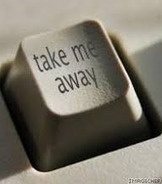
Using Smart Templates and Autotext:

Slide 17
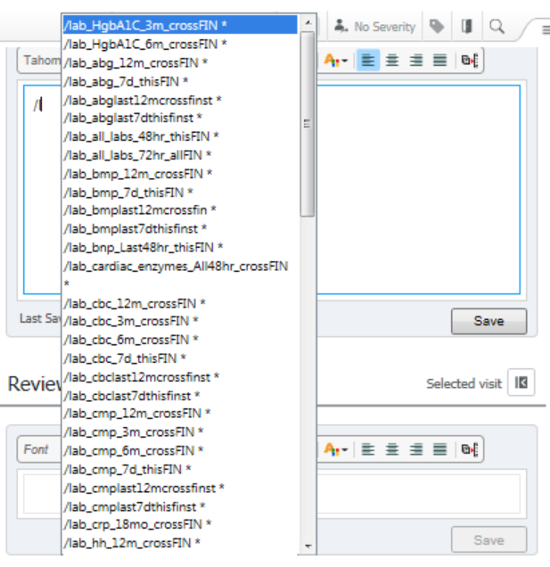
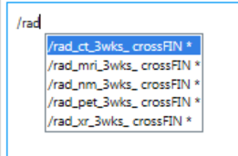
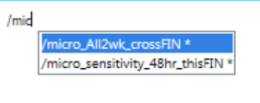
Smart Templates (Also Known As .Imissinsertingthingslikewedidincentricity)
Smart Templates bring labs, rad, micro, and other content into your note.
Can be used in both the M-page and the document.
Generally are organized by if they pull from this encounter (thisFIN) or across encounters (crossFIN). This has implications for inpatient/ambulatory use.
Smart Templates are built out as free-standing, or can be manipulated into Autotexts

Slide 18
Most Useful Smart Templates:
/vitals
/lab
/card
/micro
HPI elements accessible for Autotext building: Age, Birth date, Current Date and Time, Discharge Medications, Gender , Marital status, MU Future Appointments, Primary Care Physician, Smoking Status; etc:
Smart Templates can be combined with autotext to create a detailed initial HPI

Slide 19
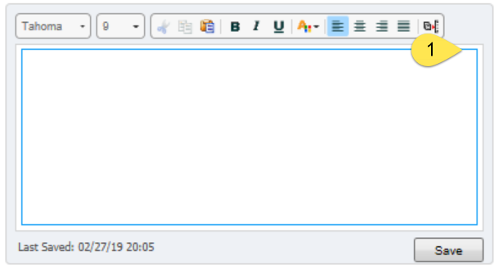
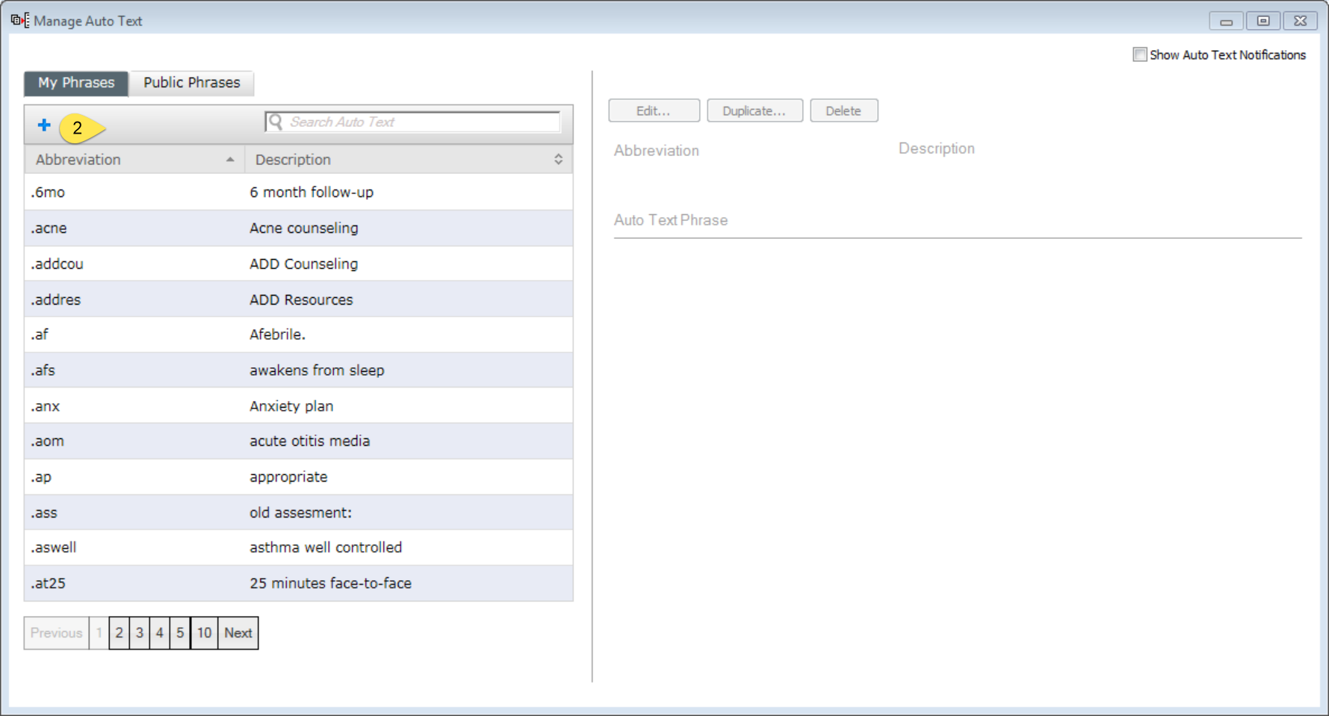
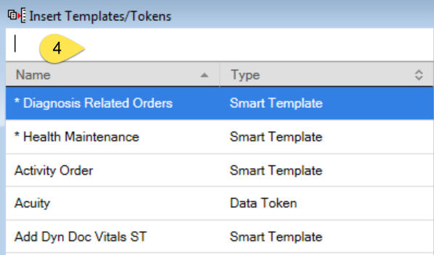
How to build smart-template-embedded Autotext:

Slide 20
Create your smart template-embedded Autotext:
There are some smart templates that are available only for autotext insertion: pathology and rheumatology in particular.

Slide 21
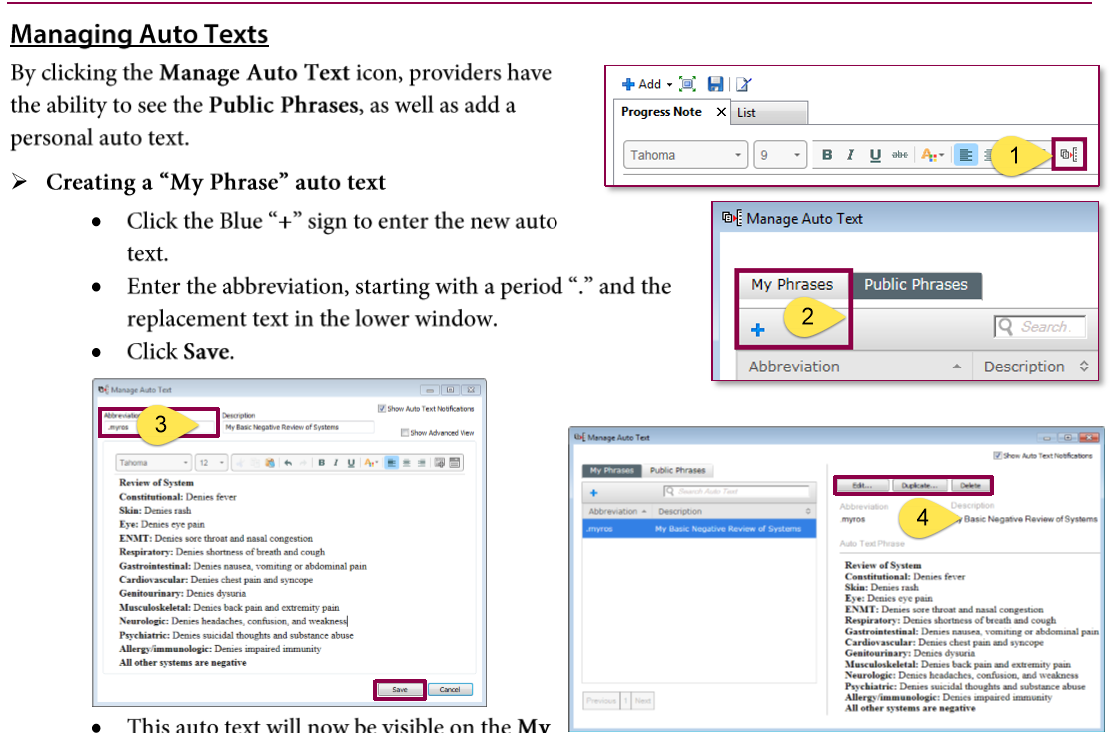
Autotext Basics:
Video Link:

Slide 22
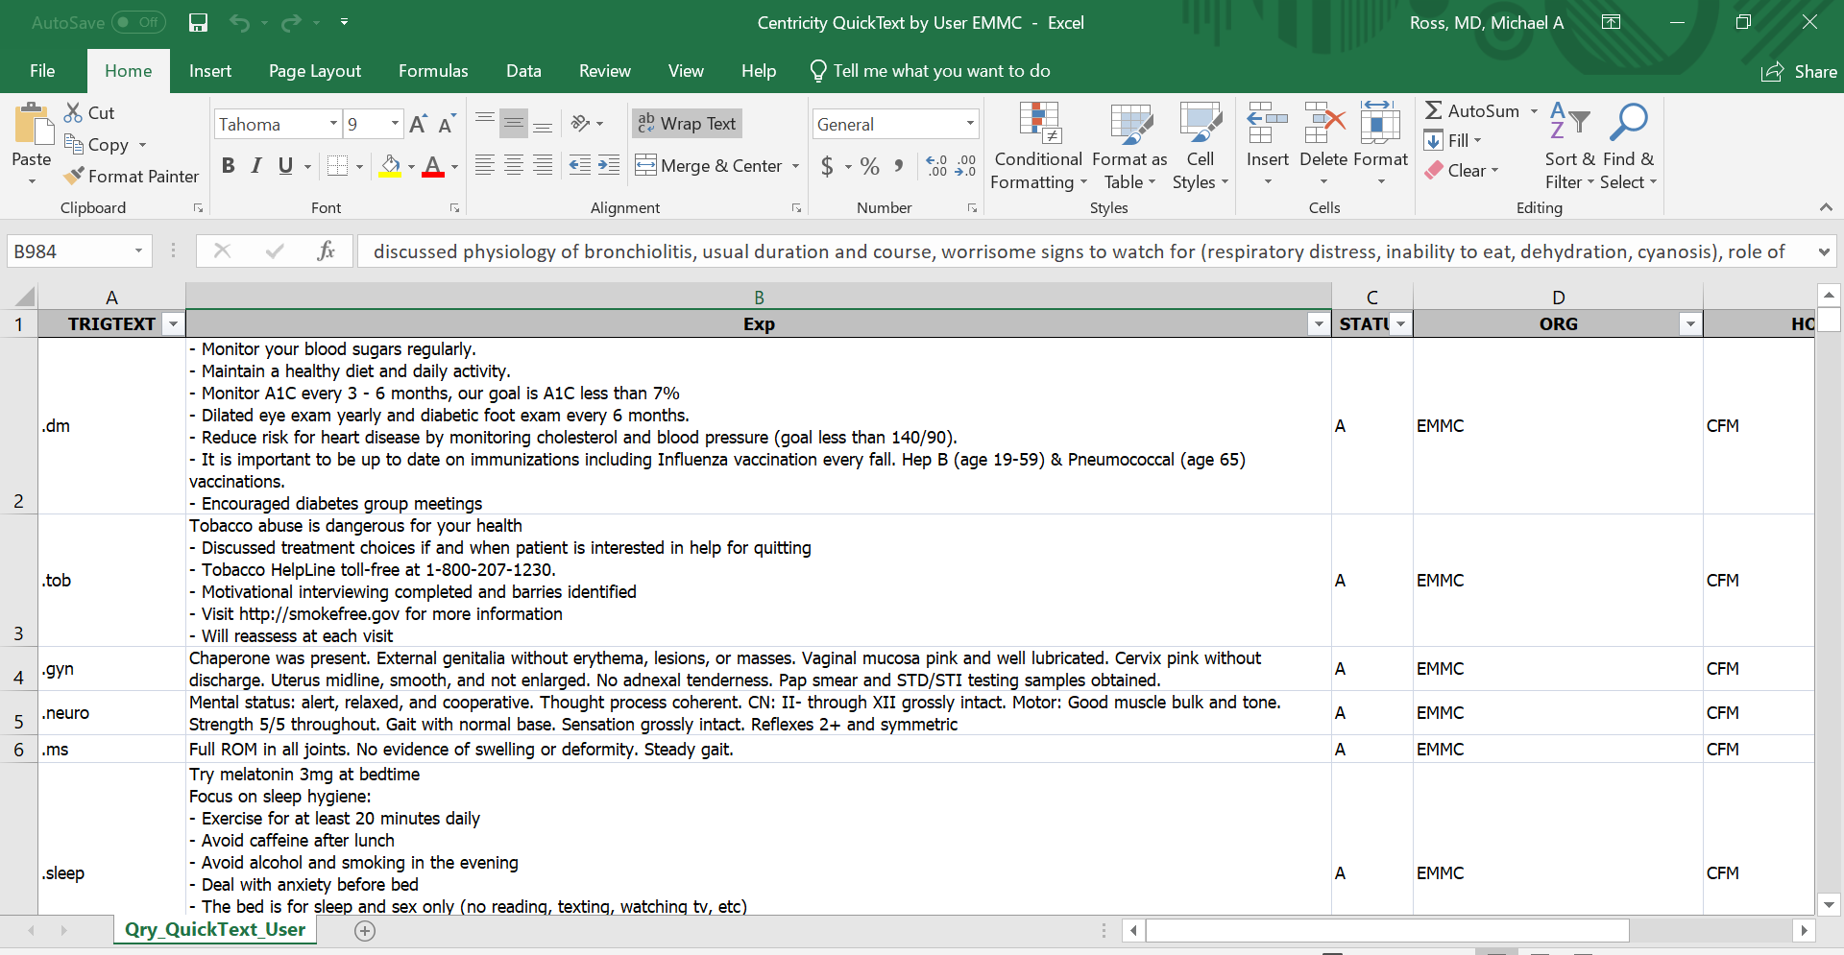
Advanced Autotext uses:
Autotext has no limit: Can add multiple pages of content
Letters
Community resources
Patient Instructions
Locations of care
Dropdowns/configuration/defaults
Smart Templates
Provider-facing content
Patient facing content
Use the Centricity Autotext as a base
(Included in email)

Slide 23
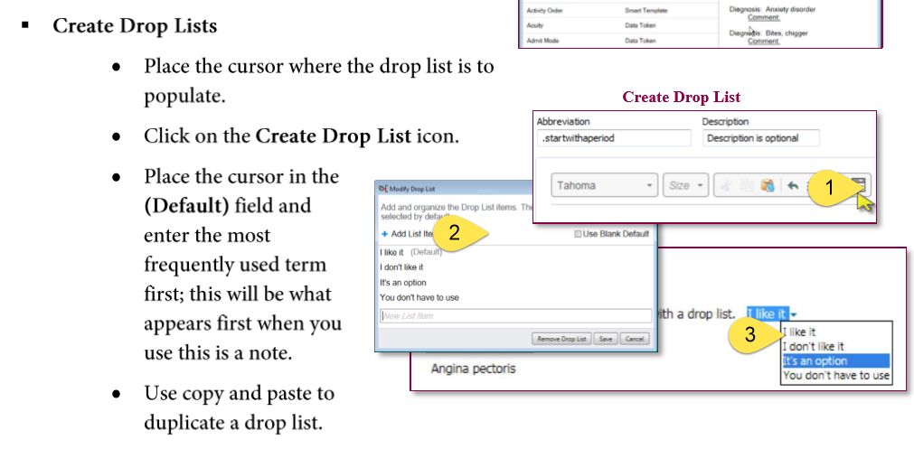
Using Autotext Dropdowns:

Slide 24
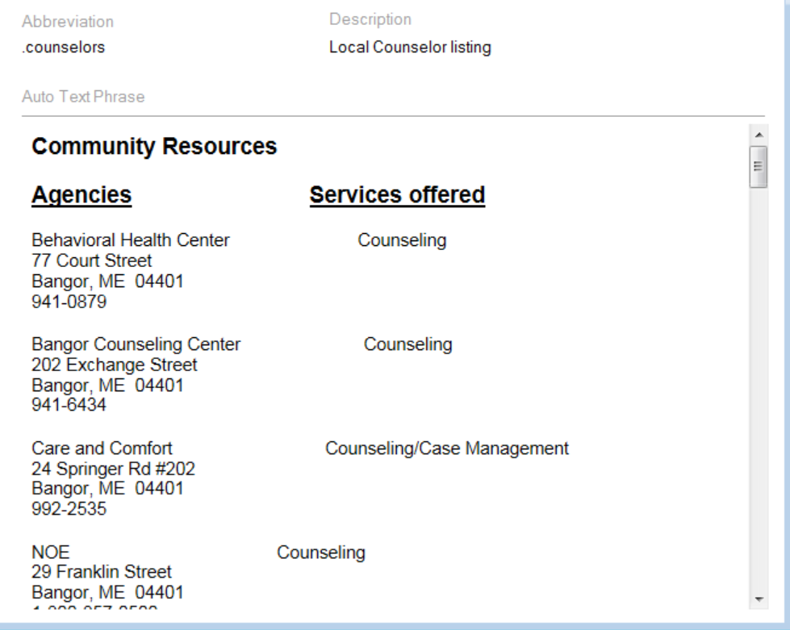
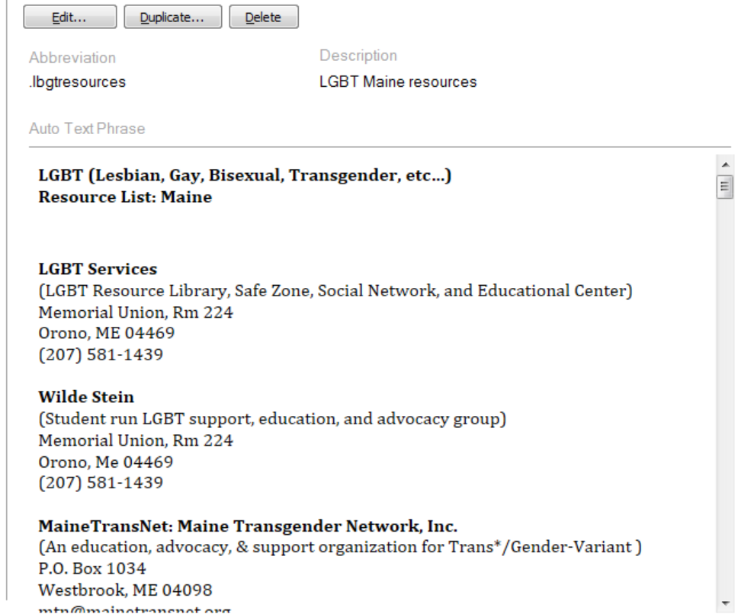
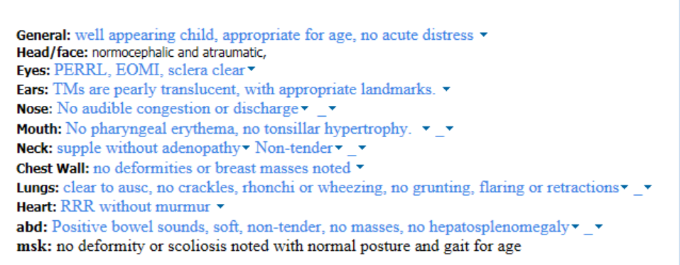
Autotext example:

Slide 25
Best Method for Sharing Autotext:
Utilize Message Center:
Least amount of clicks
Doesn’t require the user to go into the Autotext tool each time:
Video link:

Slide 26
Autotext Building Session: (Copy/paste from Centricity Autotexts to supplement)

Slide 27
Mmodal and Autotext pairing:

Slide 28
Patient Letter

Slide 29
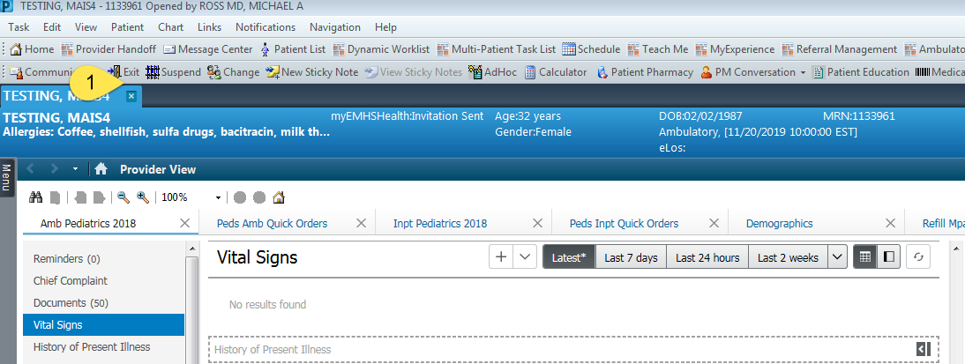
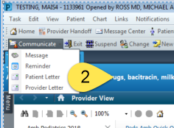
Patient Letter:
Used to produce letter for patient
Letter templates exist within the system using /let autotext.
Create your own templates as you see fit to supplement.

Slide 30
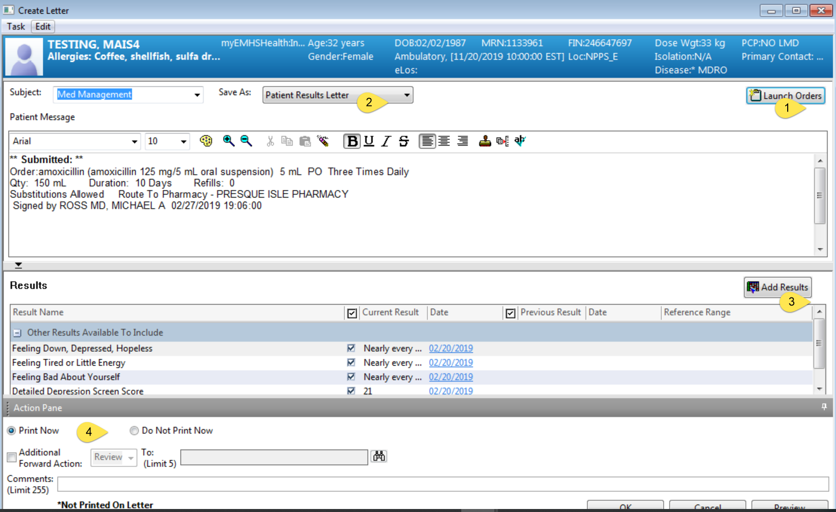
Patient Letter
Can add orders (including prescriptions) and labs
Change type of letter
Multiselect labs to include
Print, or send to office staff
on your behalf.

Slide 31
Provider Letter/Provider-to-provider communication

Slide 32
Provider Letter
Preferred method of sharing clinical content with colleagues
Suggest using this instead of just forwarding notes
Allows delegation to office staff
Draws attention to the most pertinent clinical area

Slide 33
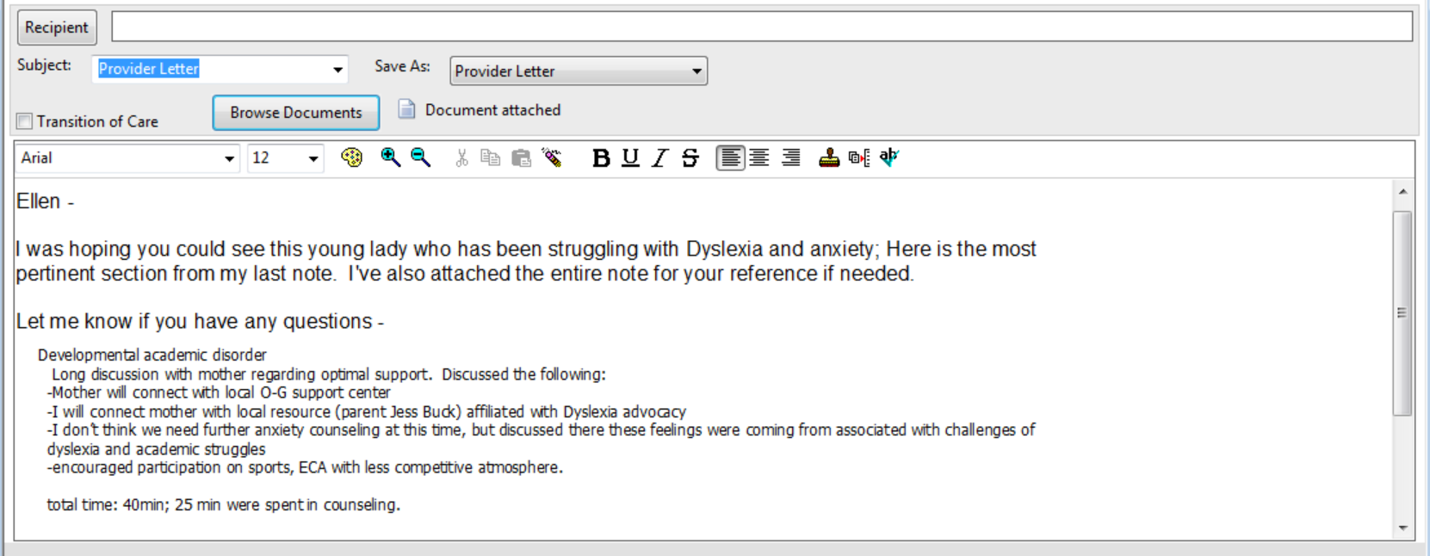
Example of Provider-to-provider communication:

